Slide 1
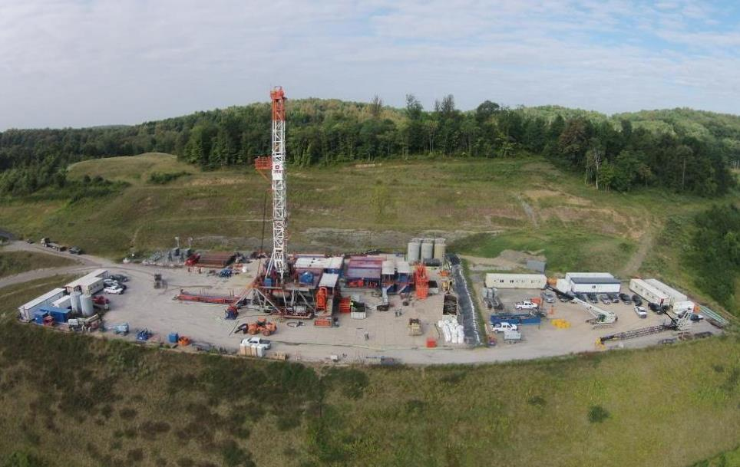





Marcellus Shale Energy and Environment Laboratory
MSEEL
Tim Carr
Phone: 304.293.9660
Email: tim.carr@mail.wvu.edu

Slide 3






CAFEE.wvu.edu
MSEEL Campaign
Dual-Fuel Diesel-Natural Gas Engine Activity, Fuel Flow, and Emissions
DE – FE0013689 and
DE – FE 0024297

Slide 4
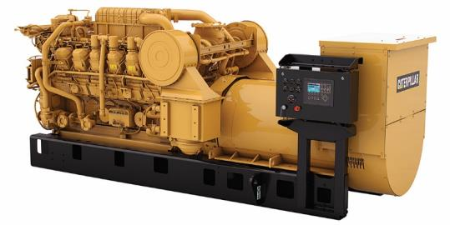
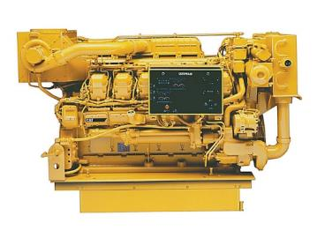
Data Collected
Engines Tested
Emissions (Exhaust and Crankcase)
  Pre-Catalyst Diesel Only
  Pre-Catalyst Dual-Fuel
  Post-Catalyst Diesel Only
  Post-Catalyst Dual-Fuel
Fuel Consumption
  Diesel Flow IN and OUT
  Natural Gas Flow IN
Engine Activity
  J1939 Broadcast Parameters
    Engine Speed (RPM)
    Engine Load (%)
Caterpillar 3512C - 1101 kW
Caterpillar 3512B HD - 1678 kW
Both Engines Outfitted with Caterpillar Dynamic Gas Blending (DGB) Dual-Fuel Kit

Slide 5
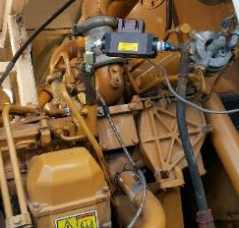
Fuel Consumption & Conversion
Fueling and Substitution
Fuel Energy Efficiency
Fueling |  | Diesel |  | Dual
Steady State Drilling
Percent Load | % | 55.2 | 57.9
Diesel Flow | gal/hr | 39.9 | 15.3
CNG Flow | DGE/hr | 0.0 | 41.6
Substitution Ratio | % | 62%
Pipe Tripping
Percent Load | % | 24.4 | 23.2
Diesel Flow | gal/hr | 19.7 | 15.0
CNG Flow | DGE/hr | 0.0 | 9.8
Substitution Ratio | % | 24%
Hydraulic Fracturing
Percent Load | % | 72.2 | 74.8
Diesel Flow | gal/hr | 89.6 | 45.2
CNG Flow | DGE/hr | 0 | 86.6
Substitution Ratio | % | 50%
Drilling Engine Activity >
KRAL Fuel Flow Meter on Diesel Return Line

Slide 6
Exhaust & Crankcase Emissions
Brake Specific
Methane Slip
16% during Steady State Drilling
20% during Pipe Tripping
23% during Hydraulic Fracturing
1-2% from Crankcase
High Load Drilling
Steady State |  | Diesel | Dual
 |  | Post-Cat | Post-Cat
CO₂ | g/kw-hr | 663.53 | 762.64
CO |  | 0.02 | 0.14
NO_{x} |  | 3.65 | 3.02
THC |  | 0.01 | 26.02
CH₄ |  | 0.01 | 25.64
Drilling GHG Emissions
Hydraulic Fracturing
Steady State |  | Diesel | Dual
 |  | Post-Cat | Post-Cat
CO₂ | g/kw-hr | 754.97 | 891.12
CO |  | 0.04 | 0.57
NO_{x} |  | 3.04 | 3.17
THC |  | 0.01 | 43.46
CH₄ |  | 0.01 | 42.61

Slide 7
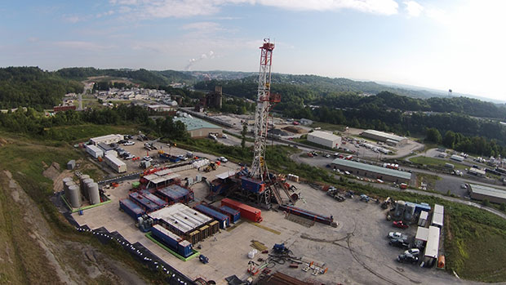
Summary
Dual Fuel Operation
  Between 6-16 % increase in CO₂ Emissions
  Up to 3000 times higher CH₄ Emissions
  20-65% Substitution of Diesel Fuel
  15-25% Unburned Methane in Exhaust
  Crankcase Methane 1-2% of Exhaust Rates
  2.5-3.0 times Higher GHG Emissions
    CO₂ Equivalent
    Based on Methane GWP of 25
Thank You !

Slide 8
PAD SITE EMISIONS
Dust – PM2.5 & Ultrafines
MSEEL
Community Sampling
Sampling Methods
Results – PM2.5 “Plume”; Diesel Ultrafine Generation
Conclusion – 1km ~ background concentration

Slide 9
Sampling Sites
Valley Background
Residential
Close In
Well Pad
Out of Valley Background
2 miles

Slide 11
CLOSE IN
1 KM
WELL PAD

Slide 12
Marcellus Shale Energy and Environmental Laboratory:
Water and Solid Waste
Year one findings
12 feb 16
Flowback volume
Produced water
Hydrofrac fluid vs. flowback chemistry
Drill cuttings
  TCLP results
  Drilling fluid
  Radiochemistry
Paul Ziemkiewicz
Water Research Institute
West Virginia University

Slide 13
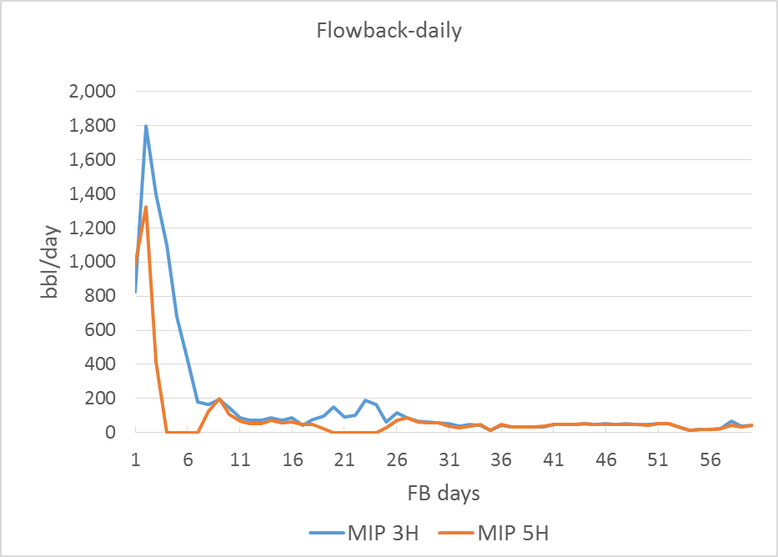
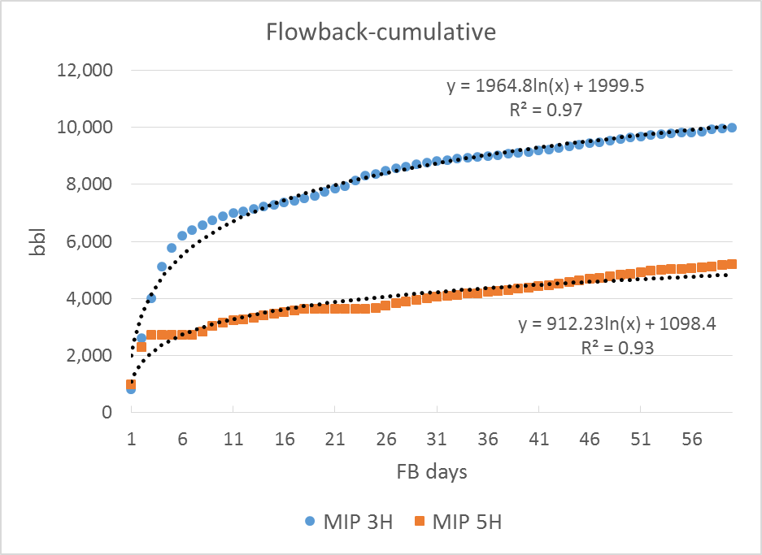
Flowback volumes: MIP 3,5H
3H produced 92% more water, 30% more gas
The area between the curves is 4056 bbl
4795 bbl

Slide 14
Flowback day ~1,350
Produced water from old (MIP 4,6H) wells predominantly
Na, Ca, Cl

Slide 15
Nearly all parameters were higher in flowback than frac fluid
Pink: exceeds drinking water MCL

Slide 16
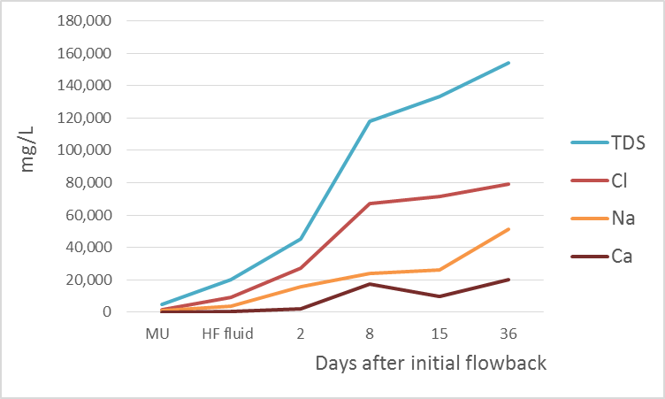
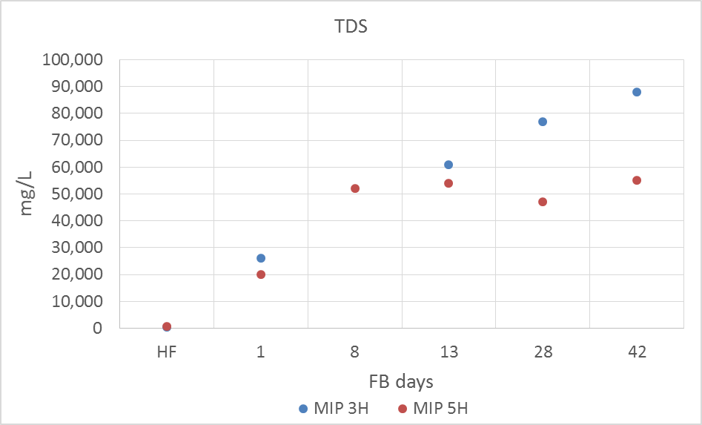
Flowback evolution-major inorganic ions
Ziemkiewicz et al., 2011
MSEEL

Slide 17
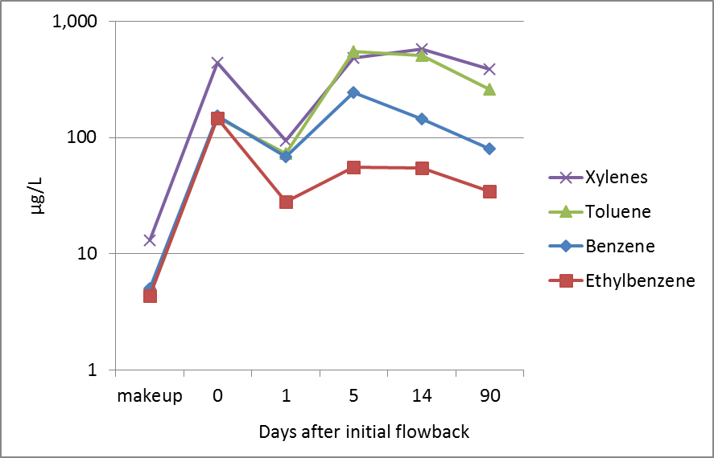
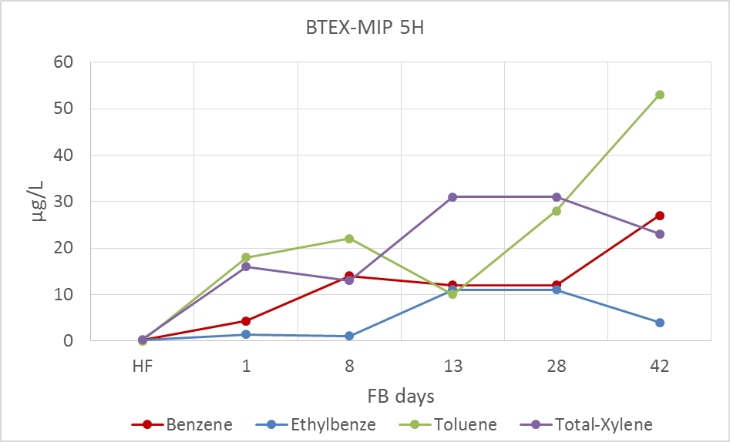
Flowback evolution-organics
Hayes, 2009
MSEEL

Slide 18
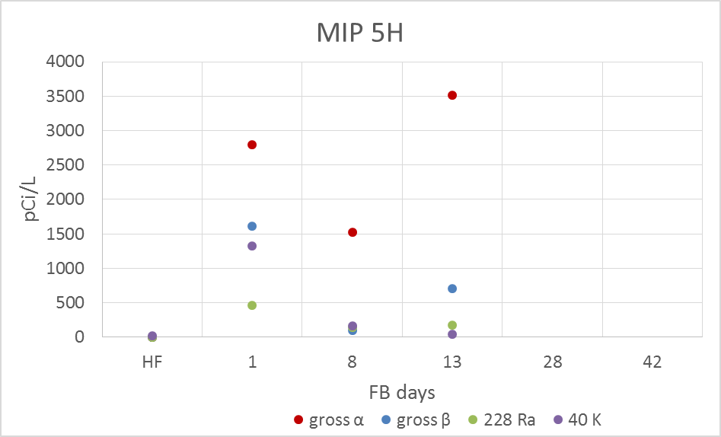
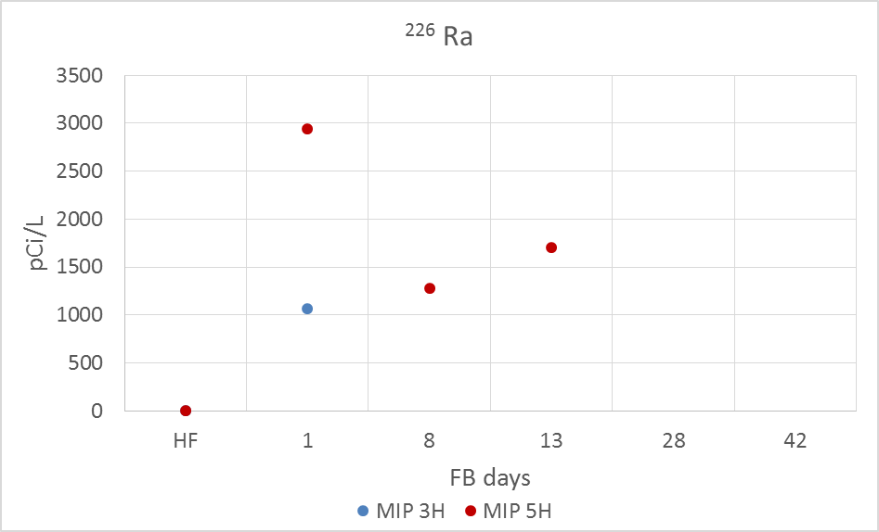
Radioactive isotopes in flowback
MSEEL
MSEEL

Slide 19
Conventional drilling mud
Drill Cuttings
% samples (Liquid fraction)
> TCLP limit

Slide 20
Using ‘Green’ Drilling Mud no parameters exceeded TCLP
In the Vertical and Horizontal (Marcellus) sections:
TCLP organics-no exceedances
TCLP inorganics-no exceedances

Slide 21
Drilling mud: Bio-Base^{tm} 365
Property Unit Value Test Method
Physical state Liquid Visual
Biodegradation, 28 days %m 55-60 OECD 301
Potential carcinogenic label - No -
BTEX mg/kg < 1 * ASTM 5790 mod.
PAH mg/kg < 0.1 * EPA 8100
* Below the detection level of the method. BETX (Benzene, Ethylbenzene, Toluene, Xylene).

Slide 22
Bio-Base 365 from MSDS:
Alkanes, Linear and Branched, Light paraffins
Product Name CAS No. Conc. (%)
Aliphatic Hydrocarbons 90622-53-0 70-95
  Undecane 1120-21-4 1-9
  Dodecane 112-40-3 1-14
  Tridecane 629-50- 5 1-9
  Tetradecane 629-59-4 1-11
  Impurities 1-8

Slide 23
Radiochemistry: drill cuttings
Brazil nuts are about 12 pCi/g

Slide 24
For more information Please Contact:
Paul Ziemkiewicz, Director
WVU Water Research Institute
304 293 6958
pziemkie@wvu.edu

Slide 25
USGS team objectives unconventional oil and gas development (UOG)
Focus is on human and environmental health of waste materials from UOG development
Identify potential contaminants in waste materials: drill cuttings, flowback/produced water.
Conduct mass balance on injected chemicals.
Examine partitioning of contaminants between liquid, solids.
Focus on MSEEL Well 5H
Results used to identify UOG contaminants in environmental samples, and substances that may affect water reuse

Slide 26
-River water and fracturing fluid contain > 100 mg/L SO₄²⁻
-SO₄²⁻ in wastewater has decreased to bdl
-Fe is bdl in fracking fluid but has reached 180 mg/L in wastewater; precipitates in wastewater likely to be hydrous ferric oxide
-Cl⁻, Na⁺, Ca²⁺ in PW are variable with no clear trends
-Dissolved organic carbon (DOC) low levels in river water
-DOC over 120 mg/L in frac fluid and over 100 mg/L in initial flowback
-Gradual decline in DOC to levels of 40-60 mg/L

Slide 27

Extractable Hydrocarbons in MSEEL 5H Wastewater
*
9
River
*
*
10
121015
5
7
*
*
*
4
*
*
*
121115
1
6
*
*
8
11
*
*
3
*
*
*
121215
2
*
*
*
121715
2-butoxy-ethanol
4-methyl-cyclohexanol
undecane
naphthalene
butoxydiglycol
dodecane
tridecane
tetradecane
butoxytriglycol
butoxytetraglycol
butoxypentaglycol
-Initially, mostly glycol ethers and alcohols in flowback with some n-alkanes.
-Huge increase in alkanes on 12/17/15 with about constant amount of glycol ethers.
-Many unidentified (series of) compounds in flowback water. Red and blue * series drop off after first day of flowback.

Slide 28
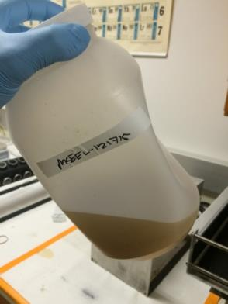
MSEEL plans
Understand partitioning of inorganic solutes between aqueous phase and solid phases that form in wastewater
Identify changes in organic substances during production; what is injected, what injected organics are lost to the ground, and what organic substances are sourced from shale
Link USGS results to other datasets to develop understanding of processes and reactions impacting wastewater composition
Ferric hydroxide precipitates in wastewater collected 12/17/15

Slide 29
BIOGEOCHEMICAL CHARCATERIZATION OF CORE, FLUIDS AND GAS
Isotopic/molecular/microbial characterization of sidewall core
WVU - Sharma ; OSU - Mouser, Wrighton, Wilkins, Cole, Darrah
Isotopic/molecular/microbial characterization of produced fluids
WVU - Sharma ; OSU - Mouser, Wrighton, Wilkins, Cole, Darrah
NETL - Hakala, Crandall, Phan
Molecular characterization of produced gas
WVU - Sharma ; OSU - Darrah

Slide 30



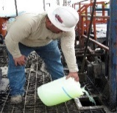
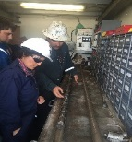
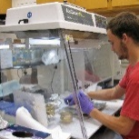
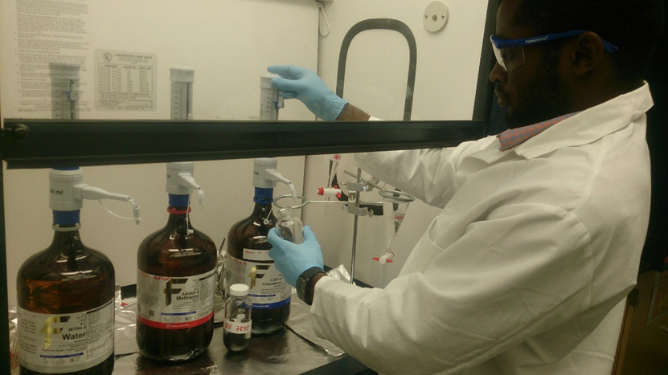
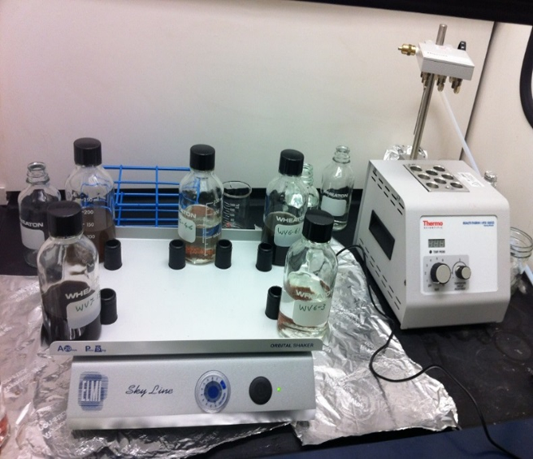
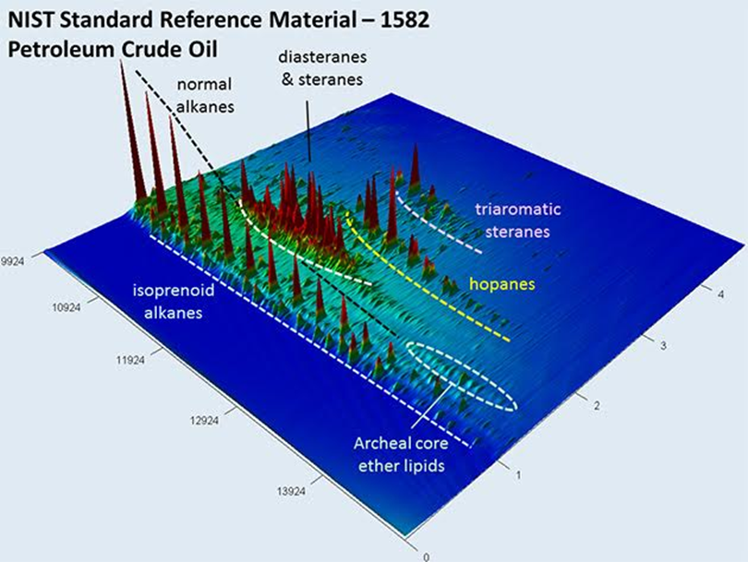
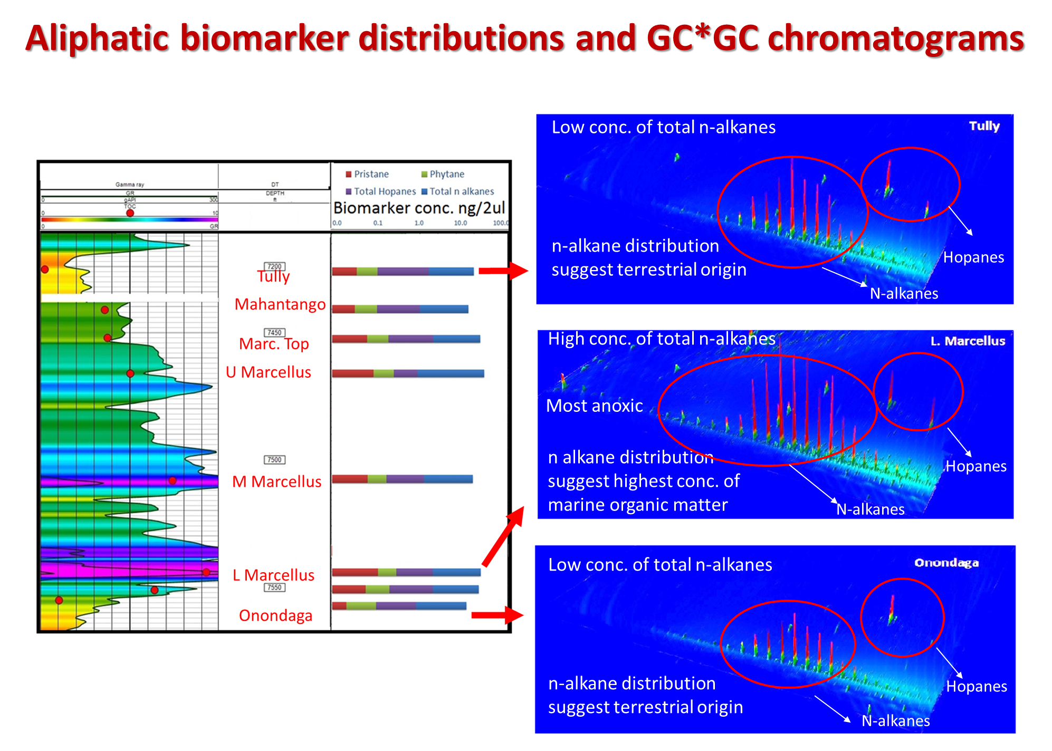


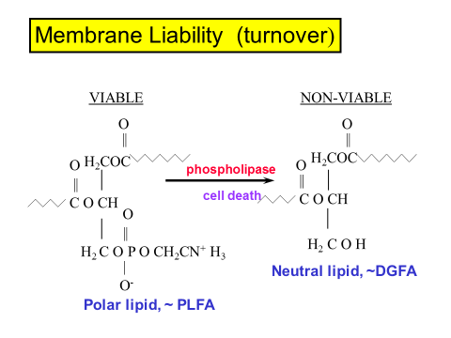
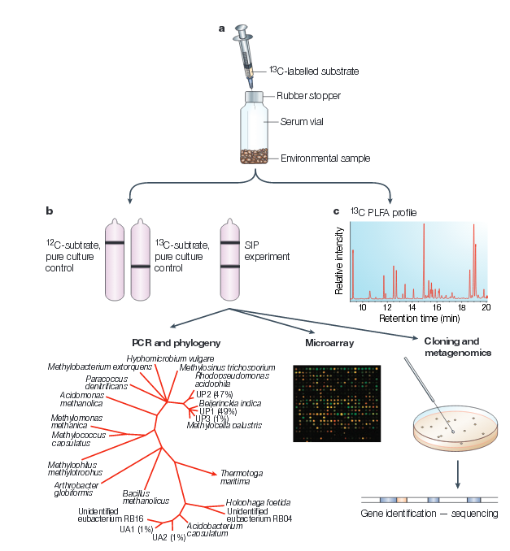


Sidewall Core Analysis
Collaborators:
Mouser, Wrighton, Wilkins, Cole,Darrah
What are geological controls on microbial distribution, diversity and function ?
Gas productivity and well infrastructure
Potential for fracture and pore clogging
Microbial life/adaptations
Tracer Addition
Sidewall core
Core processing
Sample preparation
Biomarker Extraction
GC-GC analysis
Aliphatic biomarker distribution
CSIA & Fatty Acid biomarker distribution
Vikas Agrawal
PhD. Student
Rawlings Akondi
PhD. Student
Dumont and Murrell, 2005
Ratios of physiological stress DGFA/FAME and DGFA/PLFA/FAME lipid biomarkers
Changes in the PLFA and DGFA profiles during nutritional & thermal stress
CSIA will be used to identify microbial populations involved in methanogensis, methanotrophy, sulfate reduction etc.
S. Pfiffner UTK
P. Mouser OSU

Slide 31
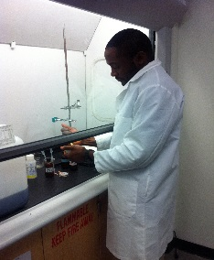
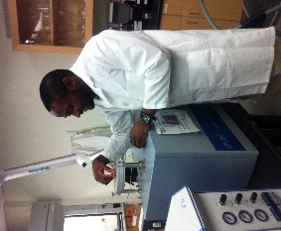
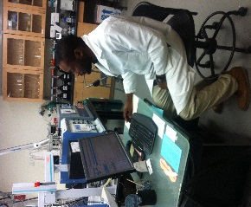
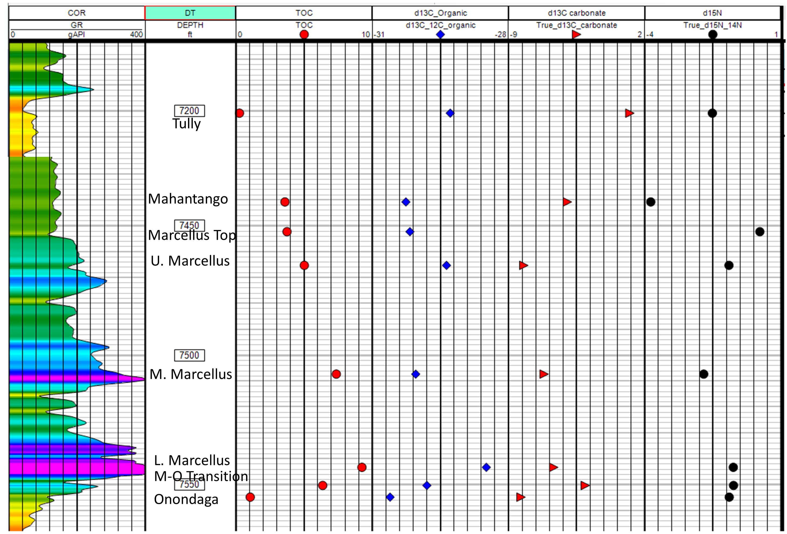
Collaborators:
Mouser, Wrighton, Wilkins, Cole, Darrah
Sidewall Core Analysis
What are major controls on TOC variation and source/type of organic matter?
Oil vs gas production
Identification of sweet spots
Frackability/Re-stimulation
Sample preparation
Sample Analysis
Data
Integration
Gamma Ray log with TOC and isotope (δ¹³C_{org} , δ¹³C_{carb} , δ¹⁵N ) variations of 8 sidewall core samples collected from well MIP 3H. Shifts in δ¹³C_{org} , δ¹³C_{carb} and δ¹⁵N values will be used to understand controls on variations in TOC , sources of organic matter, and microbial recycling of carbon and nitrogen

Slide 32

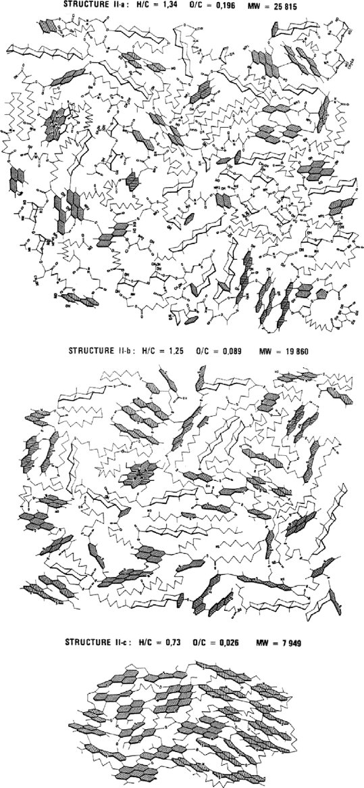
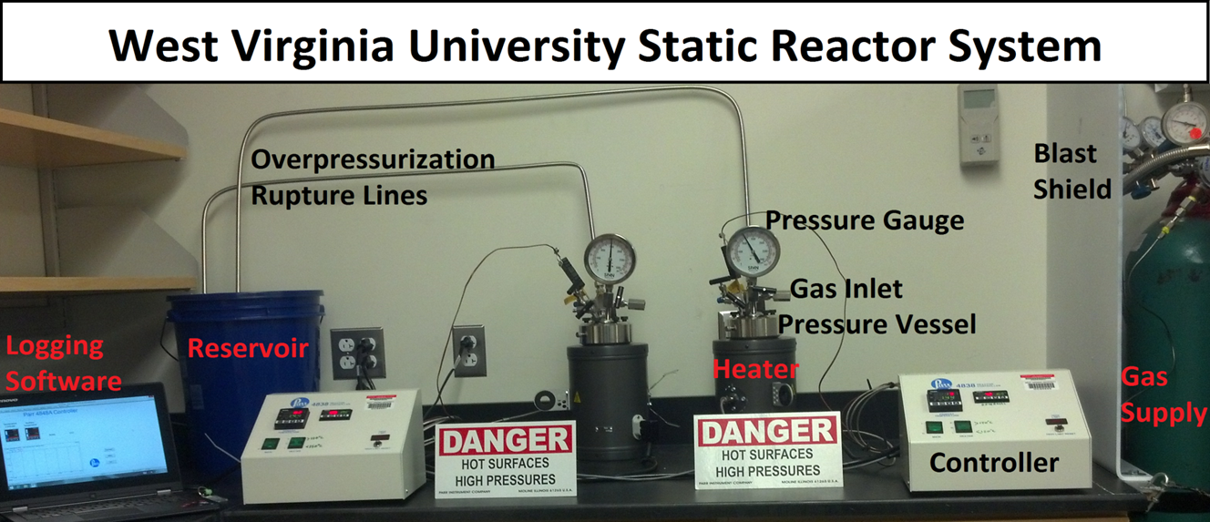
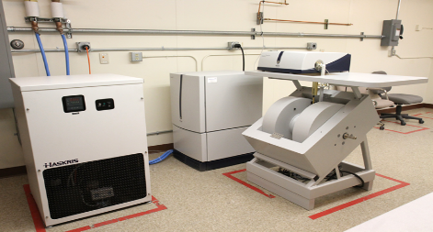
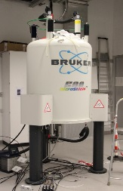
Kerogen Analysis
Collaborators:
Hoyt, Walter, Malak
DECODING KEROGEN STRUCTURE AND ITS INTERACTIONS
Electron Paramagnetic Resonance
NMR
Vikas Agrawal
PhD. Student
Frac water-shale experiments to be conducted high pressure/temperature static systems to understand:
Changes in kerogen structure and composition on interaction with frac fluids under simulated subsurface conditions.
Effect of changes in kerogen on chemistry and flow of produced water and gases
Behar & Vandenbroucke, 1987

Slide 33

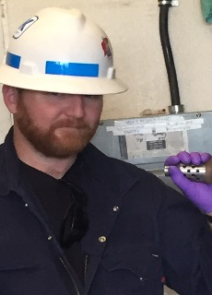
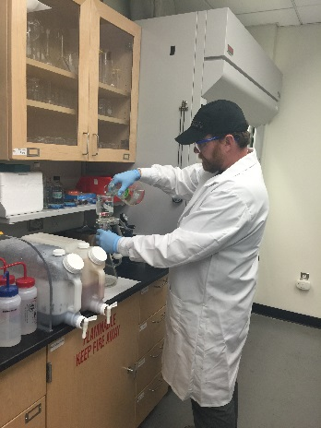
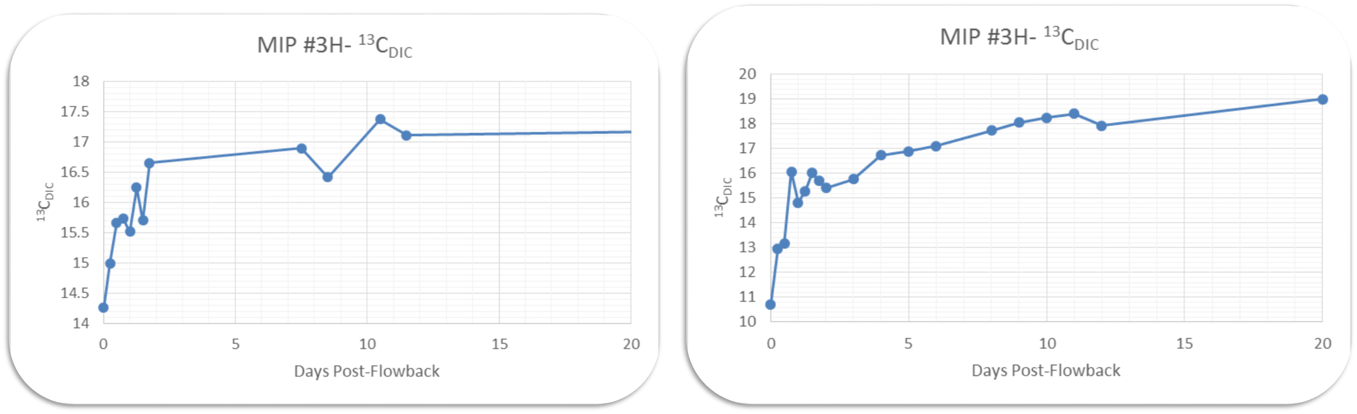
Produced Water Analysis
Collaborators:
Hakala Mouser, Wrighton
Phan Wilkins, Cole
Crandall Darrah
What are the plausible fluid-rock-microbe interactions?
Evolution of produced water chemistry
Well infrastructure & souring
Secondary biogenic methanogenesis
Travis Wilson
MS Student
MIP 5H
MIP 3H
Extraction of Sulfate and sulfur and oxygen isotope analysis in progress
Initial δ¹³C_{DIC} enrichment trend in wells 5H and 3H during first few hours to days indicates dissolution of carbonates in reservoir after injection of hydraulic fracturing fluids. High δ¹³C_{DIC} values indicate carbonates were precipitated during initial phase of biogenic methanogensis in the reservoir. The C and S isotope trends will be monitored over several months to understand microbial reactions induced in the reservoir after injection of hydraulic fracturing fluids

Slide 34

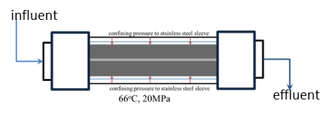
Using geochemistry to track hydraulically-fractured reservoir evolution
Prior research showed multiple chemical and physical processes can affect the reservoir.
Outstanding questions
How does the reservoir chemistry change during flowback?
How do fluid/gas flow pathways change during flowback and hydrocarbon production?
Renock et al., 2015
Approaches
Evaluate redox changes (which could affect organic and microbiological reactions in the reservoir) through analysis of iron and sulfur species
Distinguish fluid-rock reaction versus physical transport of materials through analysis of truly dissolved versus colloidal loads in produced water
Methods
Analysis of MSEEL produced water sample splits for time-series concentrations of cations, anions, and isotope ratios for Sr, Li, and B
Conduct laboratory flow-through experiments to evaluate fluid-rock interactions using MSEEL core
NETL: Alexandra Hakala, Thai Phan, Dustin Crandall

Slide 35
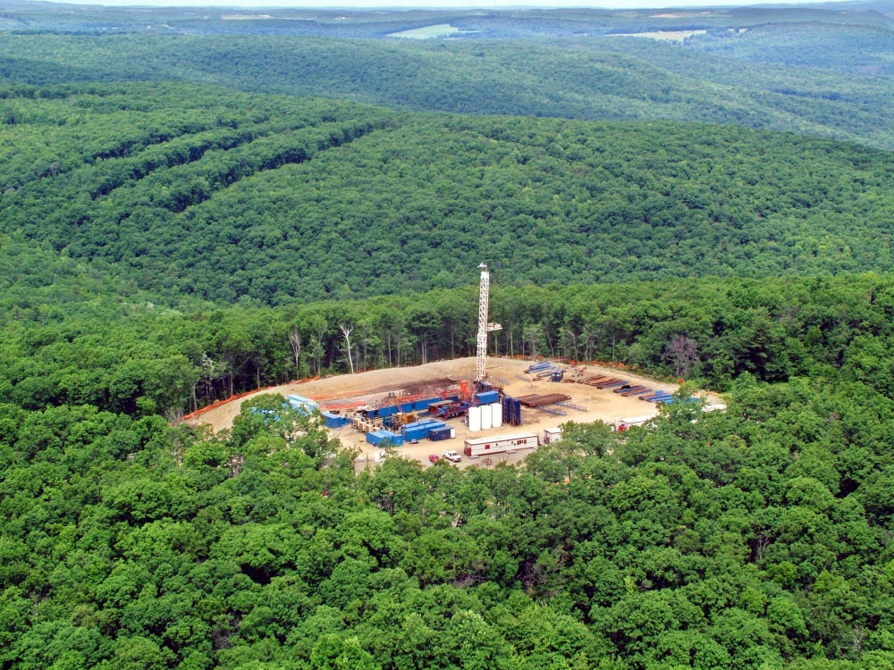
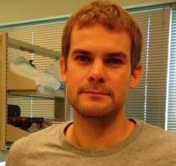






OSU-WVU Deep Biosphere Collaborative Research
Mike Wilkins
Earth Sciences, OSU
Shikha Sharma
Geology, WVU
Kelly Wrighton
Microbiology, OSU
Tom Darrah
Earth Sciences, OSU
David Cole
Earth Sciences, OSU
Jeff Daniels,
PI – OSU Team
Paula Mouser
Envr Engr, OSU

Slide 36
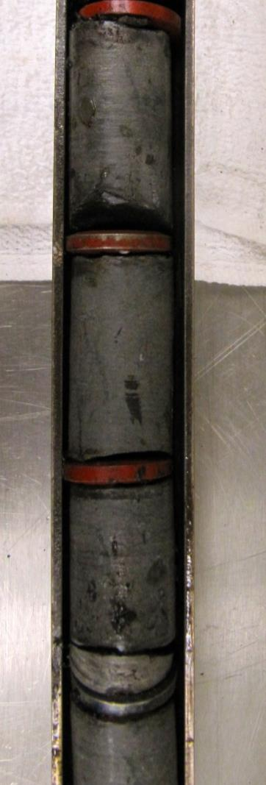

Sidewall Cores
Sample Distribution
For Each Transect
MIP-3H
(44 cores)
Geneseo Shale
1
Ground
Tully Limestone
Split – 3 Labs:
Mouser (OSU)
Wrighton (OSU)
Sharma (WVU)
2
Mahantango Fm
3
Log Depth (feet)
5
Split
Marcellus Shale
Split – 3 Labs:
Wilkins (OSU)
Cole (OSU)
Darrah (OSU)
4
Onondaga Limestone

Slide 37
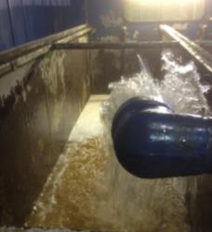
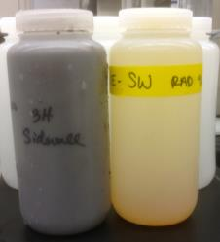
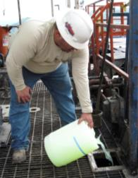
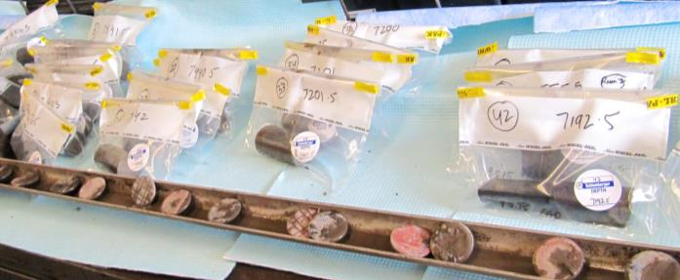
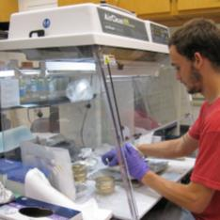
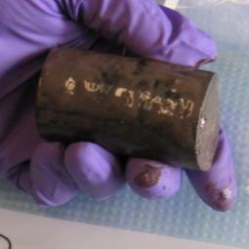
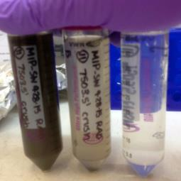
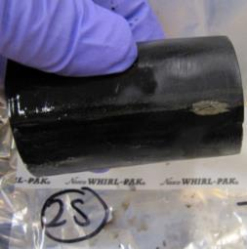
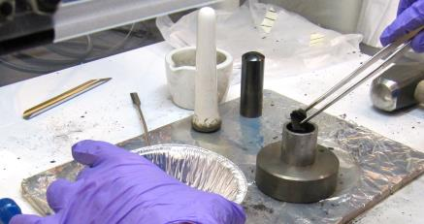
Contamination controls for sidewall cores
Wrighton Lab
1
2
3
Sample all input fluids (drill mud, brine, etc.) for DNA extraction and sequencing
Add tracer to drill mud
Bagged cores, transported anaerobically to OSU
4
5
6
100 µm
Sterile hood to process cores
Clean cores, keep washes for DNA extraction and sequencing
Quantify tracer removal
7
Ground shale distributed for:
DNA Extraction and Sequencing Efforts
7
metagenomic sequencing
Pristine core material:
9 depths in and surrounding the Marcellus for metagenomic sequencing
Contamination control:
DNA extraction and sequencing from ~375 core washes and input fluids
*First batch of DNA from pristine cores submitted to DOE for sequencing!!!
culturing
lipid analyses
flame sterilize & grind shale
Wrighton lab- R.A. Daly/Ohio State University

Slide 38
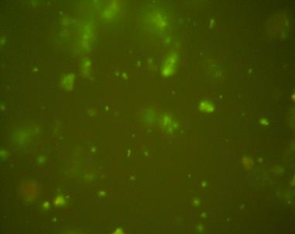
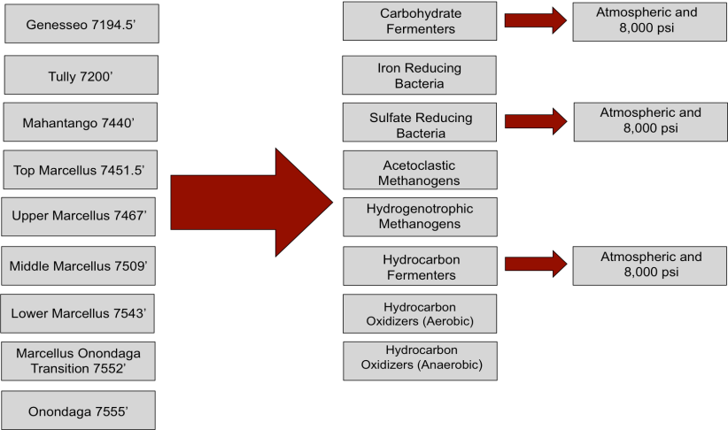
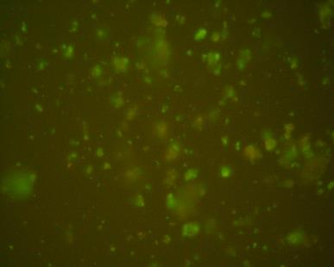



Pristine Shale Enrichments
Wilkins Lab
Enrichment Strategy
A
Depth
Enrichment
Pressure
10 μm
B
10 μm
SYBR Gold (fluorescent DNA stain) dyed Mahantango formation enrichments targeting for (A) Sulfate Reducing Bacteria and (B) Carbohydrate Fermenters. 100x. These are the most promising enrichments thus far.
Atmospheric enrichments (both aerobic and anaerobic)
⬅High pressure vessel and enrichment tube

Slide 39








Biological Signs of Recent Pristine Rock-Hosted Life, PLFA Measurements
Mouser Lab
Solvent Extraction
Total Lipid Isolation
Silicic Acid Chromatography
Polar Lipid Methanolysis
Fatty Acid Methyl Ester GC–MS
Quantification and Analysis
S. Pfiffner, UTK
--Highest Biomass Recovered from Interface
--Largest Number of Unique PL-FAMEs at Interface
--Sidewall Core Profiles Differ Between Rocks
--Cores PLFAs Differ from Muds/Washes
Notes:
Divesity of PLFAs are estimated on the total unique PL-FAMEs detected for each sample. Groups of PL-FAMEs pmol were summed based on the structure and class of the PL-FAME.
- DME: Dimethyl Ester – interesting lipids that are not typically found – detected in other subsurface envs.
- Term Br – Terminally Branched FAMEs
- Epoxy: epoxylated FAMEs at a point of unsaturation
- Keto: keto group on FAME at point of unsaturation
- Hydroxy: Hydroxyl group on FAME at point of unsaturation
- Poly Unsat: Poly unsaturated Fatty acid methyl ester
- Normal Sat: FAME with one point of unsaturation
-- No mono unsaturated FAMEs were detected.

Slide 40


Mouser Lab
Evidence of Life in Marcellus Wells
--Biomass Differed Initially Between Wells
--Stabilized Around Same Quantity
--Approximately 1x10⁵ to 1x10⁶ cells/ml
Well 3H
Flowback fluid samples were fixed in 2.5 % paraformaldehyde, stored at 4°C and enumerated within one week of sampling. Counting: Samples were filtered through a black 0.22 µm PCTE filter, stained in situ with SYBR-Gold fluorescent nucleic acid-specific stain and imaged with a 40X objective under 480 nm excitation. Bacterial cells were manually counted and averaged from images of 10-20 fields per filter. Upper and lower left: Images of flowback fluid samples collected on Feb 3, 2016 (Day 56) from wells 3H (up) and 5H (bottom). Right: Summarized bacterial counts through the most recent collection time point, February 3, 2016. Note: Both wells received the same source water but different hydraulic fracturing treatments.
Well 5H

Slide 41





Core and Filter analysis
Cole Lab
Characterize mineralogy,
organic matter and pore distribution
OM
Dual Beam FIB/SEM and QEMSCAN to relate mineralogy to 3D pore network
Analysis of filters from flowback to characterize mineral precipitates and microbes.
M6 cells and Fe precipitates
(Ba,Sr)SO₄
BaCl₂

Slide 42


Noble Gasses in Core and Fluids
Darrah Lab
Tracers for crustal fluid migration
Samples show no air contamination
Testing New Multicollector NG-MS Instrument: Only 2 in world for hydrocarbon analysis (Oxford)
  Determines residence time in natural gases and pore waters
  Provides increased precision of measurements.
Beginning analysis on cores and fluid inclusions
  -See poster Grove, Whyte, Darrah
Data will provide information on extent of fluid migration, permeability, and thermochronology

Slide 43





Scanning of the MSEEL
MIP 3H Core
Dustin Crandall
2/12/2016
From left to right: Isolated pore space in sandstone; medical CT scanner; Cover of JPT from Jan 2015 highlighting NETL’s foamed cement work; Core flow apparatus; Simulated flow velocities in fracture geometry

Slide 44
























Multi-Scale CT Flow and Imaging Facility
Micro CT Scanner
- Resolution 10⁻⁶ to 10⁻⁵ m
- Pore scale
Medical CT
Scanner
-10⁻⁴ to 10⁻²m
- Core scale
- Pressure, temperature, and flow controls
Industrial CT Scanner
-10⁻⁶ to 10⁻³m
- Pore & core scale
- Pressure & flow controls
Measuring flow at in situ P, T, stress, and geochemical conditions
CT/well log comparison
MSCL for geophysical logging
Simulating flow through pore and fracture networks
Collaborations

Slide 45




























7445’- 7460’
7460’- 7476’
7476’- 7493’
7493’- 7510’
7555’ – High Resolution Scanning

Slide 46


Combined with MSCL Data

Slide 47
Data Available
If you want any of this data, we really want to get it to you!
  Medical CT scans are already on MSEEL.org
  Poster at this meeting
    Title “Preliminary CT and High Resolution Log Data, Johnathan Moore and myself”
  Data on disc available
    We’ve burned a couple of discs for those who want to look at this weekend
Thank you!

Slide 48











It’s All About a Clean, Affordable Energy Future
For More Information, Contact NETL
the ENERGY lab
Delivering Yesterday and Preparing for Tomorrow
National Energy Technology Laboratory
48

Slide 49
Schlumberger Technology Corporation
Provided array of products and services to Northeast Natural Energy on MIP wellsite
Drilling Group
Characterization Group
Production Group

Slide 50

Cement Temperature Finite Element Model Validation using Fiber Optic Field DTS Data
Validate/calibrate current temperature model with Distributed Temperature Survey (DTS)
Possibility to include temperature behavior during drilling and post placement cement Heat of Hydration effect

Slide 51

Wellbore Integrity Through Engineered Design, Evaluation and Monitoring
Design optimization by incorporating formation/borehole data acquired before cement job
Forecast and measure wellbore integrity
Identify mechanism of defects in cement placement

Slide 52

MIP 3H & 5H Microseismic Configuration
delta z, x, y = 400 ft

Slide 53

Side View Radius Filtered Events – 2,500 ft
Sized by magnitude: 2 to 10 :: -2.5 to -1
delta z , x, y = 400 ft

Slide 54
Executive Summary of Conclusions
MIP 3H Average Half Length: 784ft, Average Height: 496ft, Average Azimuths N76°E
MIP 5H Average Half Length: 618ft, Average Height: 540ft, Average Azimuths N63°E
  Generally displays higher fracture height growth indicating the jobs were placed in geologically similar zones as well as creating similar geometries and pressure responses
Overall event complexity indicates higher stress anisotropy when compared to other unconventional plays.
Higher amounts of 40/70 sand resulted in larger fracture geometries.
Higher viscosity fracturing fluid leads smaller fracture height growth, although it will deliver better proppant transport properties.
Microseismic, lateral logs, and pumping data can be used to create a calibrated DFN model with synthetic microseismic.
Normalized production comparison recommended in order to determine the effect of slight fluid and completion alteration

Slide 55




Enhanced Perforation Design, Performance and Monitoring
  Challenge
  Ensure optimal lateral coverage while improving efficiency and EUR
  Goal
  Predict and optimize perforation cluster efficiency while monitoring performance
  Key Enablers
  Lateral measurements (SSCAN, QGEO, USIT)
  Fiber optics monitoring (hDVS, DTS)
  SLB proprietary engineering workflows
  Preliminary Results
Figure 1: Estimated breakdown pressure, predicted and actual (hDVS ) cluster efficiency. Geometric design (left) versus Limited Entry design (right).
  Steps
  Strategic stage placement based on rock fabric and mechanical properties
  Limited entry perforation design based on estimated breakdown pressure
  Performance monitoring with Fiber optics (hDVS, DTS)
Figure 2: Fiber optics hDVS data comparing Geometric design (top) versus Limited Entry design (bottom). Limited entry design show better activity distribution across treatment stage.

Slide 56





Complex Fracture Modeling in Marcellus Shale with Slickwater and Visco-Elastic Stimulation Fluids
  Challenge
  Improve frac placement and EUR with reduce water usage
  Goal
  Evaluate Slickwater and Sapphire VF fluid systems and provide recommendations based on operational risk and production performance
  Key Enablers
  Geomechanical and Petrophysical measurements
  Mangrove and SLB engineering workflows
  Sapphire VF, Microseismic monitoring
  Preliminary Results
  Decreased water usage by 25% with 30% increase in avg. PPA (1.33 to 1.75) and 100% placement
3D property modeling. Initial framework for hydraulic fracture simulation
Slickwater Design
Modeled
17%
Sapphire VF Design (25%) less water
Sapphire VF stages (blue rectangle) well contained within the Marcellus
Sapphire VF design (bottom left) showing better conductivity distribution compared to Slickwater design (top left)

Slide 57
Monitoring static strain while casing running in hole with Fiber Optic Cable
Identify well deviation and tension applied on the cable while running casing in hole using DSTS (Dynamic Strain and Temperature Sensing) technology.

Slide 58

Monitoring temperature and strain during cure after cementing
Strain and temperature measurements from fiber optic cable were used to monitor cement job and post-job curing period. Analysis will be performed during the cure after cementing to better understand how the cure is behaving.

Slide 59
Monitoring cementing job using fast update BOTDR
This publication will explain the physics of the technology and possible applications for better understanding in real time the impact on cement volumes or post cement integrity

Slide 60
Influence of Completion Deployment Techniques on DTS response during Frac Monitoring
DTS has historically been obtained by deploying a fiber on a control line strapped to tubing inside a wellbore. More recently, control lines are being deployed exterior to casing for plug-and-perf jobs.
The DTS response during injection is completely different in the two cases!! Paper would present mathematical and field-cases demonstrating what is going on, including the NNE dataset

Slide 61
Influence of Gauge Length on results from Fiber Acoustics during Frac Stimulation
Fiber Acoustics relies on backscatter of Rayleigh waves. The raw data is sampled in the time domain and over a continuous length of deployed fiber. For each time and depth, the amplitude and phase of that backscatter is computed in real-time. This computation requires a window of depth called the gauge-length. Long gauge lengths give blurry images if too long, short gauge lengths introduce numerical artifacts if too short. This paper would examine the interplay of depth-sampling and gauge length on the NNE dataset.

Slide 62
Monitoring frac job using combined DAS and DTS
This publication will examine the DAS and DTS data obtained from the NNE data set and provide insight into the physics of distributed data during stimulation. In particular, it will give an answer to the question of why are there apparent time intervals of DTS warming in the middle of each frac stage

Slide 63
Real-Time Interactive Remote Display of DTS and DAS Data for Optimization of the Well Treatment Process
In this paper we describe a novel solution to the remote display of DTS and DAS data to facilitate real-time decision making. Wellsite data is processed automatically onsite to produce a light-weight data format suitable for transmission over cellular and VSAT links to remote servers. A graphical interface provides an interactive display and interpretation of data on a web browser. This can then be made available to distributed experts and clients anywhere in the World. This approach is demonstrated using data from a stimulation treatment in US Land.

Slide 64







Improving Geomechanics Model with New Dipole Flexural Inversion Workflow
  Objective
  Improve characterization of elastic properties and stress profiles in Marcellus using the new dipole flexural inversion workflow to better predict hydraulic fracture growth
  Key Benefits
  Additional Cij parameters estimated from the new workflow
  Lower uncertainty in Stoneley modeling due to sensitivity to mud slowness
  Better understanding of formation anisotropic elastic properties
  Improvements in closure stress estimation
K_{o}
Example
Pilot
Lateral

Slide 65

Mapping Fiber-optic Cable and Perforation Placement
Monitors connected through fiber optic cables
Capable of monitoring temperature and pressure downhole remotely and in real-time
Identifying downhole conditions related to production
Acute and Chronic flow patterns

Slide 66

Mapping Fiber-optic Cable and Perforation Placement
Wireline Perforating Platform – Toolset allowing measurements while perforating
Originally used for orienting perforations in multi-string completions. Currently being used to detect fiber optics outside of casing.
Run to ensure orientation of perforations away from destructible monitoring and signal transporting elements
Integrating Standard Operating Procedures for new use in horizontal Pumpdown environments

Slide 67

Surface seismic monitoring at MSEEL: Slow shear-slip deformation

Slide 68






Deformation mechanism
Brittle
Non-brittle
(>100 Hz)
(1-30 Hz)
Hydraulic fracturing and microseismicity
Relative contribution to production per stage

Slide 69


Time (hour)
Comparison of power spectra

Slide 70

Time (hour)

Slide 71

Surface network and well location

Slide 72
Measurement of Key Shale Petrophysical Properties
Porosity
Permeability
Compressibility
Stress Effects
Adsorption

Slide 73
Precision Petrophysical
Analysis Laboratory (PPAL)
    Steady State Permeability Measurement
      Impact of stress on permeability
      Modified Klinkenburg (Double Slippage) Correction
      Fracture Closure Pressure

Slide 74





Precision Petrophysical
Analysis Laboratory (PPAL)

Slide 75





Double Slippage Correction

Slide 76




Impact of Stress

Slide 77
Sequential Stress

Slide 78
Research Overview
Ali Takbiri-Borujeni
WVU

Slide 79



Simulation of hydraulic fracturing treatment (MIP-4H well)
Hydraulic Fracturing Simulation Results
Ali Takbiri-Borujeni/WVU

Slide 80



Multiscale modeling of gas flow in shale
Molecular Dynamics (MD) simulations
Pore network modeling
http://www.poresim.org/NWM/nwm.htm
Mass flux of Methane across a 5-nm graphite channel
Kazemi, M and Takbiri-Borujeni, A, “Molecular Dynamics Simulation of Gas Flow in Shale Gas
Reservoirs”, Submitted to Journal of Natural Gas Science and Engineering, 2016

Slide 81

Using Predictive Modeling to Develop a Cost Efficient and Effective Completion Design

Slide 82
Variables of Interest
To develop a predictive model for production per stage data gathered through the use of fiber optics, microseismic, and high imaging lateral logs will be used. The variables of interest at the start of this process include the following listed below:
  Depth
  Bond Index
  CBL Amplitude
  Gamma Ray
  Gamma*ROP
  Sonic Porosity
  Shots
  Clusters
  Faults
  Total Fractures
  Wellbore Placement Above Onondaga
  Target Top Above Onondaga
  ROP/WOB
  Background Gas
  Rate of Penetration
  ROP/WOB
  Number of Microseismic Events
  Fracture Height
  Fracture Complexity
  Fracture Width
  Average Magnitude
  Downward Growth
Average Stage Temperature
Cluster Efficiency
Frac Gradient
ISIP
Breakdown Pressure
Average Treating Pressure
Average Treating Rate
Pad Volume
Total Clean Fluid
Total Proppant
Total 100 Mesh
Total 40/70 Mesh
Flush Volume
LB/BBL
Flow Rate Per Perforation
Gel Per Stage
Percentage Coated Proppant

Slide 83


Weka
Weka is a popular machine learning software developed by the University of Waikato in New Zealand.
Weka is a collection of algorithms used for data mining, data analysis, and predictive modeling.
For our project, Weka will mainly be utilized to run linear regressions and multiple linear regressions to find the best predictive model for production per stage.

Slide 84

Marcellus Shale Energy and Environment Laboratory
MSEEL
Integration of Research/Technical Results
  Key Research Foci
  Anticipated Results
  Impact/Implications
  Timeline - Acceleration
Coordinated Publication/Presentations
  National Meeting(s) Session(s)
  Dedicated Journal/Memoir
  Other Avenues of Dissemination
  Timeline
Results Supporting 2017-18 Decision Point
  Extend Study – Drill Additional Wells
  Remaining Questions for Marcellus

