Slide 1




Marcellus Shale Energy and Environment Laboratory
MSEEL
The objective of the Marcellus Shale Energy and Environment Laboratory (MSEEL) is to provide a long-term collaborative field site to develop and validate new knowledge and technology to improve recovery efficiency and minimize environmental implications of unconventional resource development
Tim Carr
Phone: 304.293.9660
Email: tim.carr@mail.wvu.edu

Slide 2
MSEEL Vision
Demonstrate the Best Approach to Drill, Complete and Produce a New Horizontal Well That Minimizes Any Environmental/Social Costs While Maximizing Economic Productivity
Monitor and Document Impacts in a Controlled Environment
  Greenhouse Gas Emissions
  Local Air Pollution
  Water Supply and Quality
  Noise and Activity
  Societal Impacts
Develop New Technologies
  Microseismic Monitoring
  Production Monitoring
  Advanced Logging
Develop New Scientific and Engineering Approaches to Apply to Multi-disciplinary and Multi-institutional Natural Resource Studies
2

Slide 3
Agenda
Introductions
Overview of MSEEL – Tim Carr
Collaboration
  The Ohio State University
  Other Universities and National Laboratories
  Industry - Schlumberger
Overview of NNE Operations
Technical Plan Presentation
  Website & Data Portal – Maneesh Sharma
  Surface Water/Cuttings Sampling – Paul Ziemkiewicz
  Fluids & Gas – Shikha Sharma
  Air & Noise Stations – Michael McCawley
  Core & Sidewall Core Sampling – Kashy Aminian
  Logging – Tim Carr
  Microseismic/Fiber Optics – Tim Carr substitute for Tom Wilson
  Social / Economic – Tim Carr substitute for Randall Jackson
  Drilling and Completion – NNE
Lunch and Discussion
3

Slide 4
MSEEL
Overview
Tim Carr
4

Slide 5
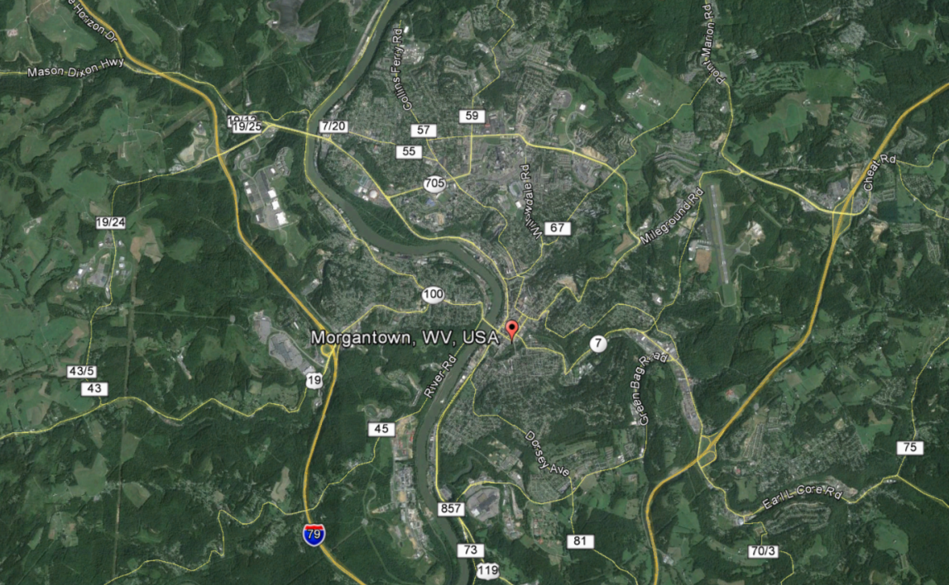
Marcellus Shale Energy And Environment Laboratory - MSEEL
NETL
4.7 miles
MSEEL
5

Slide 6
MSEEL PROJECT ORGANIZATION
Director
T. Carr (WVU)
Associate Director
J. Daniels (OSU)
Operations Manager
S. Taylor (WVU)
Site Coordinators
External Advisory Committee
B.J. Carney (NNE)
J. Hewitt (NNE)
T. Carr (WVU)
Technical Committee
NETL
WVU
OSU
Industrial - NGO Partners
T. Carr (WVU)
J. Daniels (OSU)
K. Aminian (WVU)
P. Ziemkiewicz (WVU)
NETL
Deep Subsurface Geochemistry
Database Dev. & Maintenance
Surface Environmental
Geologic Engineering
Geophysical
Geomechanical
Economic & Societal
Shikha Sharma (WVU)
M. Sharma (WVU)
P. Ziemkiewicz (WVU)
K. Aminian (WVU)
T. Wilson (WVU)
R. Jackson (WVU)
6

Slide 7
MSEEL Tasks Year 1
Budgets and Contracts
Develop PMP
Develop Safety Protocols
Locate Service Companies
Baseline Geology, Engineering & Environment
Drilling and Completion Plan
  Present Technical Plan to Advisory Committee, May 18
  Drill Top Holes – All Three Wells July 2
  Drill science Observation Well, August 1
  Drill Production Wells, September 12
  Complete Production Wells, October 12
Continue Monitoring
Modeling and Evaluation
7

Slide 8
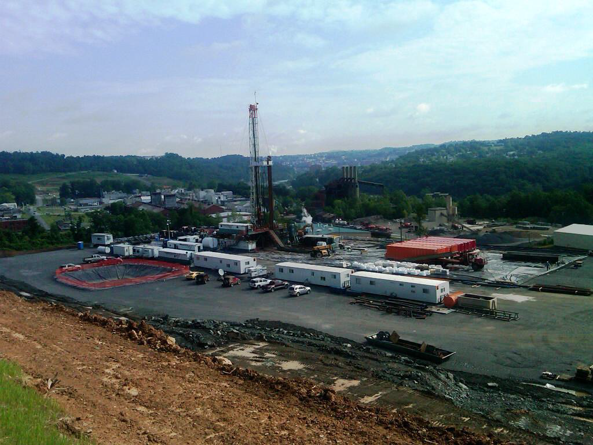
Northeast Natural Energy
MIPU 4H and 6H
8

Slide 9
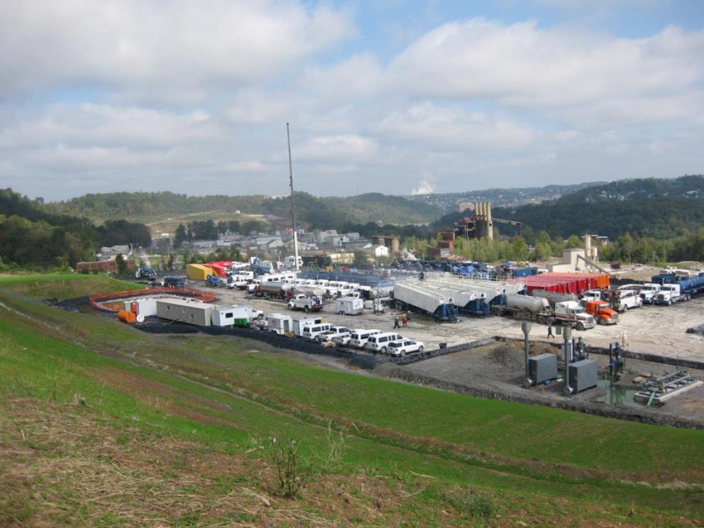
Northeast Natural Energy
MIPU 4H and 6H
9

Slide 10
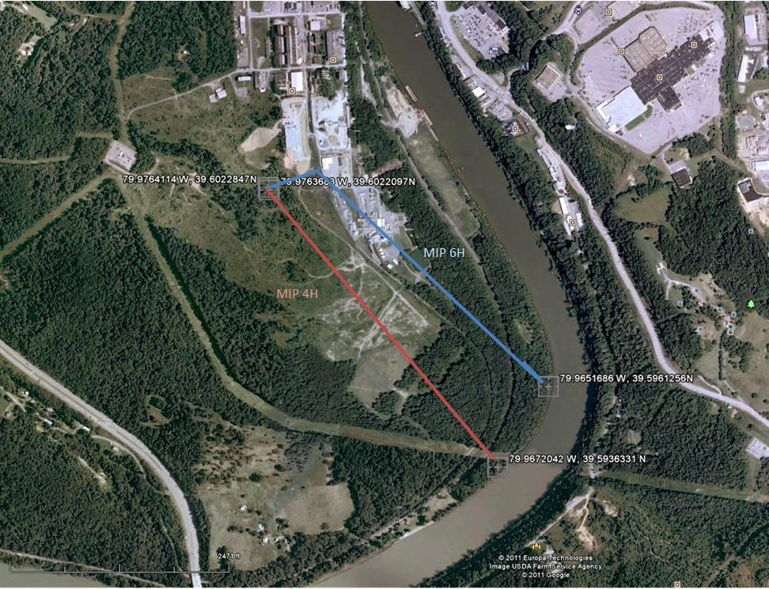
Northeast Natural Energy
MIPU 4H and 6H
B
A
B’
A’
10
Notes:
In the summer months (no heating load) ranges from 2000 mcf to 6000 mcf per day. On a peak winter day the usage is between 35,000 mcf and 45,000 mcf per day.
If you need more precise numbers ‑ let me know.
Hope you are doing well and glad to see Northeast drilling in Morgantown. Not making out so well in Charleston with your legislator from Morgantown
Bob

Slide 11
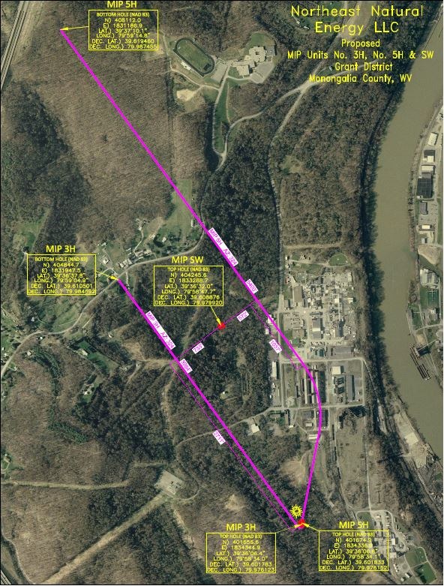
MSEEL Well Project
11

Slide 12
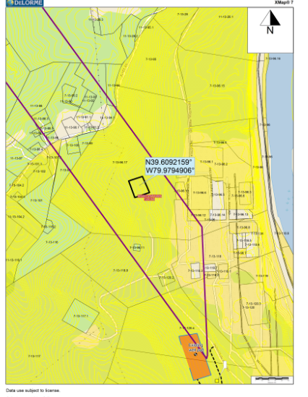
MSEEL Science Well
12

Slide 13
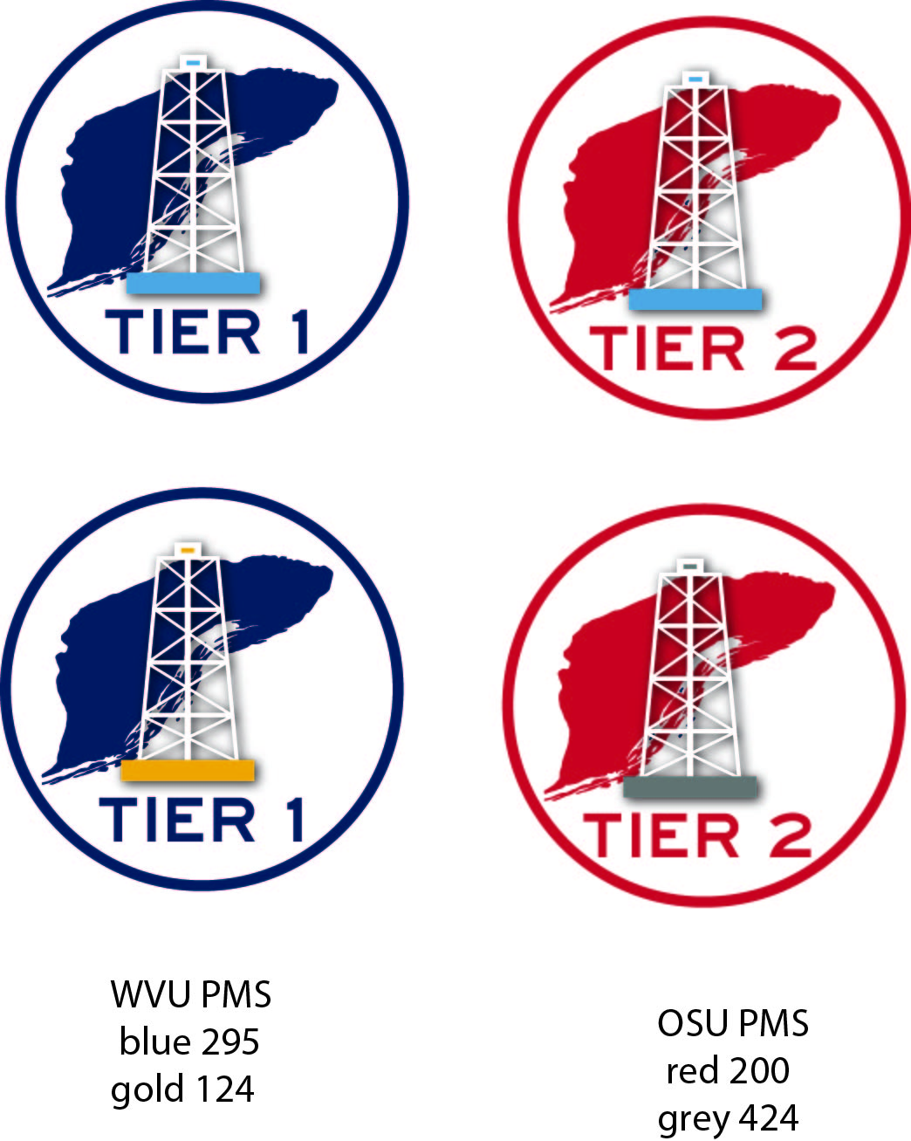
MSEEL
Safety
Safety Protocols
  Site Access
    Tier 1 and Tier 2
    Tightly Controlled Site Access
Safety Training – WVU Extension
  Twenty People Passed SafeLand Training
  Fourteen additional Individuals
  Multiple Organizations
13

Slide 14
MSEEL
Data Portal And Web Site
Maneesh Sharma
14

Slide 15
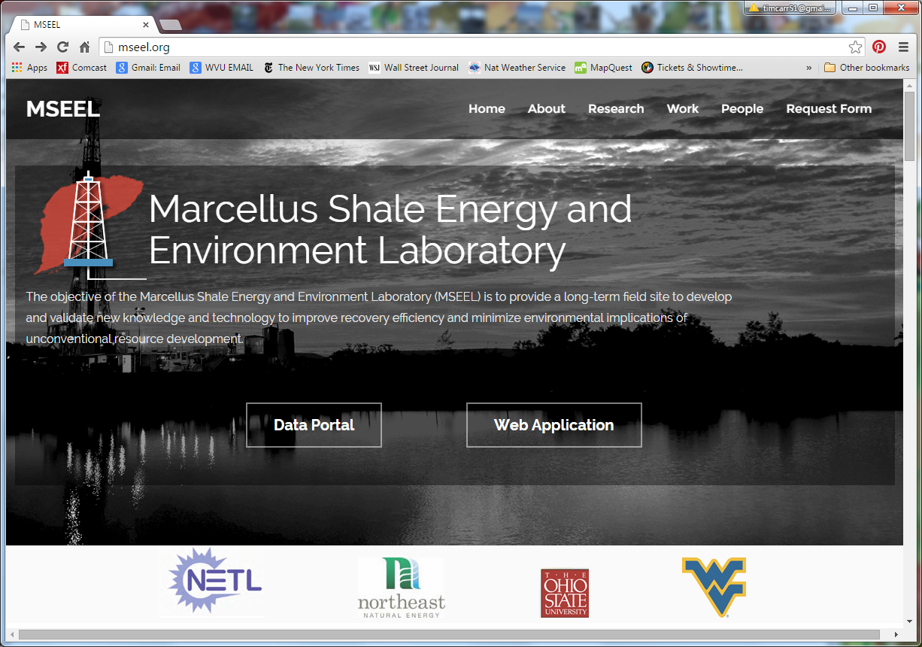
15

Slide 16
MSEEL Data Portal
Data portal will serve as central place to exchange and search for data
CKAN - Open source data portal software (www.ckan.org) will be used
  EDX and Data.gov among several agencies use the same platform
  Data Portal Features
  Publish and find datasets
        Store and manage data
        Private Workspaces and Federate
        Store raw data and metadata
        Add data directly through web interface
        Harvesting – Using same data portal will allow to search data in different federal databases
        Search and Discovery
        Search and Display Geospatial Data
16

Slide 17
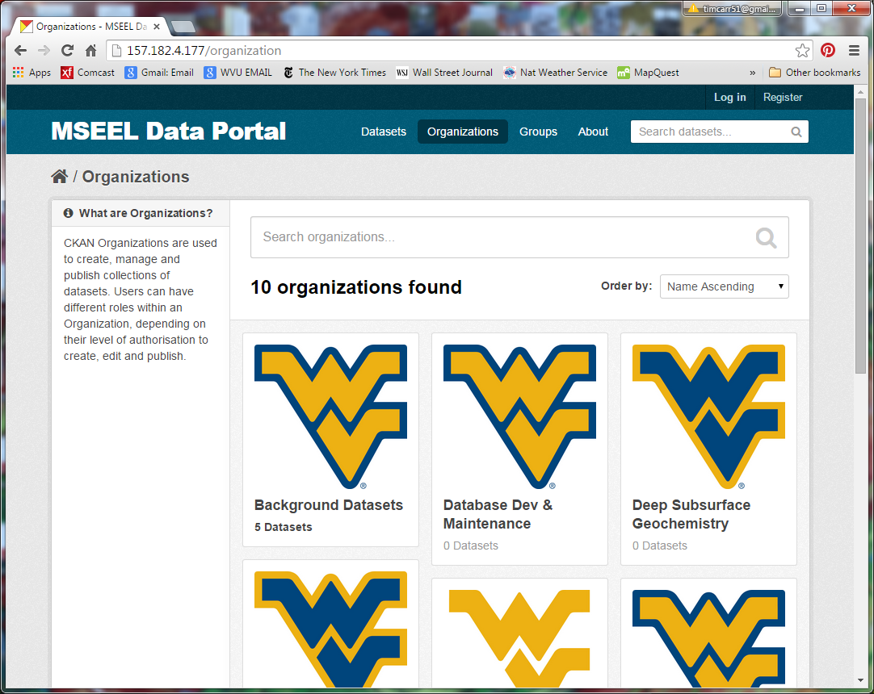
17

Slide 18
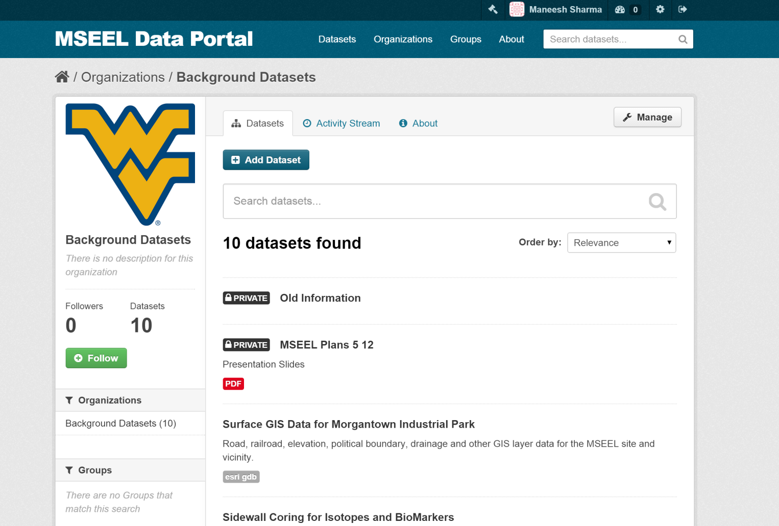
PUBLIC VS. PRIVATE
18

Slide 19
MSEEL
Liquid and solid wastes/
Surface Water Sampling
Paul Ziemkiewicz
19

Slide 20
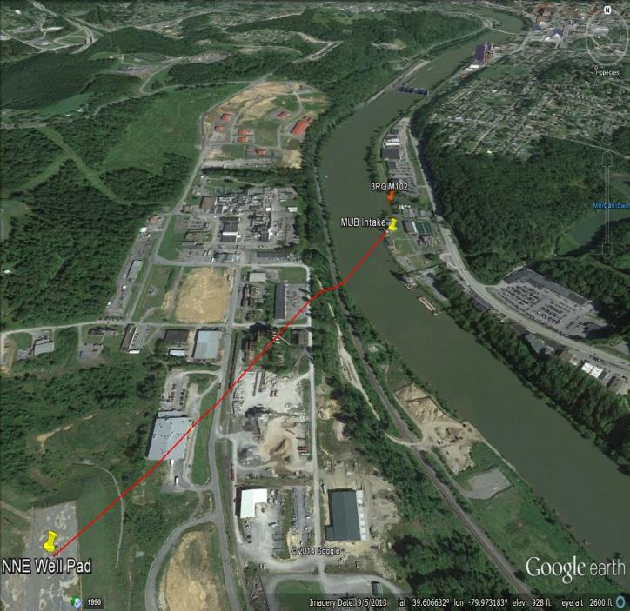
Surface water, liquid, solid waste sampling
Parameters: Inorganic/organic/NORM
Baseline Monongahela River-Compare to historic record
Drilling-cuttings/mud/flowback precipitates
Completion-Flowback
Production-Produced water
Coordination with NNE, NETL, OSU, USGS and other researchers
Sampling Schedule
20

Slide 21
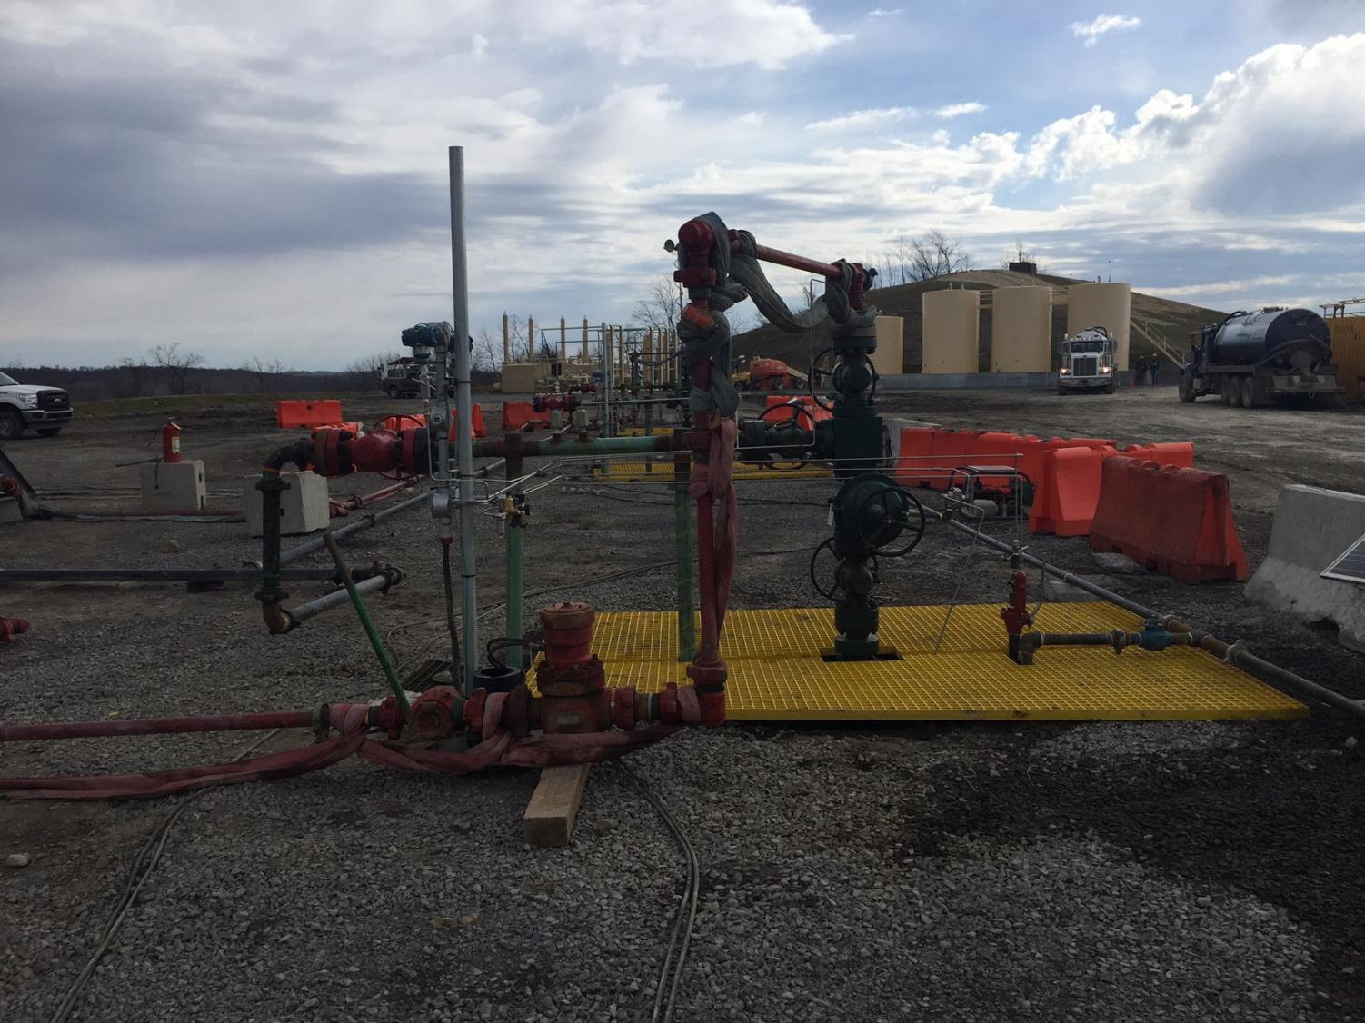
Water Sampling

Slide 22
Surface water sampling with continuous monitoring station
22

Slide 23
Surface water sampling: no continuous monitoring station-additional chemical sampling
23

Slide 24
Aqueous Analytical Parameters
24

Slide 25
How long will it take for GW contamination to reach the River?
25

Slide 26
Water Sampling Budget Projections
26

Slide 27
MSEEL
PRODUCED Fluids and Gas
Sampling at the Separator
Shikha Sharma
27

Slide 28
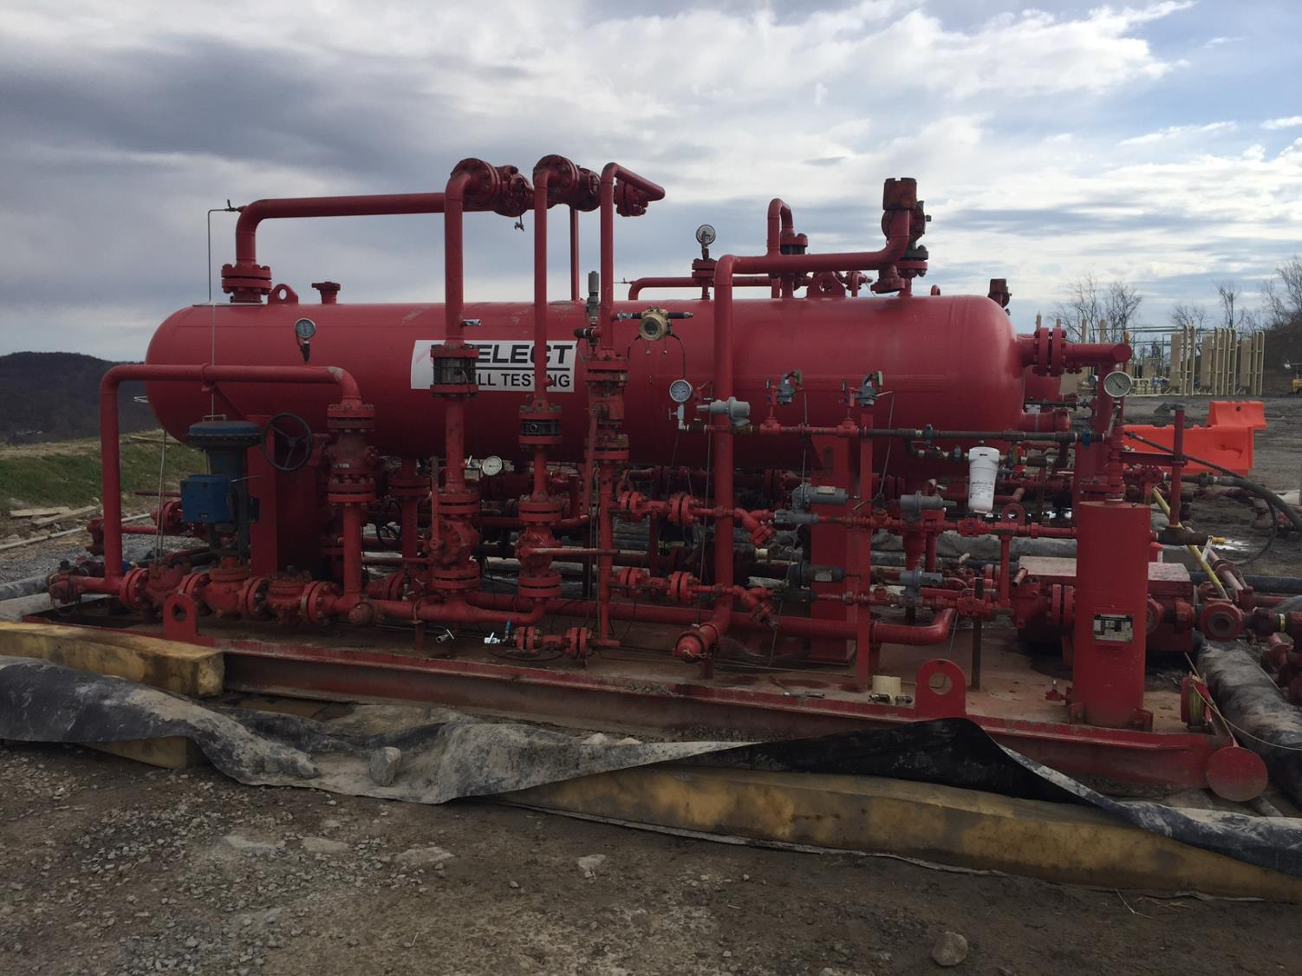
Characterization of Produced Fluids
Samples to be collected right after separator with minimal exposure to atmosphere and minimal residence time
Sharma to ensure that all samples are collected and distributed from one homogenous sample pool so all data can be pooled
28

Slide 29
Characterization of Produced Fluids
Dissolved Gas and Geochemical Characterization Fluids Darrah & Cole (OSU)
Microbial Characterization of Fluids
Mouser , Wrighton, Wilkins (OSU)
O,H,C,S isotopic Characterization of Fluids
Sharma (WVU)
SUB-TASKS
Sr & Li isotope Characterization of Fluids
Hakala & Lopano (NETL)
29

Slide 30
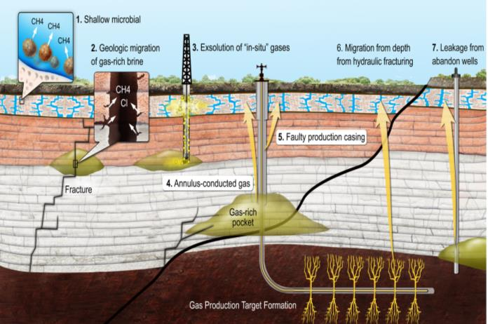
Characterization of Produced Fluids
KEY RESEARCH QUESTIONS:
What are the primary controls on evolution of produced water chemistry?
What are the possible water-rock-microbial interactions in shale as a result of injection of fracturing fluids ?
      Well longevity/productivity
      Well infrastructure and souring
      In situ production of organic pollutants
      Are there any changes in hydrologic connections associated with hydraulic fracturing?
      Can we verify water-rock reactions from laboratory to field scale?
Photo Courtesy: Darrah
Current Work Examples:
Sharma et. al., 2014 Applied Geochemistry
Sharma et. al., 2014 Groundwater
Pelak & Sharma 2014 Environmental Pollution
Cuff et. al., 2014 Env. Science & Technology
30

Slide 31
Characterization of Produced GASES
Samples to be collected at well-head before gas undergoes any processing
SHARMA-WVU
DARRAH-OSU
Characterization of
of Hydrocarbons
Characterization of
Noble Gases
31

Slide 32
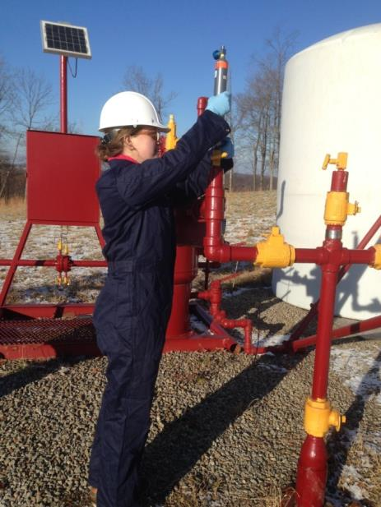
Characterization of Produced GASES
KEY RESEARCH QUESTIONS:
Does hydraulic fracturing create new pathways for gas migration?
    Gas production
    Contamination of shallow formations
    How does the gas chemistry change over time?
    Assessing free/adsorbed gas
    Residual hydrocarbon fluids-in-place
    Characterizing hydrocarbon migration
    Understanding biogeochemical reactions in sub-surface
    Constraining rates of biogenic methane and sulfide generation
Current Work Examples:
Sharma et. al., 2014 Applied Geochemistry
Darrah et. al., 2014 Proc. National Acad. Sciences
Photo Courtesy: Sharma, WVU
32

Slide 33
MSEEL
Air & Noise Stations
Michael McCawley
33

Slide 34
Environmental Monitoring
Area PM2.5, PM0.1
Area VOCs (on site/remote sensing)
Area Gases
Area Diesel and Point Source
Area Noise
Meteorological (Wind speed, direction)
Traffic Counts
No Individual Monitoring or Toxicology
34

Slide 35
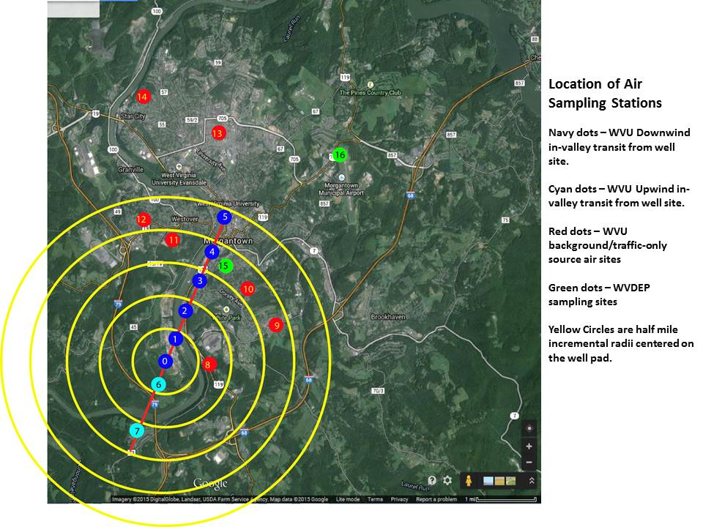
35

Slide 36
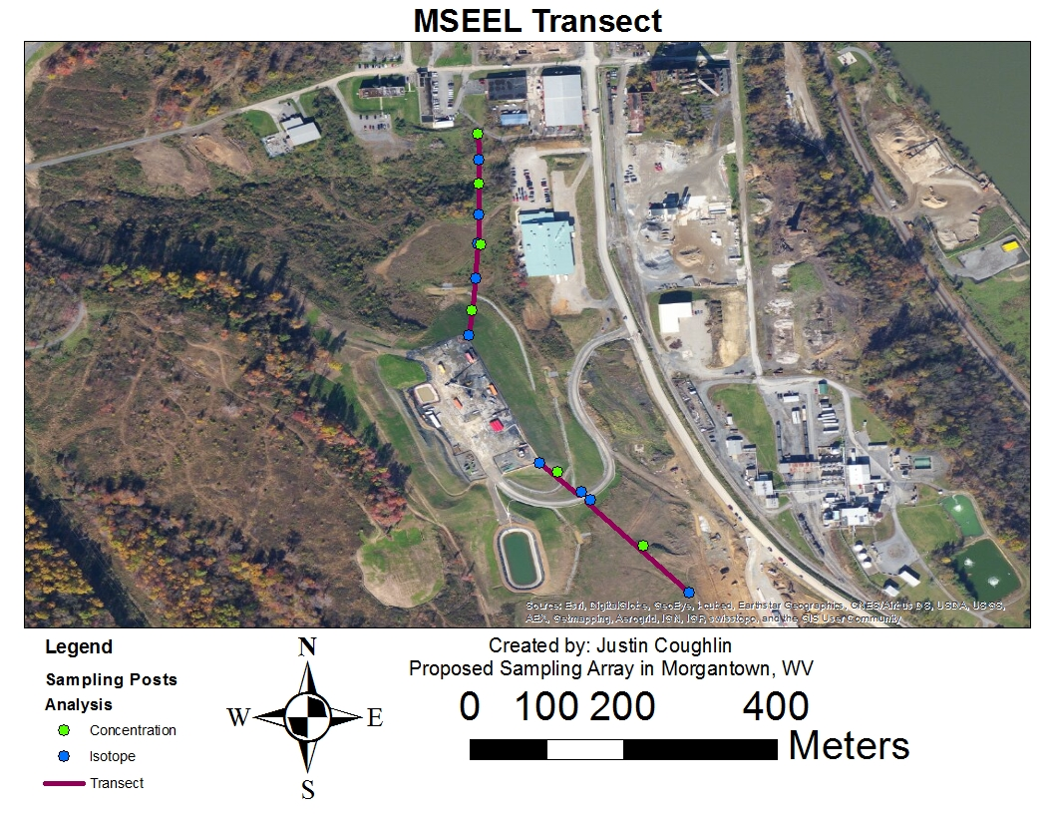
36

Slide 37
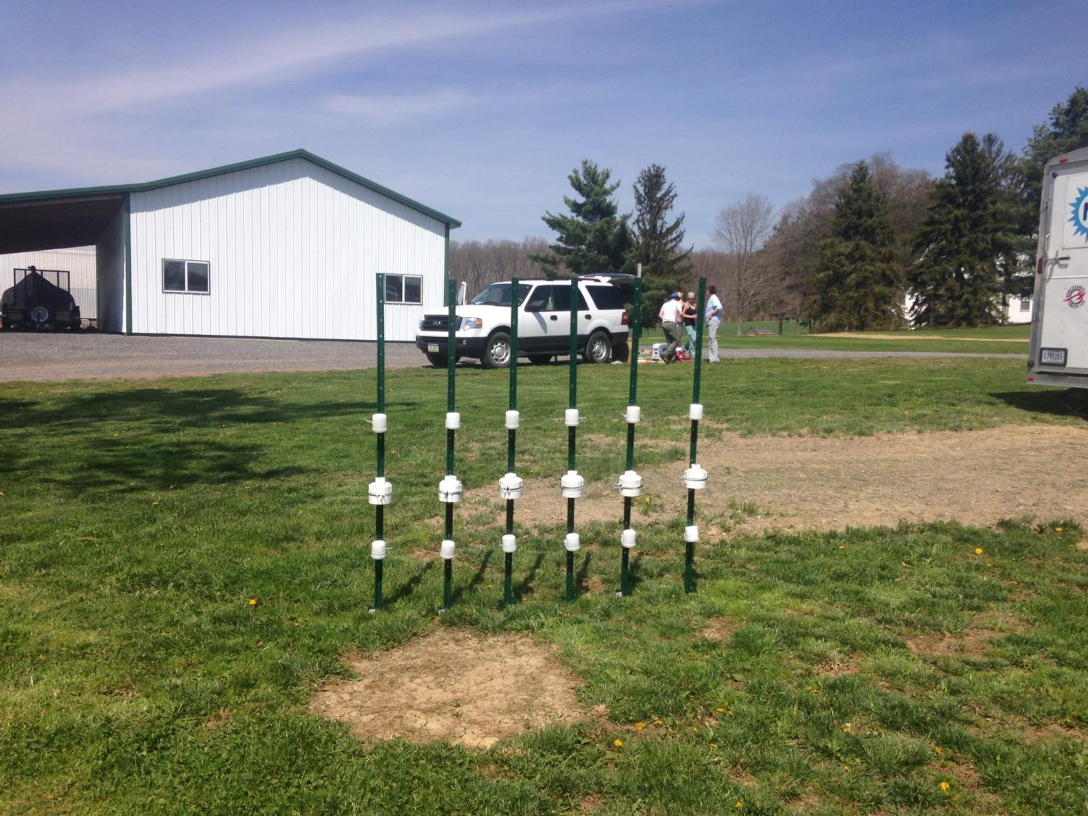
Air and Noise Sampling
37

Slide 38
38

Slide 39
39

Slide 40
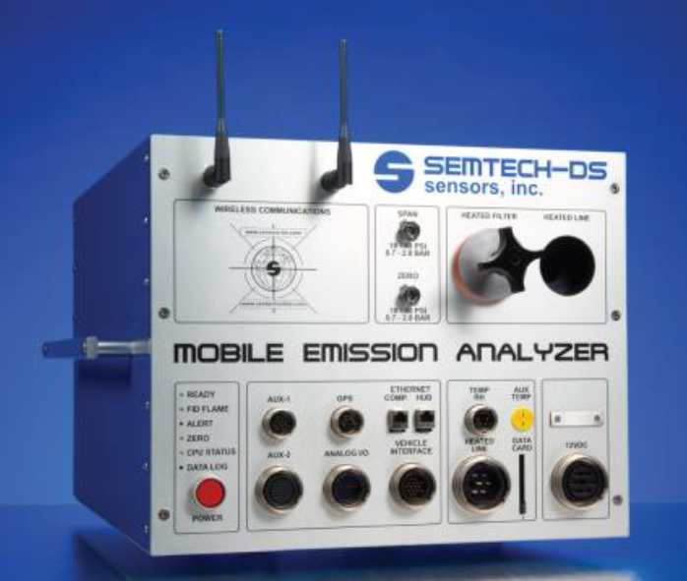
measuring gaseous emissions from the exhaust
40

Slide 41
MSEEL
Core & Sidewall Core Sampling
Kashy Aminian
41

Slide 42
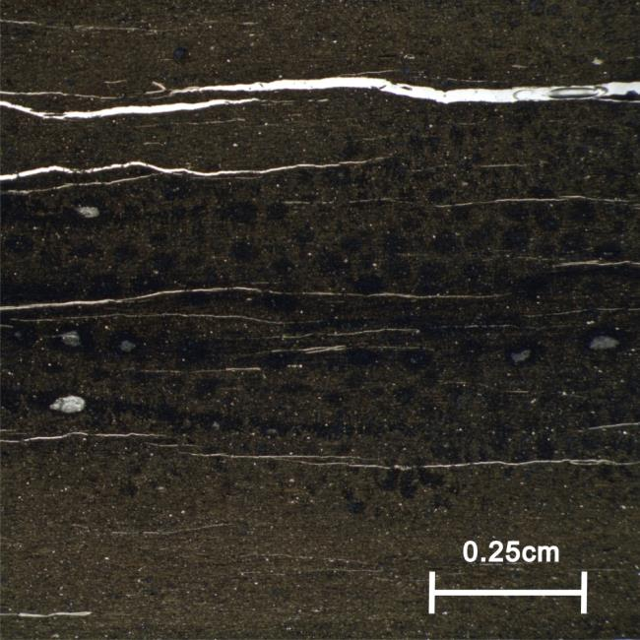
Core Analysis- Key Research Questions
What is the heterogeneity in petrophysical properties at different scales ?
    Presence, geological migration, and modern flow of fluids, water, gases and microorganisms
    Long-term production behaviour of reservoir
    What is the spatial and temporal variations in mineral and elemental composition?
    Natural/induced fracture networks
    Implications for rock-fluid interactions
Photo Courtesy: Sharma, WVU
42

Slide 43
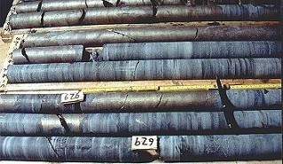
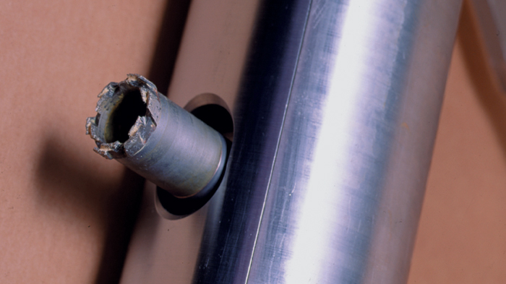
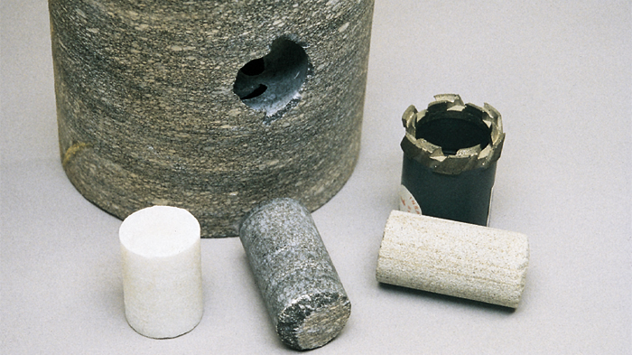
Cores Vertical Well
Sidewall Cores
50 - 2.5” X 1.5” cores
50 - 2” X 1” cores
Whole Core
120’ – 4” Core
Above, Through and Below Marcellus
43

Slide 44

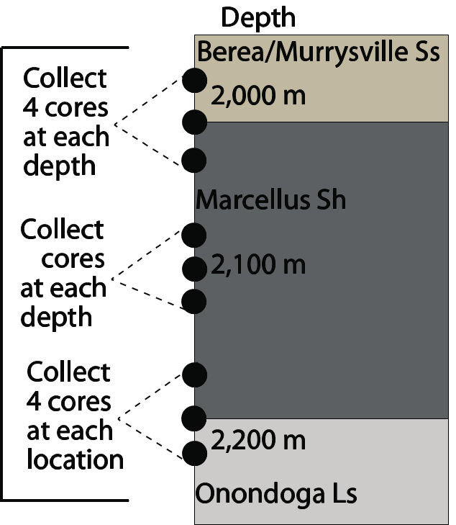
SIDEWALL CORE: OSU-WVU Microbiology Group
Sample Requirement:
36 sidewall cores from 9 target locations based on log data
Formation interfaces
High TOC zones
Fracture zone
Research Questions:
What is extent of life in shale?
How microbial diversity and function relates to geology, mineralogy, geochemistry, & hydrocarbon production?
4
44

Slide 45
Side Wall Cores
10 to UT- Austin Preserved
36 to OSU/WVU
Preserved
10 to LANL
Preserved
2” X 1”
10 to Schlumberger
2.5” X 1.5”
20 to WVU
Confined Stress
4 in
Reserve
10 in
Reserve
45
Notes:
50 - 2.5” X 1.5” cores
50 - 2” X 1” cores

Slide 46
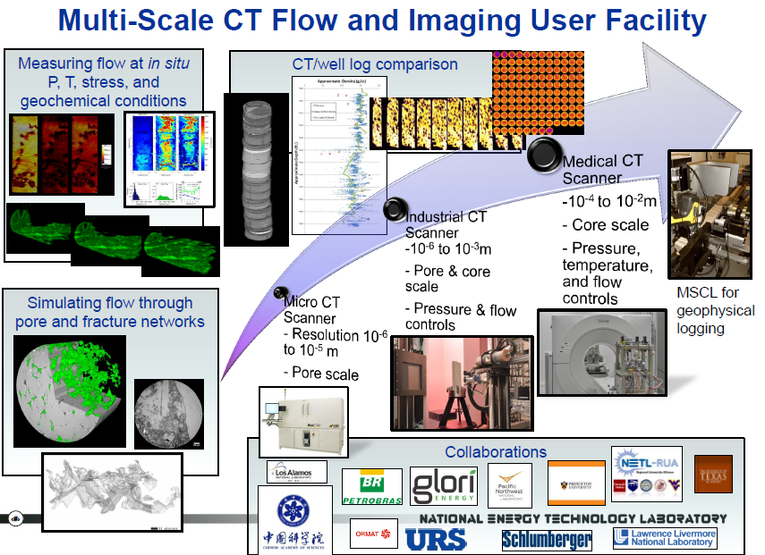
Whole Core
46

Slide 47
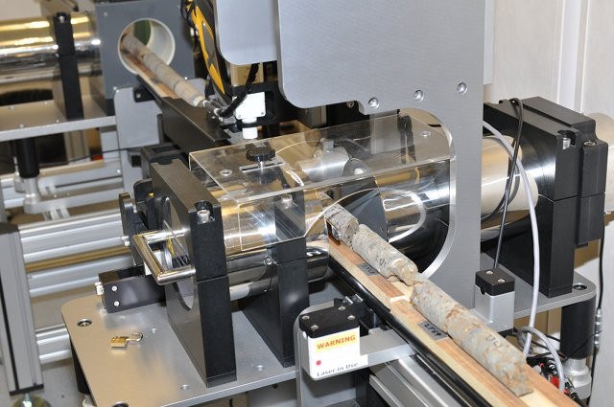
Multi-Sensor Core Logger
The NETL logger is able to rapidly obtain high-resolution data including
  p-wave velocity
  gamma-density
  natural gamma, resistivity
  magnetic susceptibility
  X-ray fluorescence spectrophotometry
on whole-round or split core samples
  Geotek Multi-sensor Core Logging unit
47

Slide 48

WHOLE CORE
Sample Requirement:
50g of sample from the inner part of the vertical core at 1-3 feet sampling interval to be determined based on multisensor core logger (MSCL) and Source Rock Analyzer (SRA) data from NETL
5-10 sub-cores (1.5*4 inch diameter) from vertical core; sampling interval TBD based on MSCL and SRA data
Parameters to be measured:
TOC, δ¹³C, δ¹⁸O, δ¹⁵N, δ³⁴S, Geochemistry, Biomarkers (n-alkanes, pristane, phytanes, hopanes, steranes etc.)
Research Questions:
What are temporal variations in redox, source/type of organic matter, clastic influx?
What are possible variations in fluid-rock interactions?
48

Slide 49
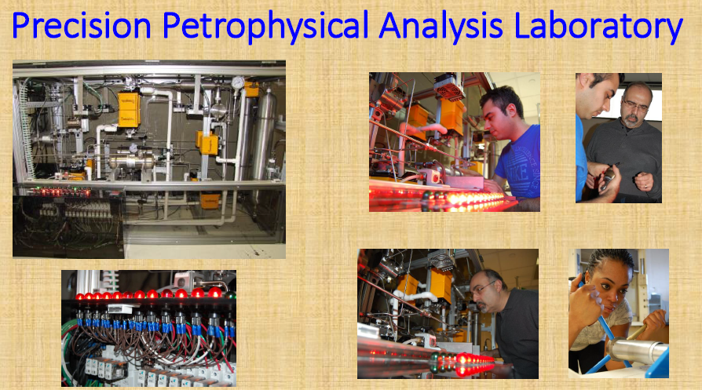
49

Slide 50
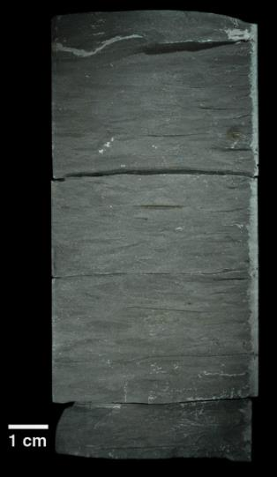
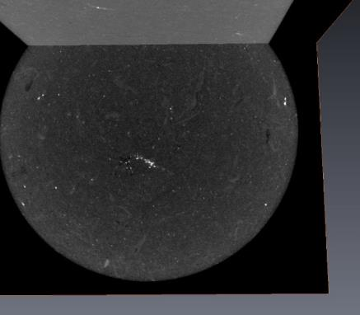

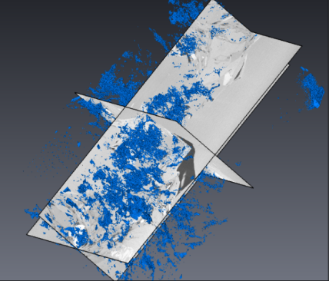
Direct Imaging Across Many Length Scales: Utica Shale
2.5 cm
Kerogen
Pores
Flow modeling
20 μm
20 μm
20 μm
50

Slide 51
Whole Core
Core
Bulk CT
NETL
Multi-Sensor Core Logger
NETL
TOC
NETL
FIB SEM
OSU
XRD
WVU
Split and Plug Core
Commercial Lab
GRI P&P /TOC
Confined Stress
WVU
Core Description
WVU
Gas Adsorption
WVU
PPAL
WVU
Geochem
WVU/OSU
51

Slide 52
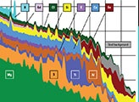
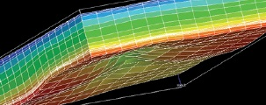
MSEEL
Logging
Tim Carr
52
Notes:
Microseismic/Fiber Optics – Tim Carr substitute for Tom Wilson

Slide 53
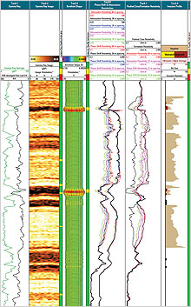
Logging Vertical Well
Full-bore Micro Imager ^{sw}
MDT stress ^{sw}
Dielectric Permittivity ^{sw}
Magnetic Resonance ^{sw}
Reservoir Saturation Tool ^{sw}
Quanta-Geo Imaging
Litho Scanner

Slide 54
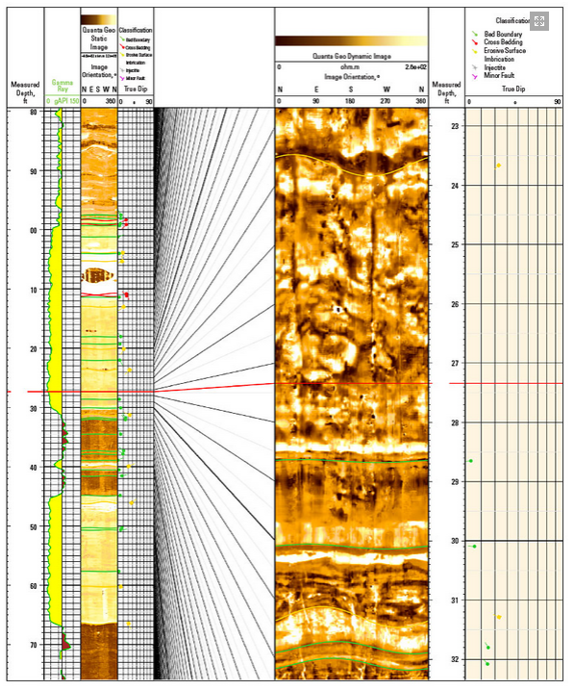
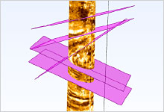
MSEEL
Logging Lateral
Schlumberger
54
Notes:
Drilling-induced fractures are clearly visible as linear or curvilinear subvertical features at approximately N45E and S45W in the expanded-scale dynamic image from Quanta Geo photorealistic reservoir geology service in Track 5. The well’s intersection of this channel sand close to its axis makes many of the scour features appear flattened, which would render them unrecognizable on a conventional OBM-adapted image. The dipping portion of a basal scour interpreted at 31.3 ft suggests that the axis of deposition is N20E–S20W. The scour is filled by a 1-ft-thick lower-energy deposit. Scour features identified higher in the section indicate that paleotransport shifted to a NW–SE axis.

Slide 55
MSEEL
Microseismic & Fiber-OPtics
Tim Carr substitute for Tom Wilson
55
Notes:
Microseismic/Fiber Optics – Tim Carr substitute for Tom Wilson

Slide 56
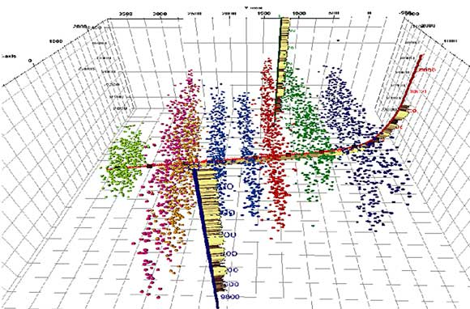
Micro Seismic
56

Slide 57
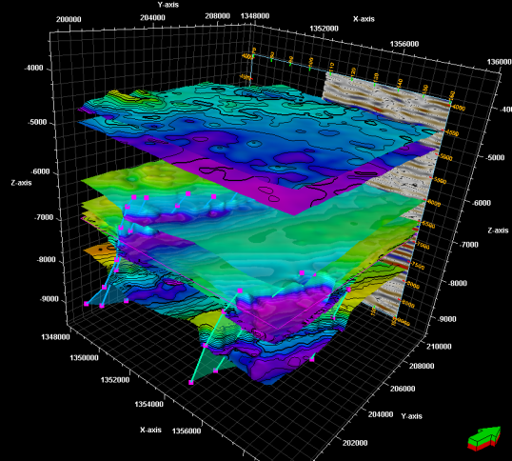
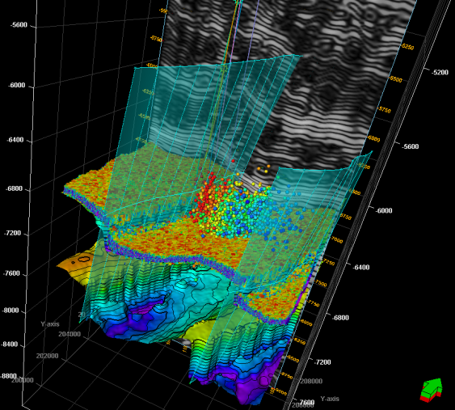
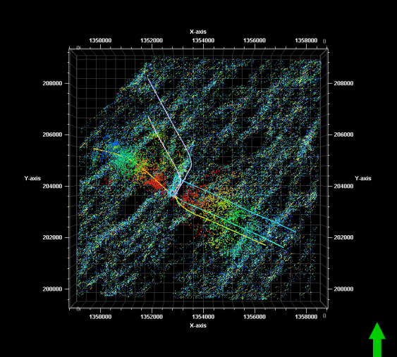
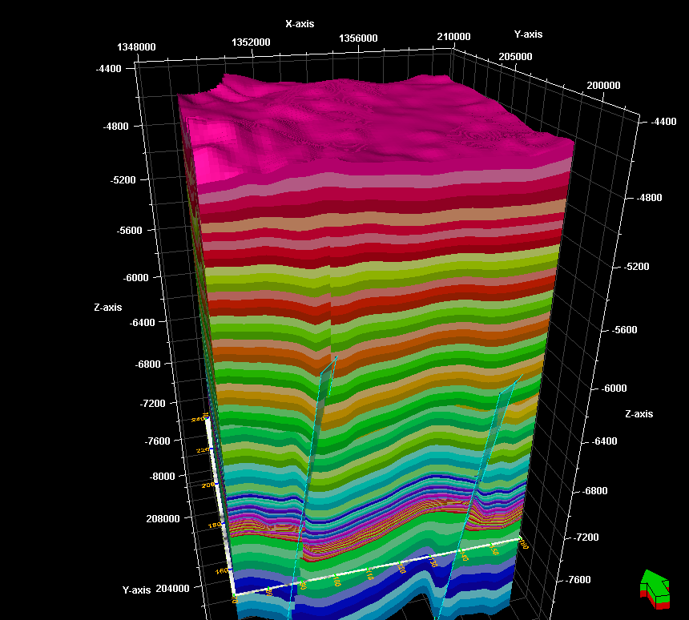
Some microseismic perspectives for the Morgantown MSEEL site
Starting model
Tom Wilson, WVU Geophysics
57

Slide 58
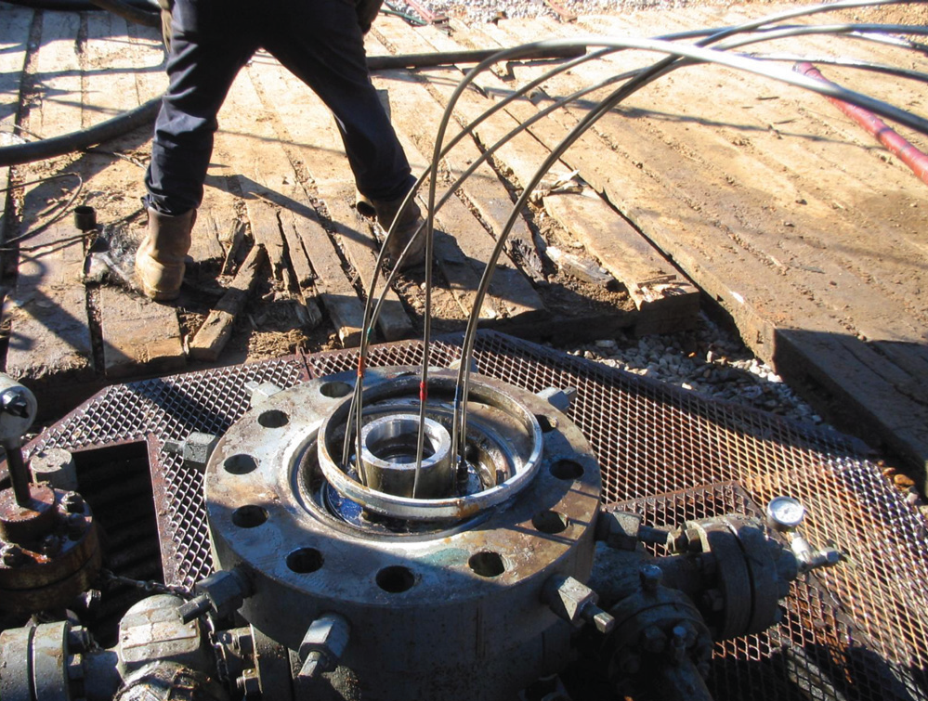
Fiber-Optics
58

Slide 59
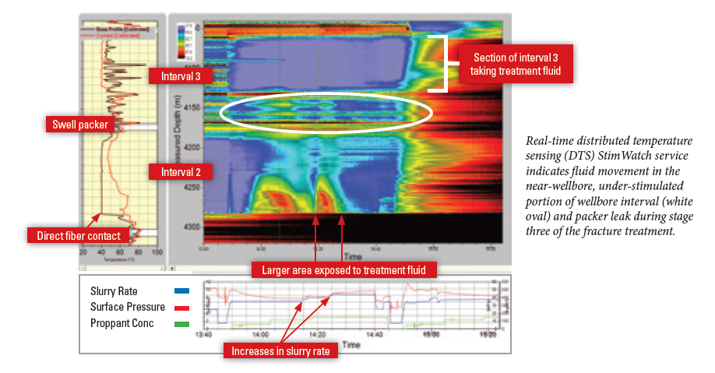
Fiber-Optics
Distributed Temperature Sensing

Slide 60
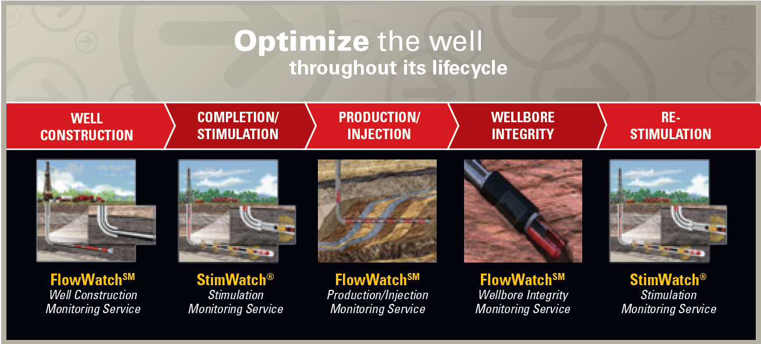
MSEEL
Microseismic and Fiber Optics
Pinnacle
60

Slide 61
MSEEL
Social / Economic Impact
Tim Carr substitute for Randall Jackson
61

Slide 62
Social Impact
Worker Background and Experience:
What is your occupation ________________ [E.g., motor man, scrub hand, etc.]
How many years have you worked in the oil and gas sector? __________
How long have you been working in the Appalachian Area? ___________
On average, how much time do you spend on each job site? __________
In the past year, when on a job, what was your average commute time to the job site? ______ (in minutes)
Local Interactions
When on a job away from home, does staying in the city/town give you a sense of community or feeling of belonging? _____ (yes/no)
When on a job away from home, do you feel the local residents are mostly welcoming, mostly unwelcoming, or neither? ______

Slide 63
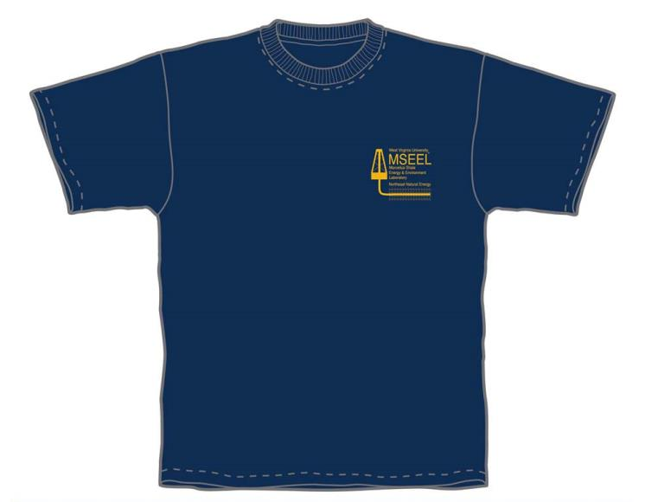

MSEEL
Economic and Societal Impact
63

Slide 64
MSEEL
Drilling & Completion
NNE
64
Notes:
Drilling and Completion – NNE
Social / Economic – Tim Carr substitute for Randall Jackson

Slide 65
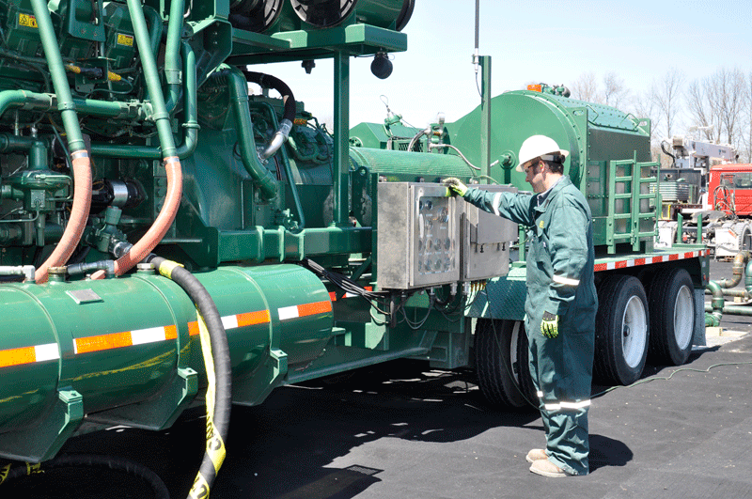
MSEEL
Drilling and Completion Services
FTSI
65
Notes:
David Knapp, district manager for FTSI in Williamsport, Pa., inspects one of the company’s dual-fuel pressure-pumping units in the Marcellus Shale in northeastern Pennsylvania. FTSI partnered with Cabot Oil & Gas this year to test dual-fuel technology on its pressure-pumping equipment.

Slide 66
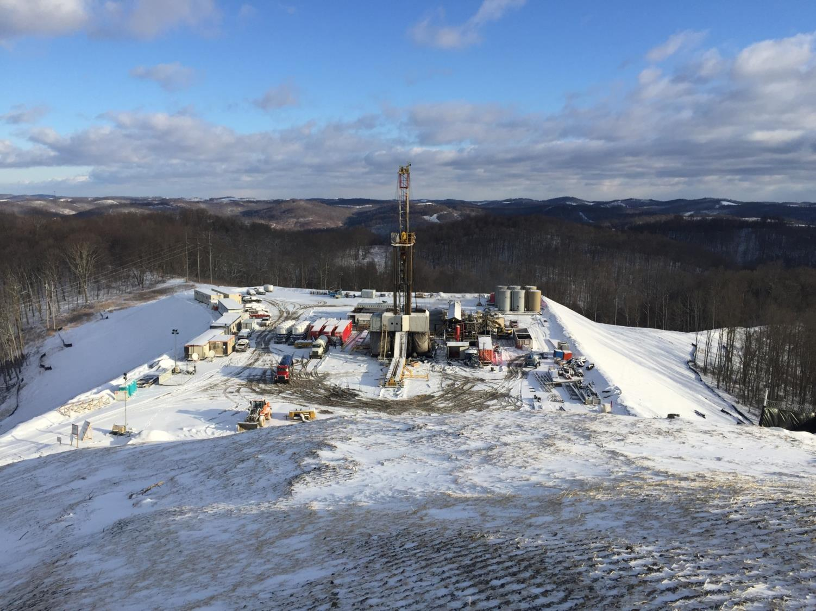
Drilling Services

Slide 67
Patterson 254
Rotary Steerable (Archer)
Synthetic Based Mud (Megadril/Warp)
PDC MDSi613
Solids control (Reuse)

Slide 68
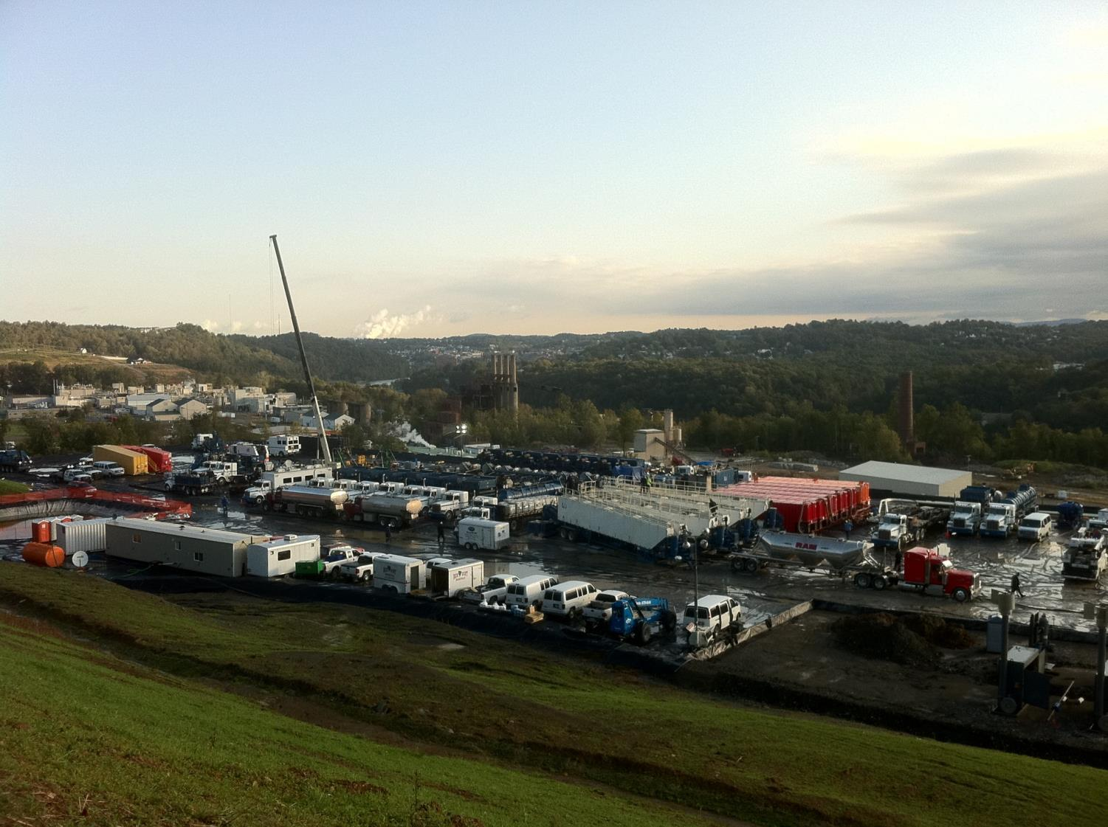
Completions

Slide 69
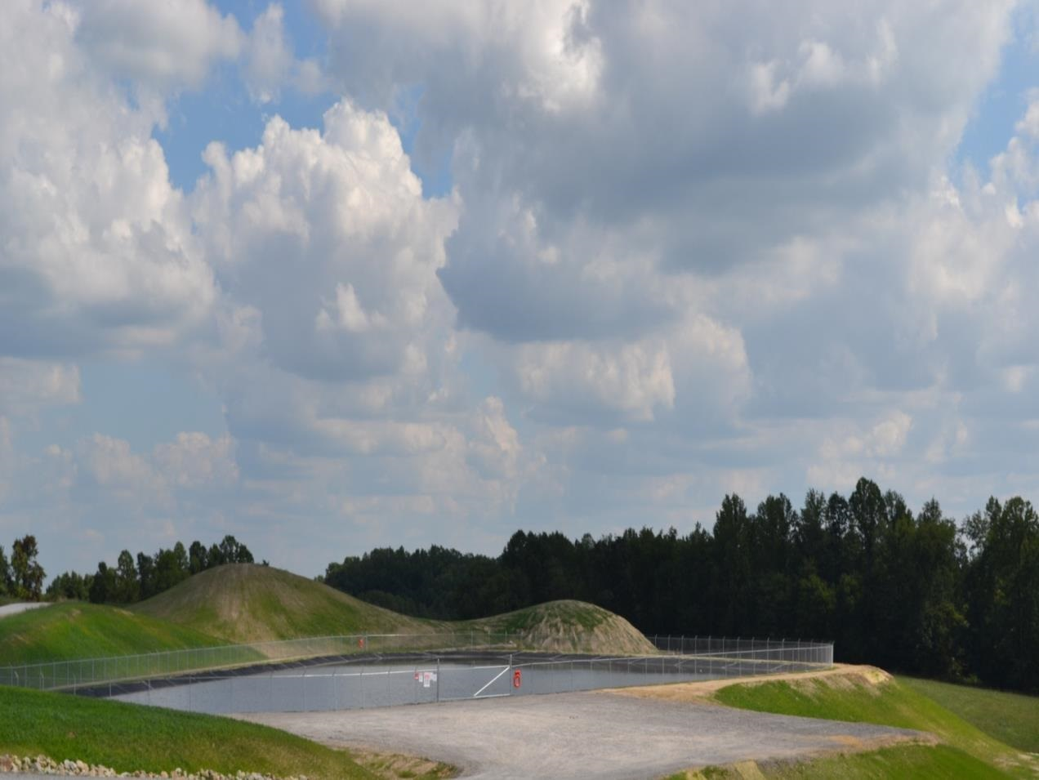

Building Partnerships for Research, Education, and Outreach
Industry
Community
MSEEL
NGOs
Government
Academia
69

