Slide 1
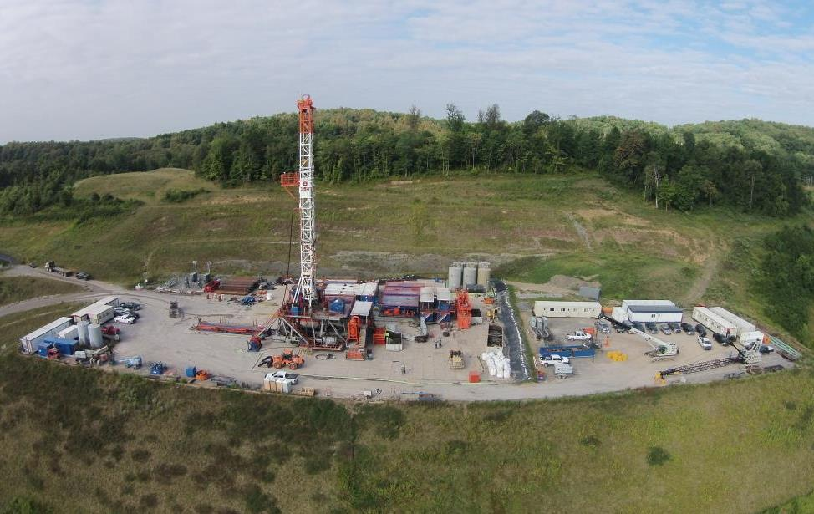





Marcellus Shale Energy and Environment Laboratory
MSEEL
Presented by: Tim Carr
West Virginia University
NACBM– April 12, 2017
Notes:
TITLE: The Marcellus Shale Energy and Environment Laboratory (MSEEL)
The Marcellus Shale Energy and Environment Laboratory (MSEEL) consists of a multidisciplinary and multi-institutional team undertaking integrated geoscience, engineering and social science research in cooperation in cooperation with the operator, Northeast Natural Energy, numerous industrial partners and the National Energy Technology Laboratory of the US Department of Energy. MSEEL consists of two legacy horizontal production wells, two new instrumented horizontal production wells, a vertical pilot bore-hole, a microseismic observation well and surface geophysical and environmental monitoring stations. Production from the new horizontal well began in December 2015. The goal is to develop and validate new knowledge and technology that can improve recovery efficiency and minimize environmental impacts of unconventional resource development. The MSEEL approach is data driven with a platform to store, manage, publish and share very large and diverse (multiple terabyte) datasets among researchers. MSEEL integrates drilling and fracture stimulation operations, geophysical observations, fiber-optic monitoring of high-resolution temporal and spatial flow of injected and produced fluids, and produced gases, mechanical properties logs, microseismic and core data to better to characterize subsurface rock properties, faults and fracture systems. Models at multiple scales are being developed to identify best practices for field implementation, and assess potential methods that could enhance shale gas recovery through experimental and numerical studies integrated with the detailed results of the production wells at the MSEEL site.
We provide several examples that illustrate technologies and approaches that are being developed to store, query, and display and analyze large and diverse data sources and new data types derived from surface and subsurface to design innovative stage spacing and cluster density practices that can be used to optimize recovery efficiency.

Slide 2
88.1%

Slide 3
4.1%

Slide 4
89.4%

Slide 5
13.2%

Slide 7
West Virginia Direct Oil & Gas
Industrial Sector Employment
Industrial Sector
Average Wage $84,123/yr.
Avg. WV $41,655/yr.
2001-2015 – 5,322 Oil & Gas
Jobs Increase to 10,635
62% of the total increase in
private sector employment
Source: Workforce West Virginia, http://http://www.workforcewv.org
Through 2015
Notes:
Average an 8% growth rate in number of jobs over the last 10 years
Accounts for 190% of the growth in total industrial jobs over the last decade
Over the last 10 years we have seen a increase of less than 33,000 jobs, but an increase of 5,950 direct employees in oil and gas
Average wage is 91% more than the average wage for the industrial sector.
Added ~0.5 billion in direct wages were added to WV payrolls in the last decade
http://www.workforcewv.org/

Slide 8

Marcellus Shale Energy and Environment Laboratory
MSEEL
The objective of the Marcellus Shale Energy and Environment Laboratory (MSEEL) is to provide a long-term collaborative field site to develop and validate new knowledge and technology to improve recovery efficiency and minimize environmental implications of unconventional resource development

Slide 9
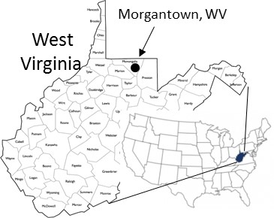
MSEEL Site
Notes:
In the summer months (no heating load) ranges from 2000 mcf to 6000 mcf per day. On a peak winter day the usage is between 35,000 mcf and 45,000 mcf per day.
If you need more precise numbers ‑ let me know.
Hope you are doing well and glad to see Northeast drilling in Morgantown. Not making out so well in Charleston with your legislator from Morgantown
Bob

Slide 10
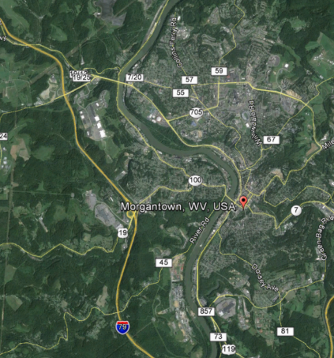
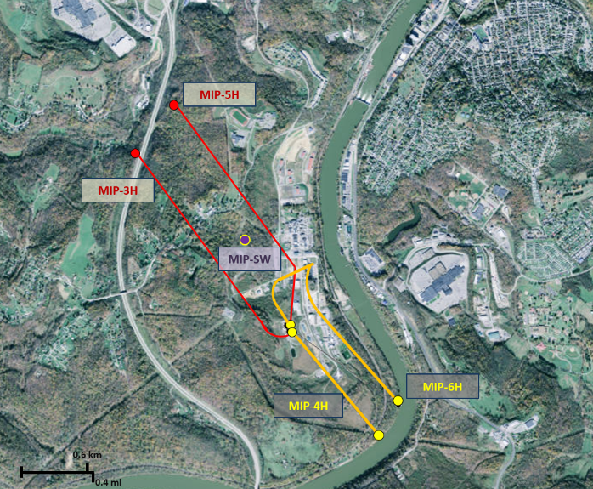
MSEEL Site
WVU
2.5 miles
MSEEL
Notes:
In the summer months (no heating load) ranges from 2000 mcf to 6000 mcf per day. On a peak winter day the usage is between 35,000 mcf and 45,000 mcf per day.
If you need more precise numbers ‑ let me know.
Hope you are doing well and glad to see Northeast drilling in Morgantown. Not making out so well in Charleston with your legislator from Morgantown
Bob

Slide 11
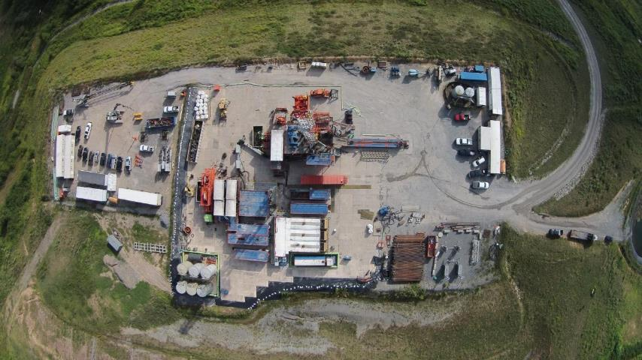
MSEEL
Drilling MIPU 3H and 5H

Slide 12
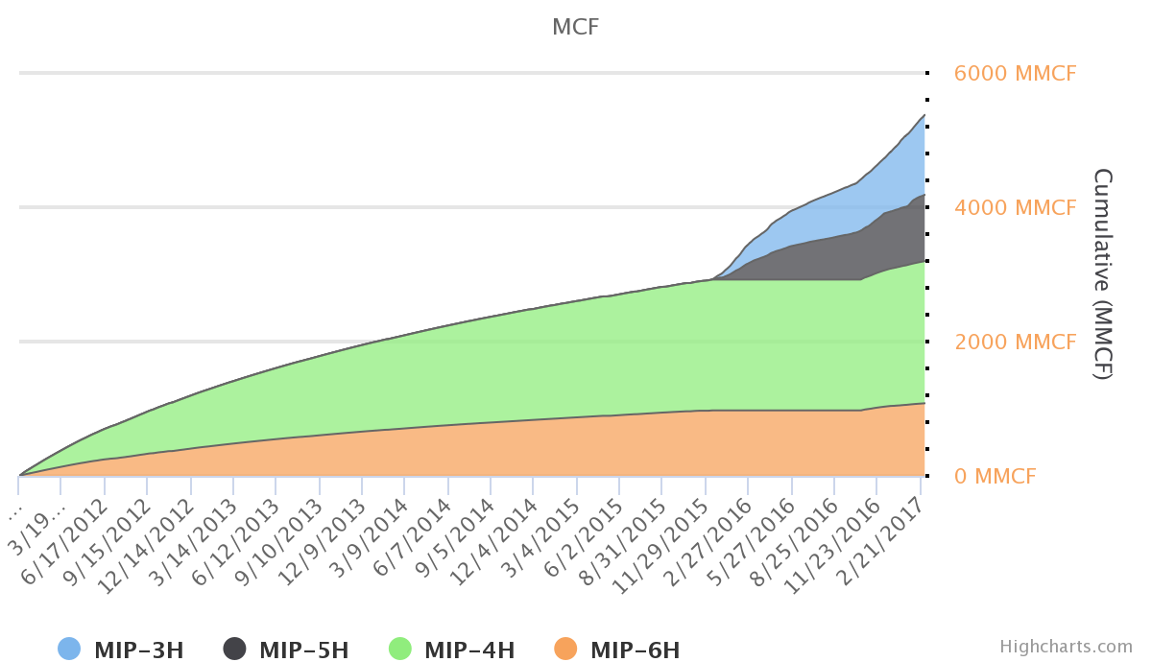
Production Volumes: MIP 3H, 5H, 4H, 6H
Downloaded from MSEEL.ORG

Slide 13
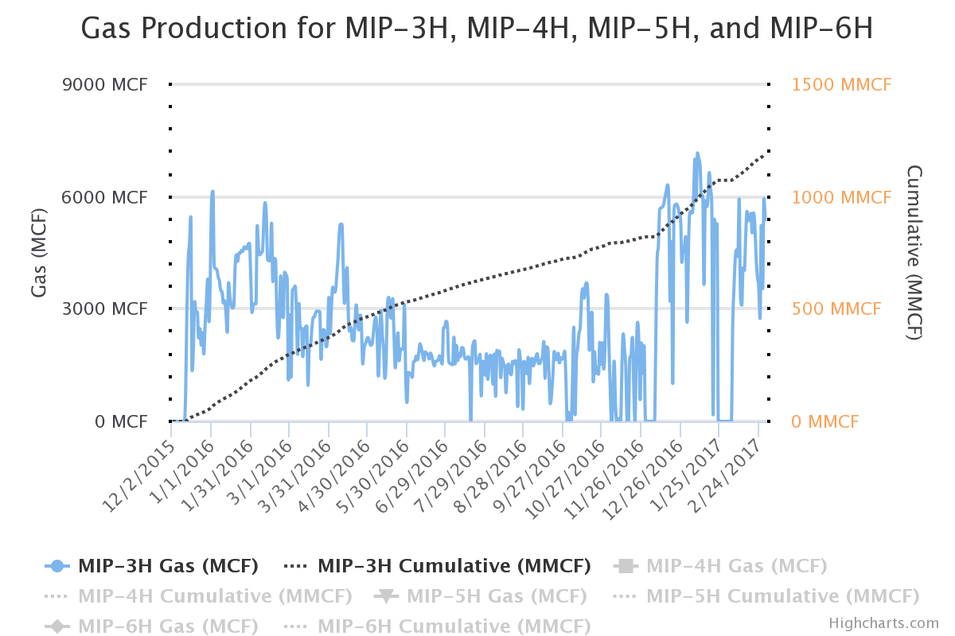
Production Volumes: MIP 3H
Downloaded from MSEEL.ORG

Slide 14
Geosteering MIP-3H
Northeast Natural Energy

Slide 15
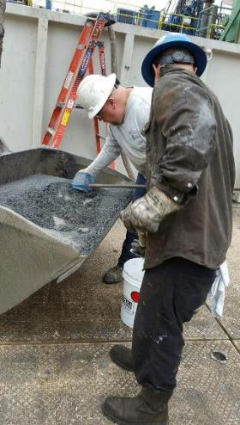
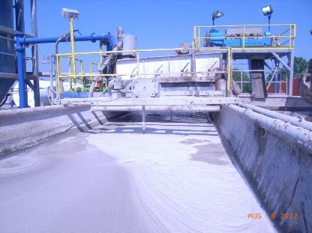
Drilling and Produced Water
Waste Monitoring
Cuttings
Mud

Slide 16
Using ‘Green’ Drilling Mud
NO Parameters Exceeded TCLP
In the Vertical and Horizontal (Marcellus) sections:
  Drill Cuttings ~500-800 tons/well or 25 to 50 truckloads
  Drilling Mud
TCLP organics-no exceedances
TCLP inorganics-no exceedances
TCLP - Toxicity Characteristic Leaching Procedure
Paul Ziemkiewicz – WVU/WVWRI
Notes:
Toxicity characteristic leaching procedure

Slide 17
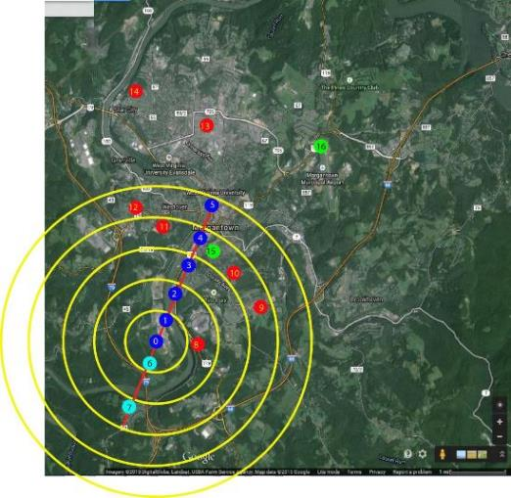
MSEEL Environmental Monitoring
Air Emissions
Michael McCawley – WVU
Derek Johnson – WVU

Slide 18
Radiochemistry: Drill Cuttings
Brazil nuts are about 12 pCi/g
Paul Ziemkiewicz – WVU/WVWRI

Slide 19
Flowback/Produced Water
Extremely saline: 10,000 to 300,000 mg TDS/L
Inorganics: Na, Mg, Ca, Sr, Ba, Cl, Br
Organics: BTEX
NORMs: α,β,²²⁶Ra, ²²⁸Ra,
During flowback cycle
  Discharge drops off rapidly
    Initially 5,000 bpd to 175 bpd after 60 days
  Ion concentrations increase
Most of the contaminants come from the formation-not frac fluid
Paul Ziemkiewicz – WVU/WVWRI

Slide 20
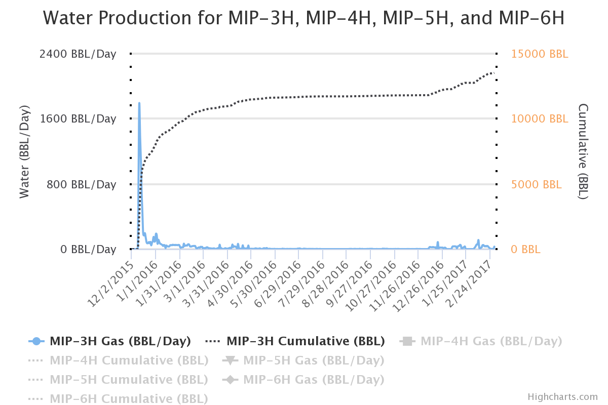
Flowback Volumes: MIP 3H

Slide 21
MSEEL data
Nearly all parameters were higher in flowback than frac fluid
Pink: exceeds drinking water MCL

Slide 22
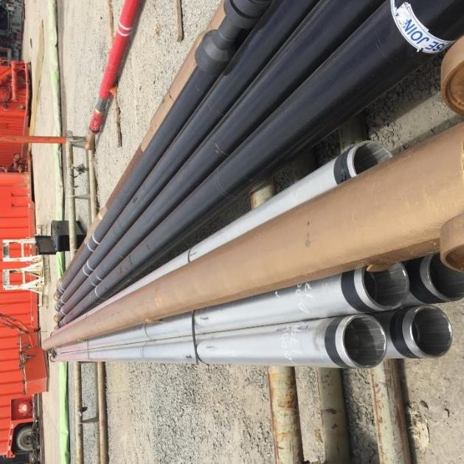
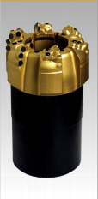
Subsurface Sampling
Retrieved 111’ of a targeted 120’ whole core

Slide 23
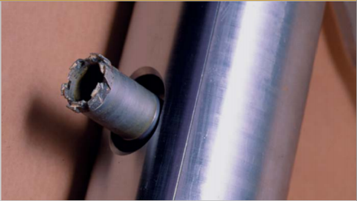
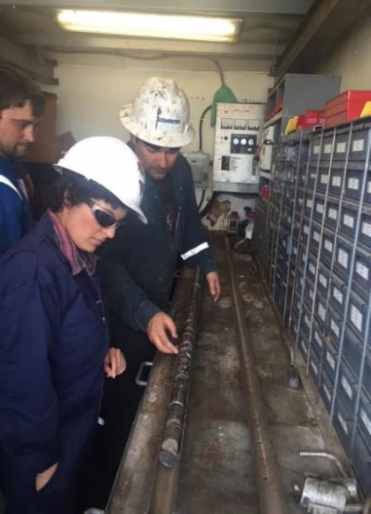
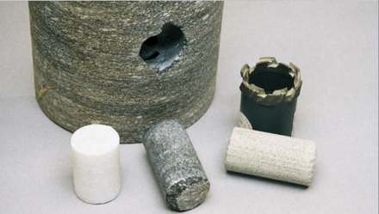
Sidewall Cores
Collected 197 sidewall cores from the SW and 3H well
Shikha Sharma – WVU
Ohio State University

Slide 24
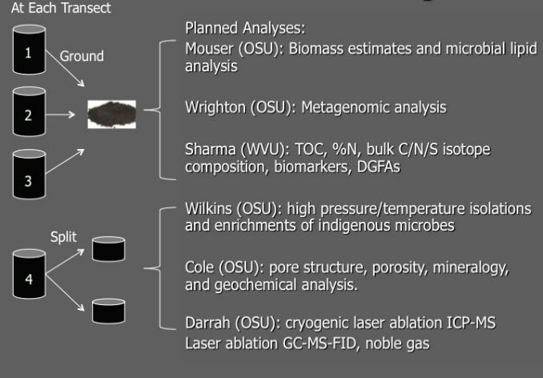
Sidewall Cores Geochemistry
Shikha Sharma – WVU
Ohio State University

Slide 25
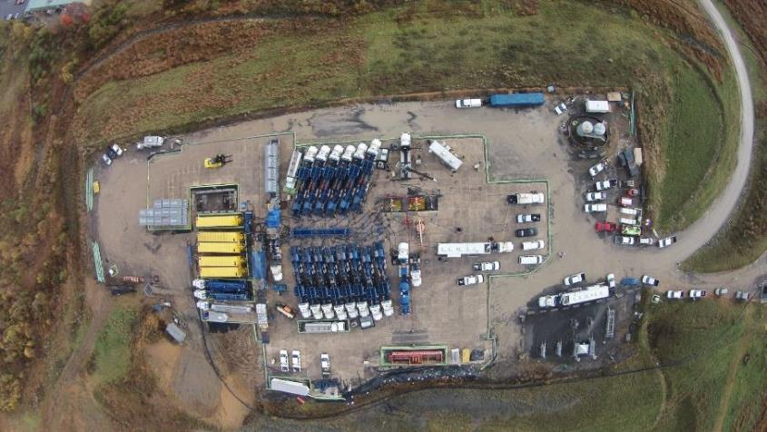
MSEEL
Completion MIPU 3H and 5H

Slide 26
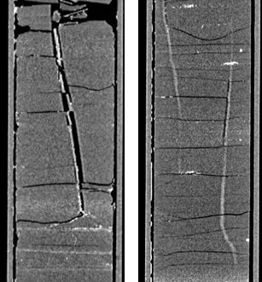
High
Resolution CT
Scanning –
Fractures
Dustin Crandall - NETL

Slide 27
High Definition open hole logs in lateral with synthetic mud
MSEEL - Logging Lateral
Schlumberger
Notes:
Lateral data. Curves are as follows (Bot-Top): gamma ray, borehole image with bedding sinusoids, fracture density with fracture/fault tadpoles, minimum horizontal stress, and cement bond log

Slide 28
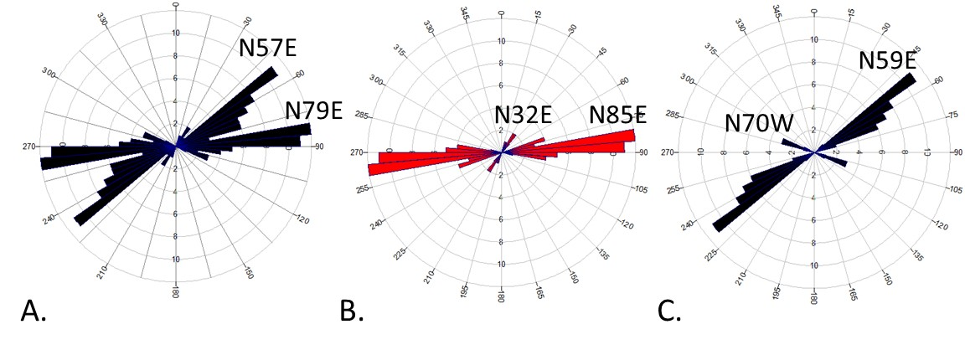
MSEEL - Microseismic
Thomas Wilson - WVU
Notes:
Figure 14: A) Rose diagrams of natural fractures observed in the vertical pilot well (n=91); B) natural fractures likely to rupture in response to hydraulic fracture stimulation (n=48); C) fractures observed in the vertical pilot well unlikely to fail (n=43).

Slide 29
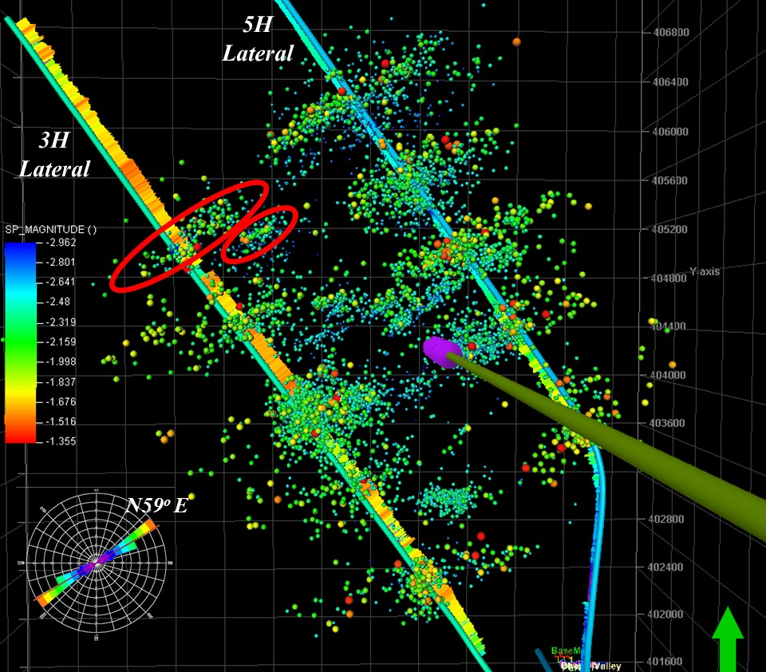
MSEEL - Microseismic
Thomas Wilson - WVU
Notes:
Microseismic events from select stages along the length of the NNE 3H and 5H laterals. Events are colored by magnitude. Rose diagram of microseismic event trends shown lower left.

Slide 30
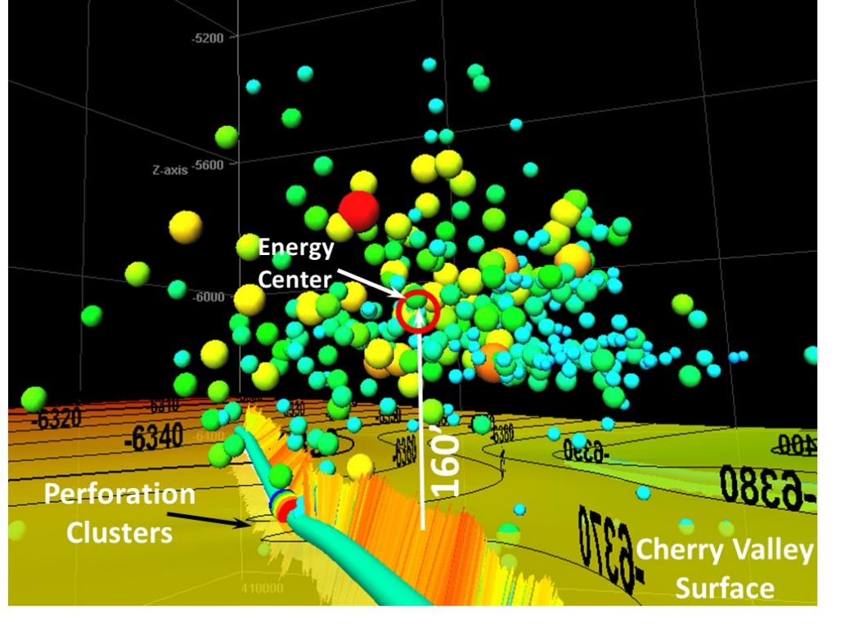
MSEEL - Microseismic
Thomas Wilson - WVU
Notes:
Microseismic events from select stages along the length of the NNE 3H and 5H laterals. Events are colored by magnitude. Rose diagram of microseismic event trends shown lower left.

Slide 31
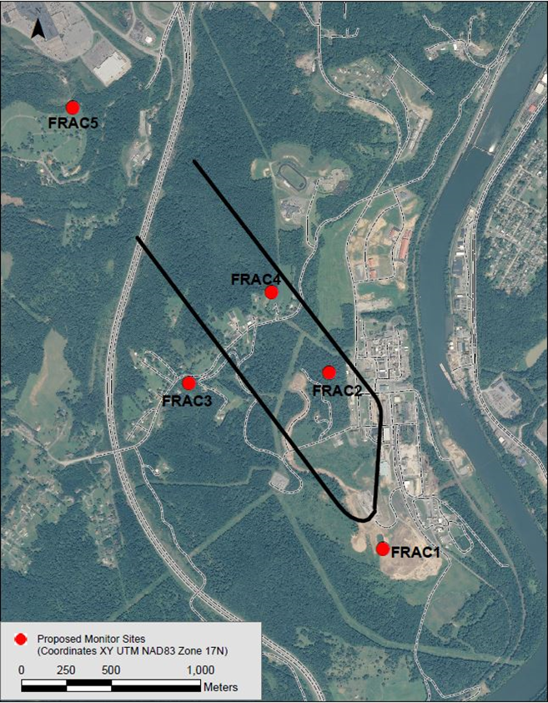
Surface Monitoring of Slow Slip (LPLD)
Kumar at al. NETL

Slide 32
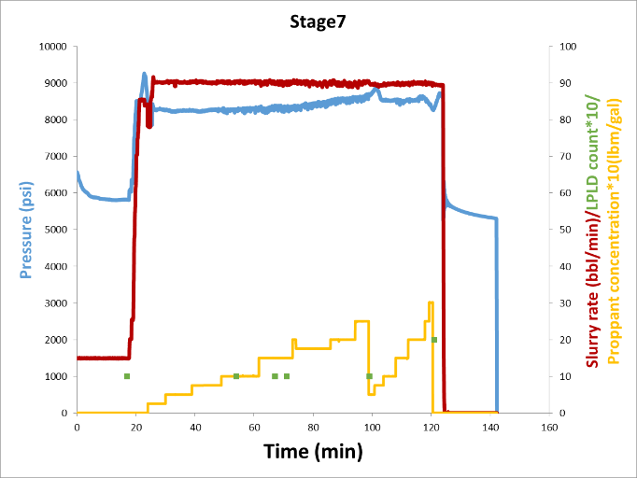
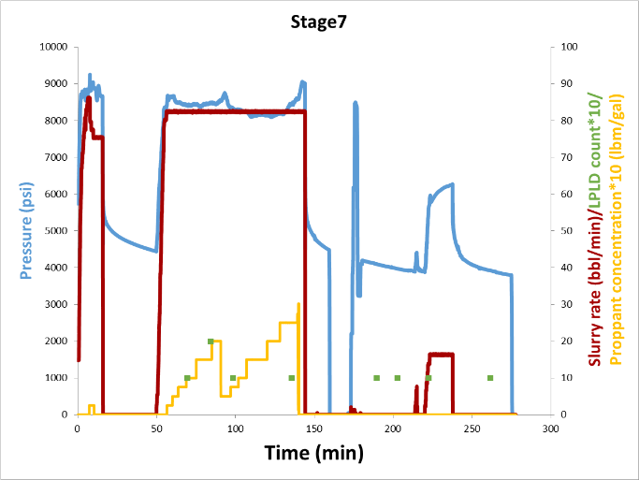
Surface Monitoring of Slow Slip (LPLD)
LPLD and injection parameters
Well 3H
Well 5H
Kumar at al. NETL

Slide 33
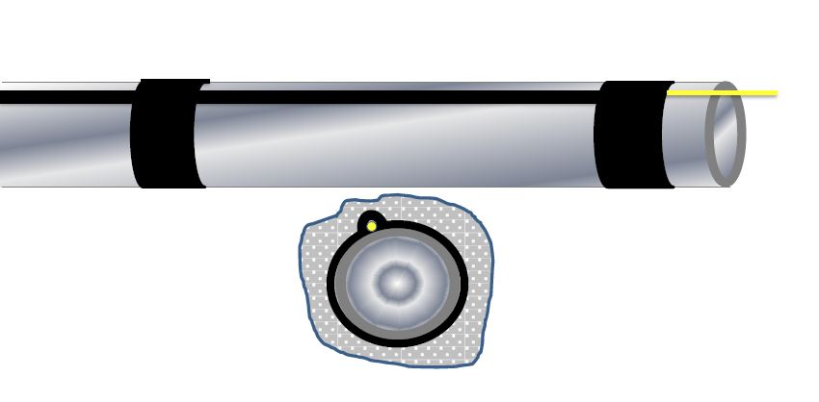
Fiber Optic Installation
Fiber Optic Cable
Blast Shield
Casing
Cement

Slide 34
MIP 3H Completion Design
Section |  | Stage | Cluster Count | Total Shot Count | Shot Density (shot/ft) | Stage Length (ft) | Pump schedule
E | Best Practice Applied | 28 | 4 | 40 | 6 | 191 | A
 |  | 27 | 4 | 40 | 6 | 184 | A
 |  | 26 | 5 | 40 | 6 | 225 | A
 |  | 25 | 5 | 32 | 6 | 231 | A
 |  | 24 | 5 | 30 | 6 | 222 | A
 |  | 23 | 5 | 40 | 6 | 237 | C
 |  | 22 | 5 | 40 | 6 | 220 | C
D | Saphire VEF | 21 | 5 | 40 | 5 | 218 | D
 |  | 20 | 5 | 40 | 5 | 240 | D
C | SLB Engineered Completion | 19 | 4 | 32 | 6 | 180 | C
 |  | 18 | 4 | 32 | 8 | 180 | C
 |  | 17 | 4 | 32 | 6 | 181 | C
 |  | 16 | 4 | 26 | 6 | 178 | C
 |  | 15 | 4 | 26 | 6 | 186 | C
 |  | 14 | 5 | 30 | 6 | 228 | A
 |  | 13 | 5 | 30 | 6 | 230 | A
B | NNE 75% 100-Mesh | 12 | 5 | 50 | 5 | 231 | B
 |  | 11 | 5 | 50 | 5 | 232 | B
 |  | 10 | 5 | 50 | 5 | 227 | B
 |  | 9 | 5 | 50 | 5 | 237 | B
 |  | 8 | 5 | 50 | 5 | 222 | B
 |  | 7 | 5 | 50 | 5 | 224 | B
A | NNE Standard 35% 100-Mesh | 6 | 5 | 50 | 5 | 245 | A
 |  | 5 | 5 | 50 | 5 | 234 | A
 |  | 4 | 5 | 50 | 5 | 230 | A
 |  | 3 | 5 | 50 | 5 | 238 | A
 |  | 2 | 5 | 50 | 5 | 223 | A
 |  | 1 | 5 | 50 | 5 | 233 | A
Northeast Natural Energy

Slide 35
High Definition open hole logs in lateral with synthetic mud
MSEEL - Logging Lateral
Schlumberger
Notes:
Lateral data. Curves are as follows (Bot-Top): gamma ray, minimum horizontal stress, blast protector orientation, fracture density, and treatment stages

Slide 36
Mapped Faults & Fractures
For MIP-3H the number of faults and fractures encountered at each stage is reported as:
Shohreh Amini

Slide 37
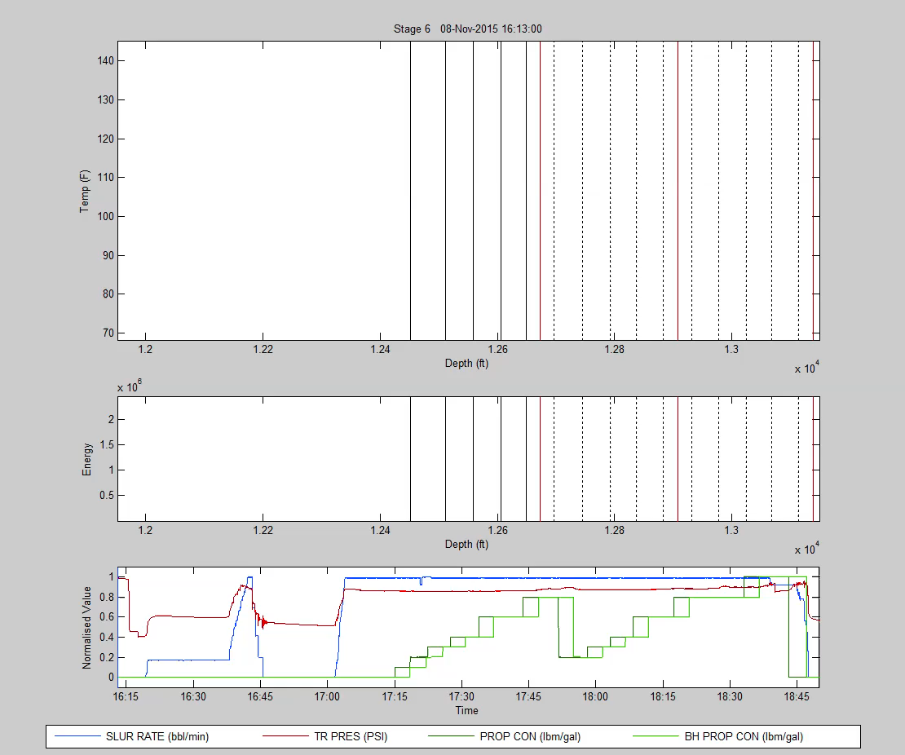
MIP3H - Stage 6: Geometric Completion
Uneven Distribution
Schlumberger

Slide 38
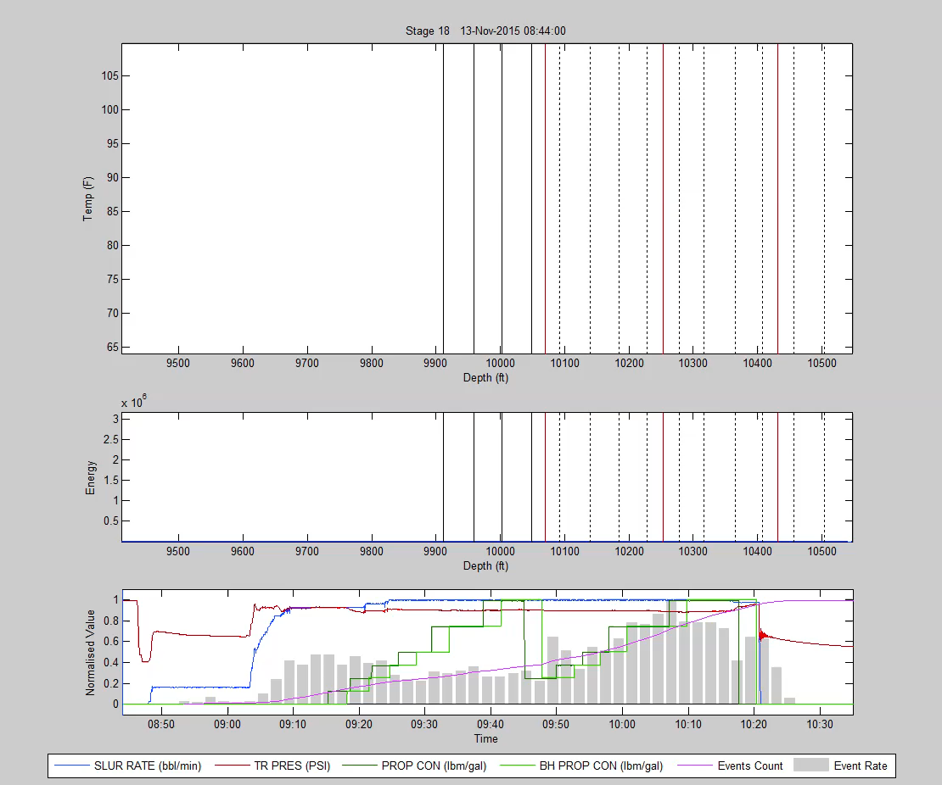
MIP 3H - Stage 18 Even Distribution
Schlumberger

Slide 39
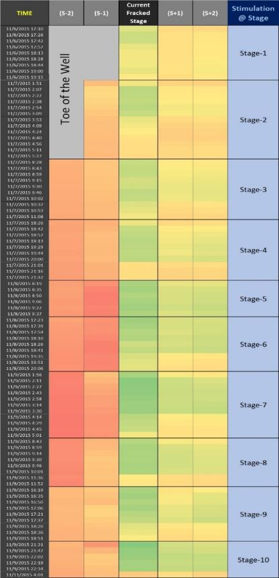
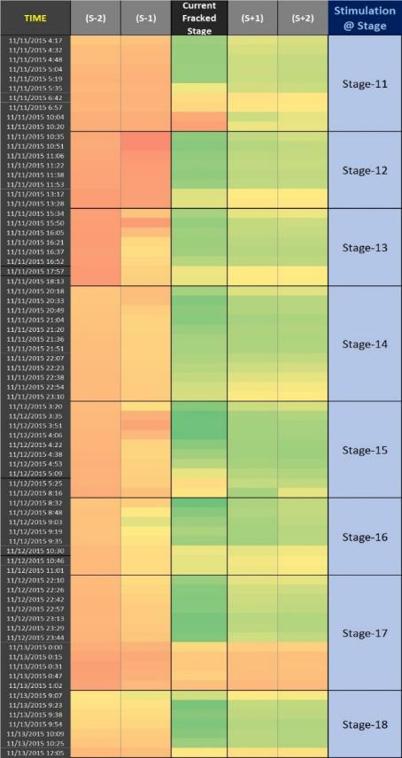
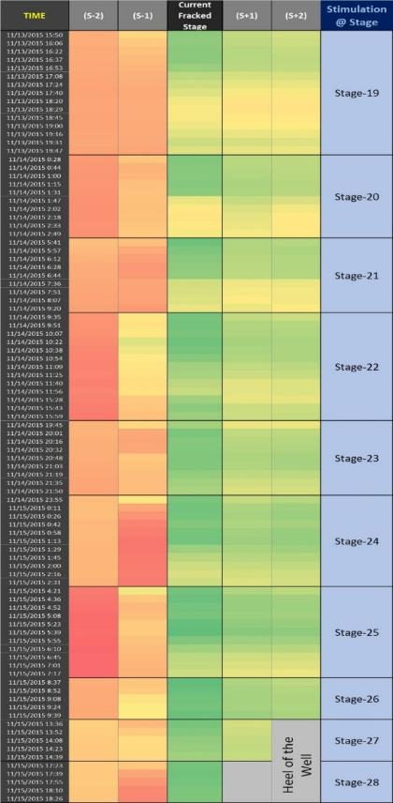
DTS Data
Shohreh Amini

Slide 40
Surface Monitoring of Slow Slip (LPLD)
Synopsis of slow-slip deformation
Sh_{min}
Sh_{max}
Temperature increase
in previous stage(s)
Optimally, critically oriented in stress field, results in “fast” slip with high frequency microseismic expression
Not critically oriented in stress field, results in “slow” slip with low frequency seismic expression typically missed during microseismic monitoring
Adapted from Kumar et al. 2016 and Zoback et al., 2012

Slide 41
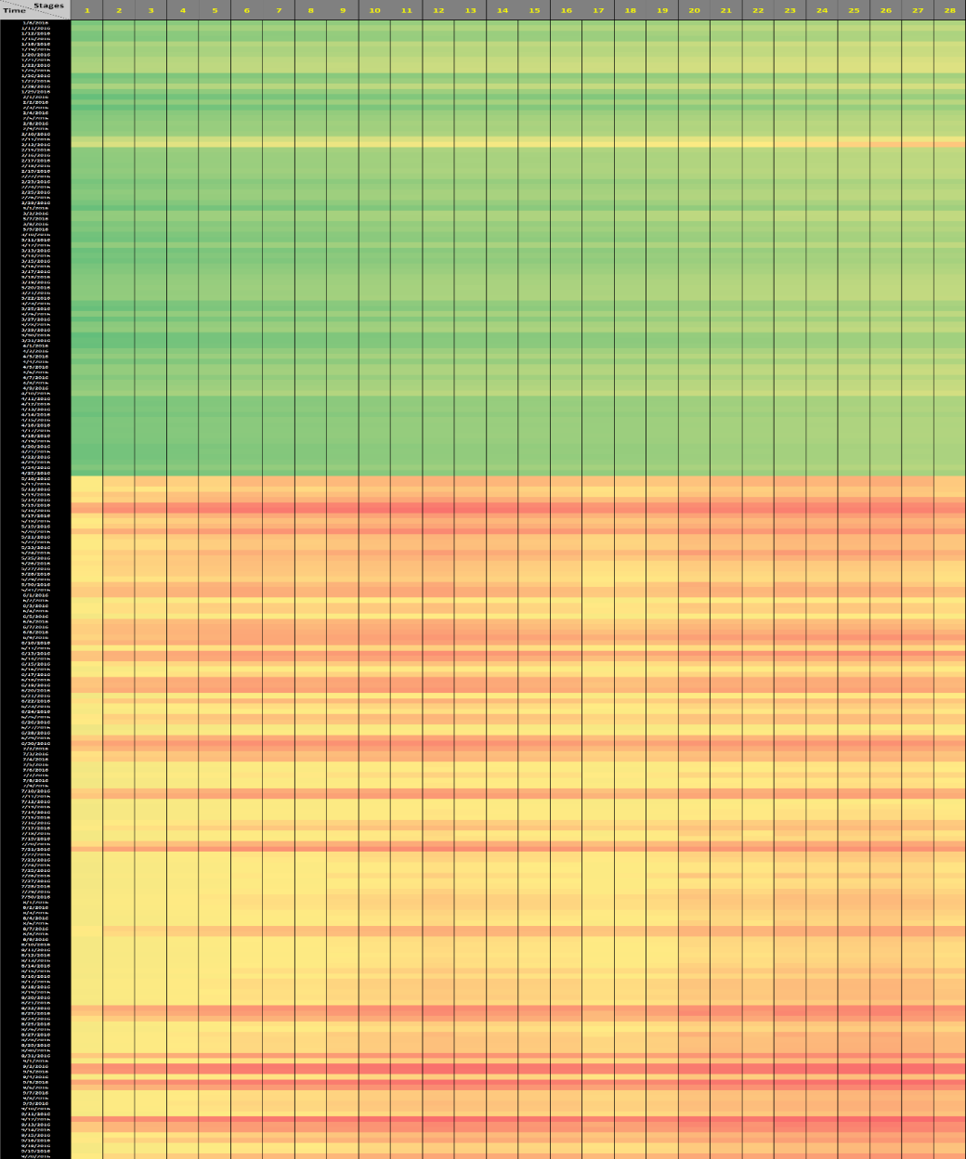
Temperature During Production
Jan 2016
April 2016
May 2016
Sept 2016
Shohreh Amini

Slide 42
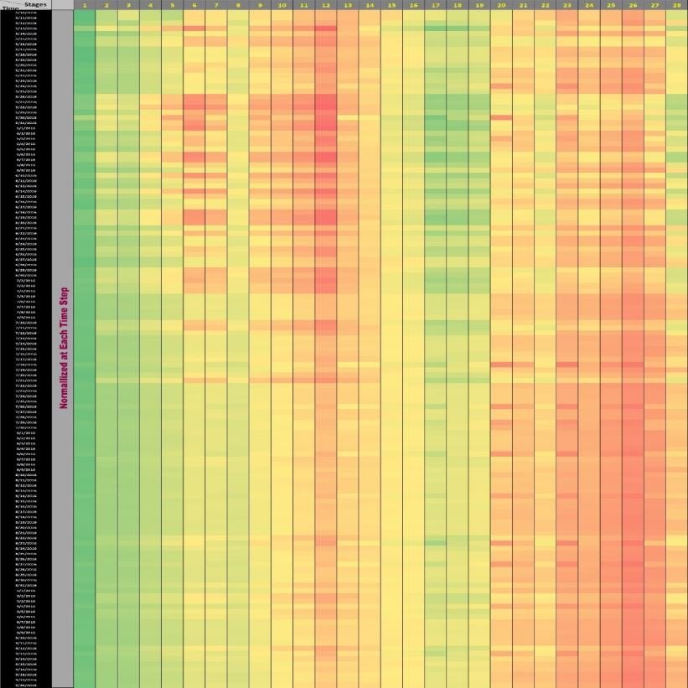
Normalized Temperature During Production
May 2016
Sept 2016
Shohreh Amini

Slide 43
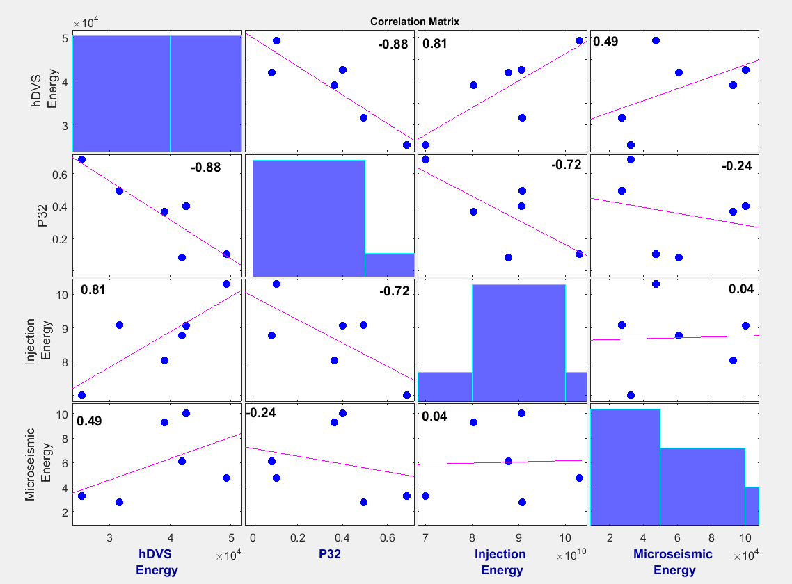
Microseismic, Injection Energy & Fractures
Payam Kavousi et al.

Slide 44
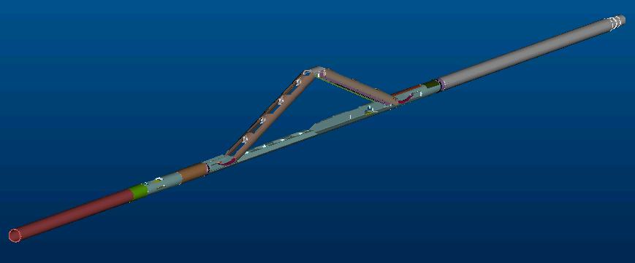
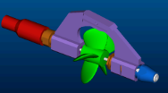


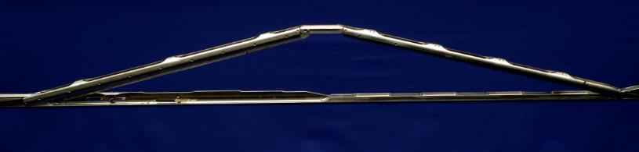
Horizontal Production Logging
Schlumberger Flow Scanner (FSI)
Standard Tool: OD 1-11/16 in.
Five
Mini-Spinners
Six GHOST*
Optical probes
Fluid velocity
Gas holdup
Six DEFT* Electrical probes
Water holdup
Real-Time Acquisition
Standard Assembly: 35.3 ft
Basic Measures: GR, CCL, CALI, DEVI, RB, Pressure, Temperature

Slide 45
MSEEL Plans
Production Logging During Winter
Thin Data Analysis and Prediction
  Drilling Parameters
  Image Processing
Continued Work on Core
  Geochemistry
  Geomechanics
  Pore Networks
Reservoir Modeling
  Nano-Scale to Reservoir Scale
  Geomechanical
  Flow Simulation
Integration Across Disciplines

Slide 46
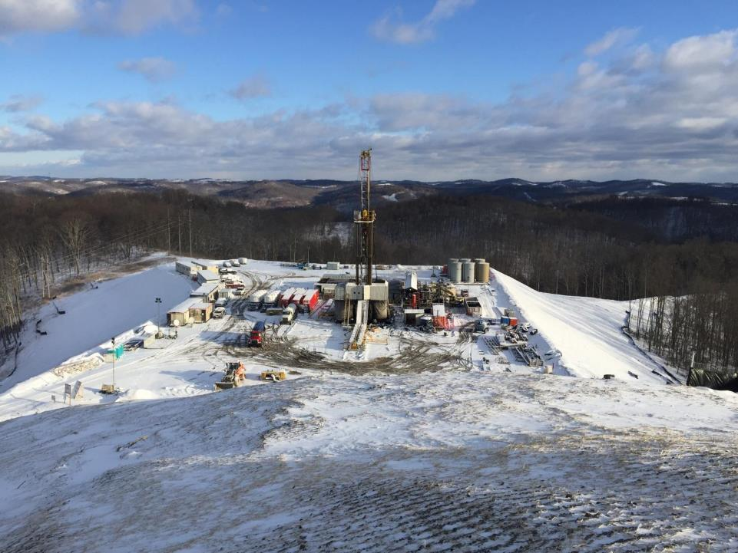

Building Partnerships for Research, Education, and Outreach
Industry
MSEEL
Community
Academia
Government
Tim Carr
Phone: 304.293.9660
Email: tim.carr@mail.wvu.edu

