Slide 1


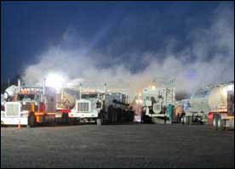
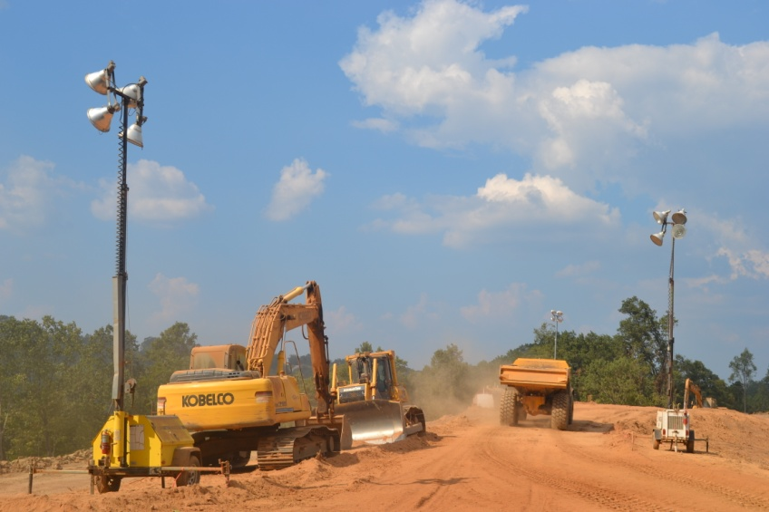
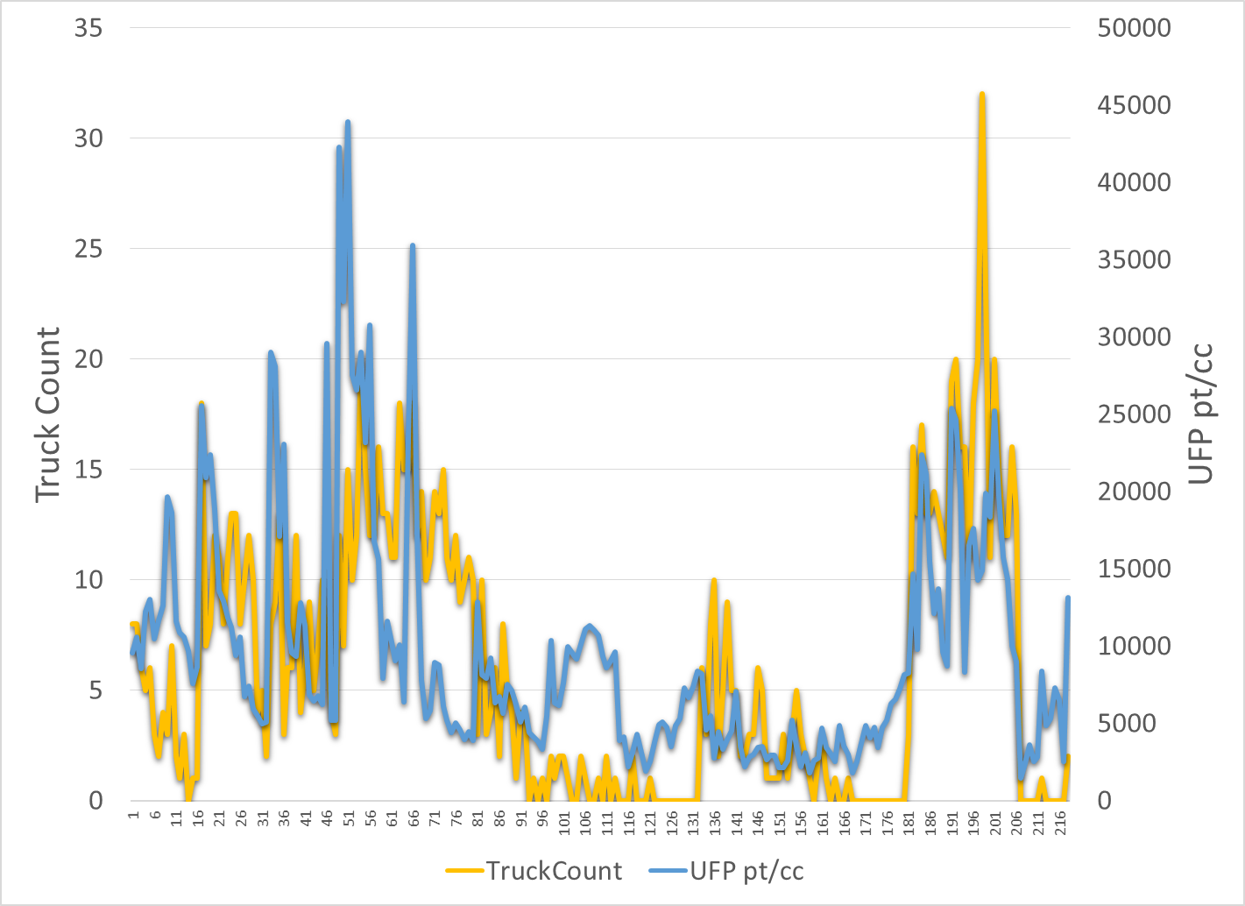
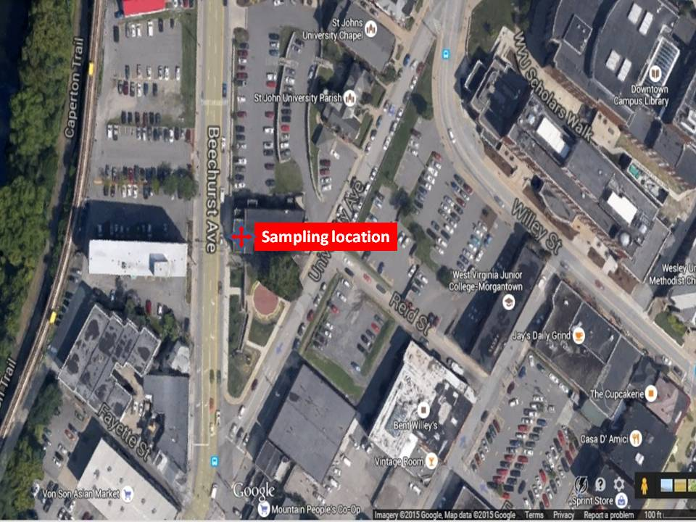
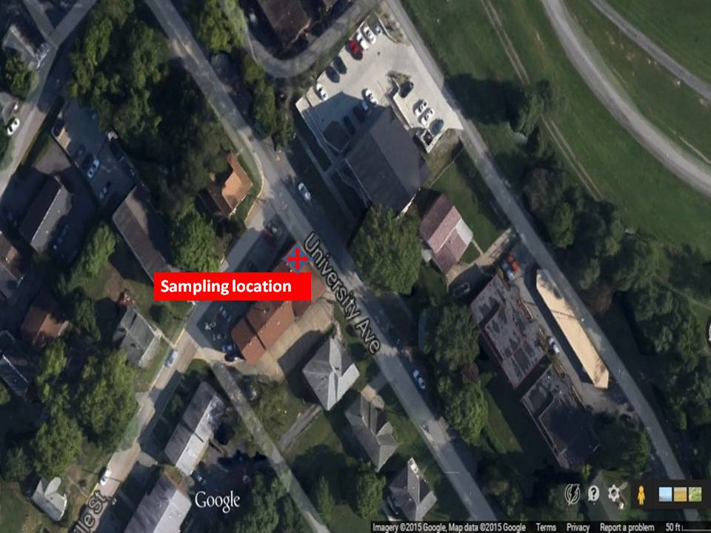
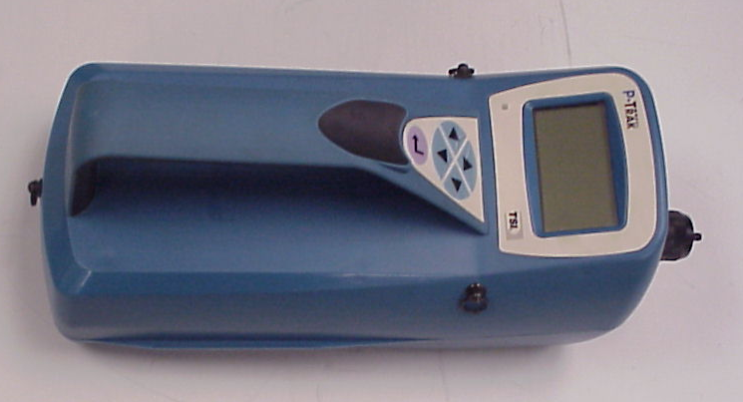
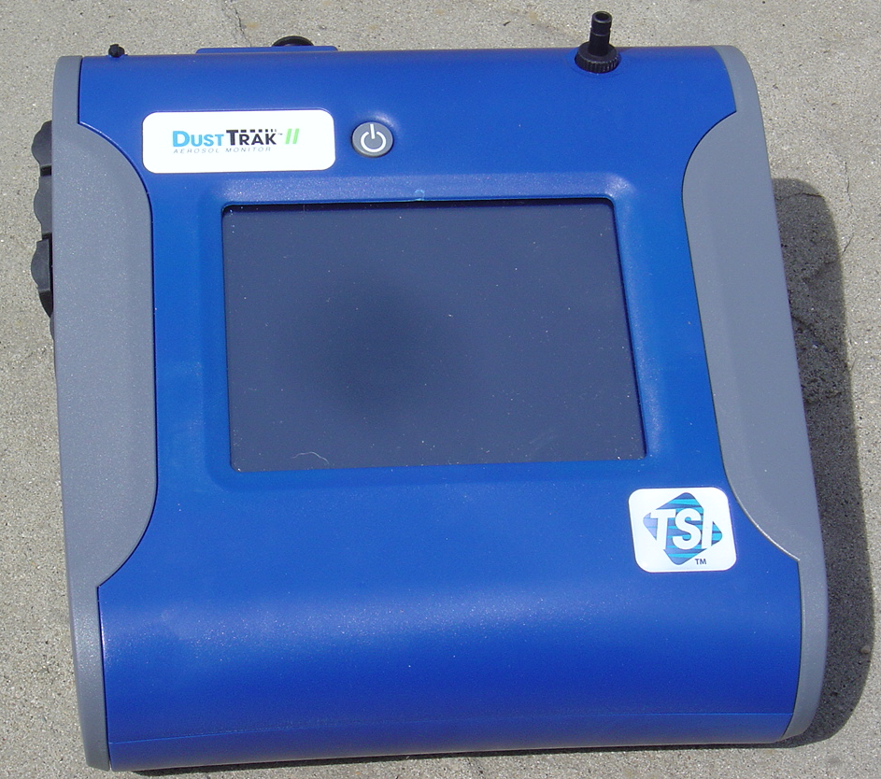
Diesel Traffic Volume Correlates With Ultrafine Particle Concentrations But Not PM2.5
Sunil Moon, MS and Michael McCawley, PhD
West Virginia University, Morgantown WV
Traffic Counts:
Traffic volume, defined as number of vehicles passing per minute, was continuously monitored by a video recorder. Light-duty vehicles, were tallied as “Car Count”, implying non-diesel engines, whereas multi-axle trucks/buses were tallied as “Truck Count”, implying diesel engines.
Results
Discussion
 | Mean | Median | Min. | Max. | Std. Dev.
Site 1
PM 2.5 (ug/m³) | 9.93 | 7.6 | 1.33 | 48.87 | 6.65
UFP (#/cc) | 9613.8 | 7309.43 | 1463.33 | 43937.13 | 7645.53
Car #/15 min. | 293.82 | 295.5 | 132 | 2296 | 146.87
Truck #/15 min. | 6.01 | 4 | 0 | 32 | 6.144
Site 2
PM 2.5 (ug/m³) | 13.15 | 10.47 | 3 | 50.47 | 9.19
UFP (#/cc) | 9250.21 | 6296.7 | 1827.67 | 41649.27 | 7043.12
Car #/15 min. | 170.95 | 158 | 88 | 317 | 47.6
Truck #/15 min. | 1.37 | 1 | 0 | 4 | 1.14
Since UFP concentrations are strongly affected by TruckCount but not CarCount, this suggests that UFP but not PM2.5 is associated with diesel engine exhaust. Rain also had moderately significant effects (p < 0.01) suggesting that rain is efficient at removing UFP from the air. The high significance level of the overall F-tests of the models suggests that the set of independent variables was fairly sufficient for describing the measured PM2.5 and UFP concentration. However, it is likely that some important variables were overlooked or not measured as a result of equipment limitations or manual recording used for monitoring traffic. Many factors could affect the concentration levels, including percentage of heavy duty and light-duty trucks on the roadway, and distance to curb. UFPs are not currently regulated by the EPA but some studies have indicated that they may still be associated with health responses such as existing asthma and cardiovascular exacerbation.
ABSTRACT
Diesel engines are used for a number of tasks at drill sites and have been considered a major source of particulate with a size range that may encompass both fine (PM2.5) and ultrafine (UFP <0.1μm) particles. A study was conducted to characterize diesel exhaust impacts on near-road air quality to determine the best methods to monitor and, in turn, mitigate particulate concentrations. Concentrations of PM2.5 and UFP were monitored along with a concurrent recording of traffic volume. In addition, environmental parameters, including wind speed and precipitation were recorded. Multivariate regression analysis was done to find the correlation between concentrations (PM2.5 and UFP), traffic count and environmental parameters. UFP concentrations were highly significant (p<0.01%) with the wind speed and truck count indicating UFP concentrations were due to diesel emissions. Concentrations of PM2.5, however, were not correlated with diesel engine emissions.
Near-road Sampling Sites
Site 1
Site 1 (high volume)
Site 2 (medium volume)
Two near-road sites in downtown Morgantown, WV (population 60-70,000) were used for sampling to provide a higher volume of traffic flow to shorten the time required for obtaining sufficient data to determine the effect of the diesel engine particulate exhaust output. This was assumed to be a reasonable surrogate for a fewer number of engines run for a longer period of time in a fixed area like a well pad. It is also not unlike increased traffic flow that may be experienced on roads leading to a well pad. (The state of Maryland estimated 10,000 truck trips per pad as an average for traffic flow.) Measurements for all the sites were performed about 5 m in height above the street level.
Log(UFP)
Source | df | Sum Sq | Mean Sq | F-ratio | Probability
Intercept | 1 | 5499.5 | 5499.5 | 98841 | < 0.01
Truck Count | 1 | 1.09208 | 1.09208 | 19.628 | < 0.01
Car Count | 1 | 0.193503 | 0.193503 | 3.4778 | 0.063
Rain | 1 | 0.453153 | 0.453153 | 8.1444 | < 0.01
Windspeed | 2 | 4.45465 | 2.22732 | 40.031 | < 0.01
Day of week | 6 | 0.522314 | 0.0870523 | 1.5646 | 0.157
Location (Loc) | 1 | 0.267329 | 0.267329 | 4.8046 | 0.029
TruckCount*Loc | 1 | 0.163731 | 0.163731 | 2.9427 | 0.087
Error | 354 | 19.6966 | 0.0556401
Total | 367 | 34.2961
 | R² = | 0.426
Conclusions
Diesel traffic volume is significantly (p < 0.01) associated with UFP concentration and is therefore a surrogate for diesel exhaust emissions.
Diesel traffic volume is not significantly ( p > 0.05) associated with PM2.5 and does not appear to be attributable as a distinguishable source of PM2.5 in the presence of automotive (non-diesel) traffic.
Controlling diesel traffic volume should result in control of emissions of UFPs, which may ameliorate some exacerbation of disease.
Control of diesel traffic to well pad sites should be investigated to determine the efficacy of this approach for reducing diesel exhaust concentrations.
METHODS
Dust Track (PM2.5)
P Track (UFP)
Particulate Sampling:
PM_{2.5} was measured with a TSI DustTrak Model 8532 aerosol monitor using a size-selective nozzle which provided real-time aerosol mass concentrations in the range of 0.001-100 mg/m³ for particles ranging in size from 0.5 to 10 µm. UFP counts at 10-second resolution were made using a TSI Model 8525 P-track Ultrafine Particle Counter for particles in the size range 0.02–0.5 µm. Particle concentration data at each site were collected as 15 minute period averages, and matched to the corresponding vehicle counts. Environmental data (wind speed and precipitation) were recorded manually during sampling.
Log(PM2.5)
Statistical Methods:
Data were collected as 15 minute period averages and analyzed by a general linear model ANOVA procedure with 368 data points in each regression with PM2.5 and UFP concentration each as the dependent variable. Independent variables included location, car and truck counts, as well as categorical parameters for rain, wind speed and time of day.
Source | df | Sums of Squares | Mean Square | F-ratio | Probability
Intercept | 1 | 1535.02 | 1535.02 | 36536 | < 0.01
Truck Count | 1 | 0.035084 | 0.035084 | 0.83505 | 0.36
Car Count | 1 | 1.19301 | 1.19301 | 28.395 | < 0.01
Rain | 1 | 0.535262 | 0.535262 | 12.74 | < 0.01
Windspeed | 2 | 0.251179 | 0.125589 | 2.9892 | 0.0516
Day of week | 6 | 3.61243 | 0.602072 | 14.33 | < 0.01
Location | 1 | 0.001414 | 0.001414 | 0.033648 | 0.85
TruckCount*Loc | 1 | 0.011767 | 0.011767 | 0.28008 | 0.60
Error | 354 | 14.8731 | 0.042014
Total | 367 | 30.0839
 | R² = | 0.506
Acknowledgements: Funding for the air sampling equipment and for support of M. McCawley provided by EFD and the US Department of Energy, NETL. Review of this work was provided by Drs. Steven Guffey and Kevin He, WVU Department of Industrial and Management Systems Engineering.

