Slide 1







Marcellus Shale Energy and Environment Laboratory
MSEEL
Tim Carr
Phone: 304.293.9660
Email: tim.carr@mail.wvu.edu

Slide 2
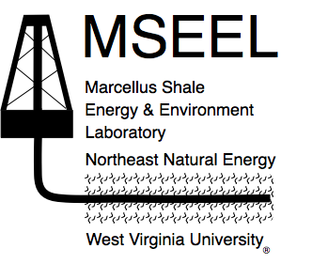
Marcellus Shale Energy and Environment Laboratory
MSEEL
The objective of the Marcellus Shale Energy and Environment Laboratory (MSEEL) is to provide a long-term collaborative field site to develop and validate new knowledge and technology to improve recovery efficiency and minimize environmental implications of unconventional resource development
2

Slide 3
MSEEL Vision
Demonstrate the Best Approach to Drill, Complete and Produce a New Horizontal Well That Minimizes Any Environmental/Social Costs While Maximizing Economic Productivity
Monitor and Document Impacts in a Controlled Environment
  Greenhouse Gas Emissions
  Local Air Pollution
  Water Supply and Quality
  Noise and Activity
  Societal Impacts
Develop New Technologies
  Microseismic Monitoring
  Production Monitoring
  Advanced Logging
Develop New Scientific and Engineering Approaches to Apply to Multi-disciplinary and Multi-institutional Natural Resource Studies
3

Slide 4
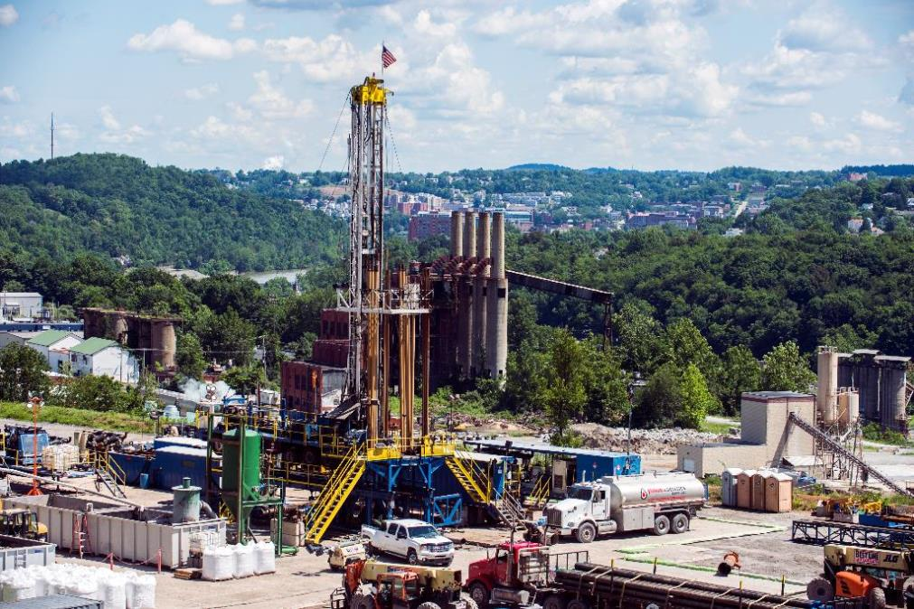
Marcellus Shale Energy And Environment Laboratory - MSEEL
The
Good
4

Slide 5
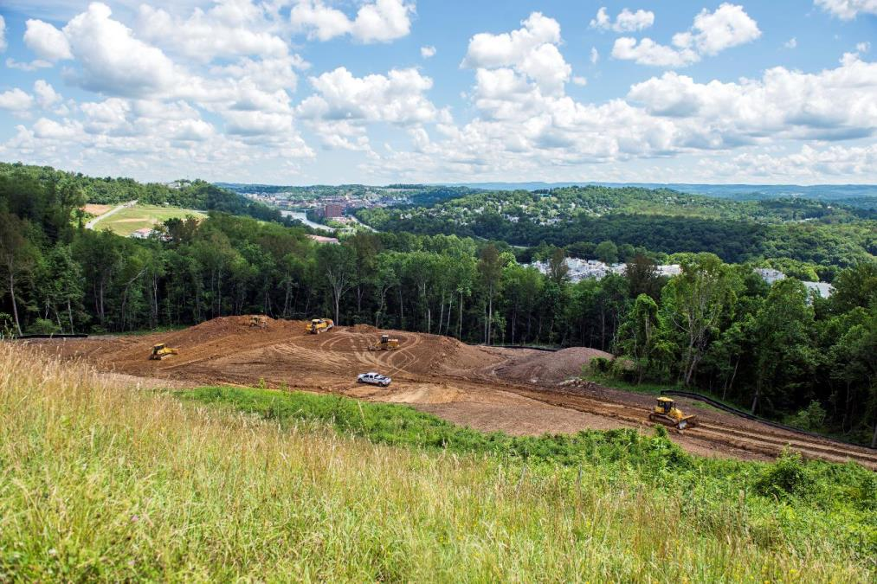
Marcellus Shale Energy And Environment Laboratory - MSEEL
The
Good
5

Slide 6
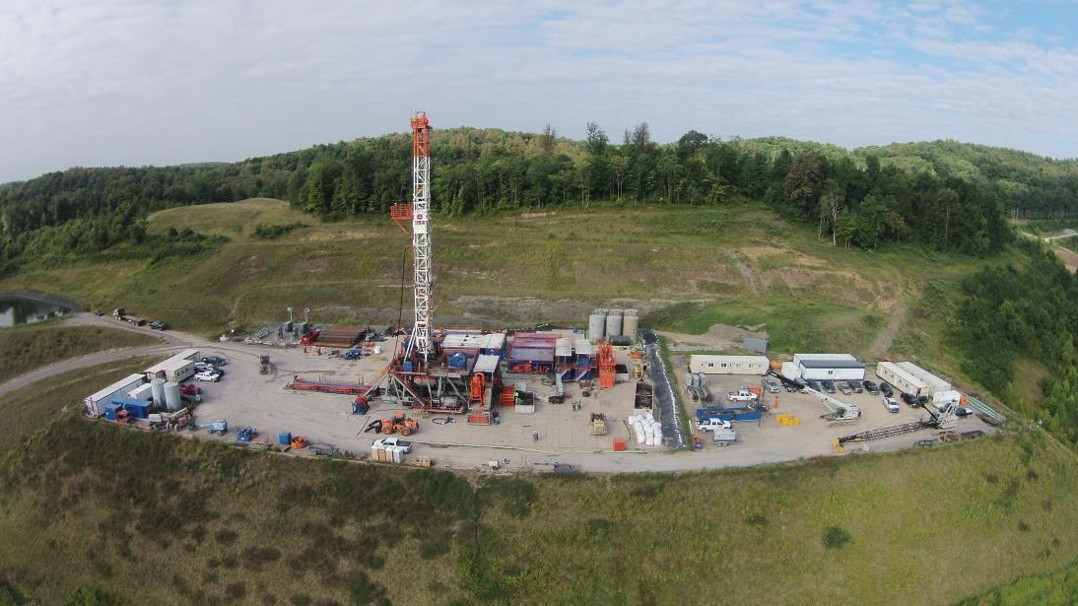
Marcellus Shale Energy And Environment Laboratory - MSEEL
The
Good
6

Slide 7
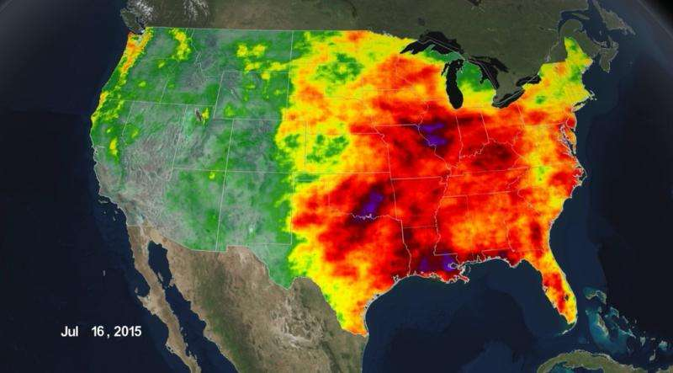
Record Precipitation in the Eastern United States
The
Bad
Morgantown in June - Twenty Days of Precipitation – 6.15 inches, 49% above normal
http://phys.org/news/2015-07-tale-extremes-rainfall.html
6
Notes:
http://phys.org/news/2015-07-tale-extremes-rainfall.html
The precipitation data shown here, from Jan. 1 through July 16, is from the joint NASA-Japan Aerospace Exploration Agency's Global Precipitation Measurement mission. Accumulated rain totals are shown in different colors: 0 to 1 inch is light blue, up to 12 inches is green, up to 20 inches is yellow, and up to 40 inches is red. Purple shows an up to 76 inches in southern Louisiana, central Illinois, and a swath of Texas and Oklahoma that all saw severe flooding associated with heavy rainfall this spring and summer.

Slide 8
Science Well Site Mitigation
and The
Ugly
GSI, Peter MacKenzie
7

Slide 9
MSEEL Major Activities Year 1
Budgets and Contracts
Developed PMP December, 2014
Revised July, 2015
Develop Safety Protocols – Training May, 2015
Locate Service Companies
Database/Website Development
Baseline Geology, Engineering & Environment
External Requests
Drilling and Completion Plan
  Present Technical Plan to Advisory Committee, May 18
  Revised July, 2015
  Drilled Topholes 3H and 5H
  Drilling Science Pilot Hole
9

Slide 10
MSEEL Task 1.1
Subtask 1.1.1 – Ongoing Project Management
  Quarterly Reports
  Revisions of SOPO and Schedules
  Revisions of Budget
Subtask 1.1.2 – Establish Advisory Team
  Presented Technical Plan to Advisory Committee, May 18
  Scott Rotruck (Spillman, Thomas & Battle), Richard Bajura (WVU-NRCCE), Brian Anderson (WVU-Energy Institute), Paul Reig (WRI)
Subtask 1.1.3 – Data Generation and Loading
  Data loaded into MSEEL Portal (Task 1.2)
10

Slide 11
MSEEL PROJECT ORGANIZATION
Director
T. Carr (WVU)
Associate Director
J. Daniels (OSU)
Operations Manager
S. Taylor (WVU)
Site Coordinators
External Advisory Committee
B.J. Carney (NNE)
J. Hewitt (NNE)
T. Carr (WVU)
Technical Committee
NETL
WVU
OSU
Industrial - NGO Partners
T. Carr (WVU)
J. Daniels (OSU)
K. Aminian (WVU)
P. Ziemkiewicz (WVU)
NETL
Deep Subsurface Geochemistry
Database Dev. & Maintenance
Surface Environmental
Geologic Engineering
Geophysical
Geomechanical
Economic & Societal
Shikha Sharma (WVU)
M. Sharma (WVU)
P. Ziemkiewicz (WVU)
K. Aminian (WVU)
T. Wilson (WVU)
R. Jackson (WVU)
11

Slide 12
MSEEL Task 1.2
Subtask 1.2.1 – Relational Database & Collaboration Platform
  Established Data Portal - CKAN
  Link to EDX Established
Subtask 1.2.2 – Online Information Transfer Site
  MSEEL.ORG online
  Added Number of Visualizations
12

Slide 13
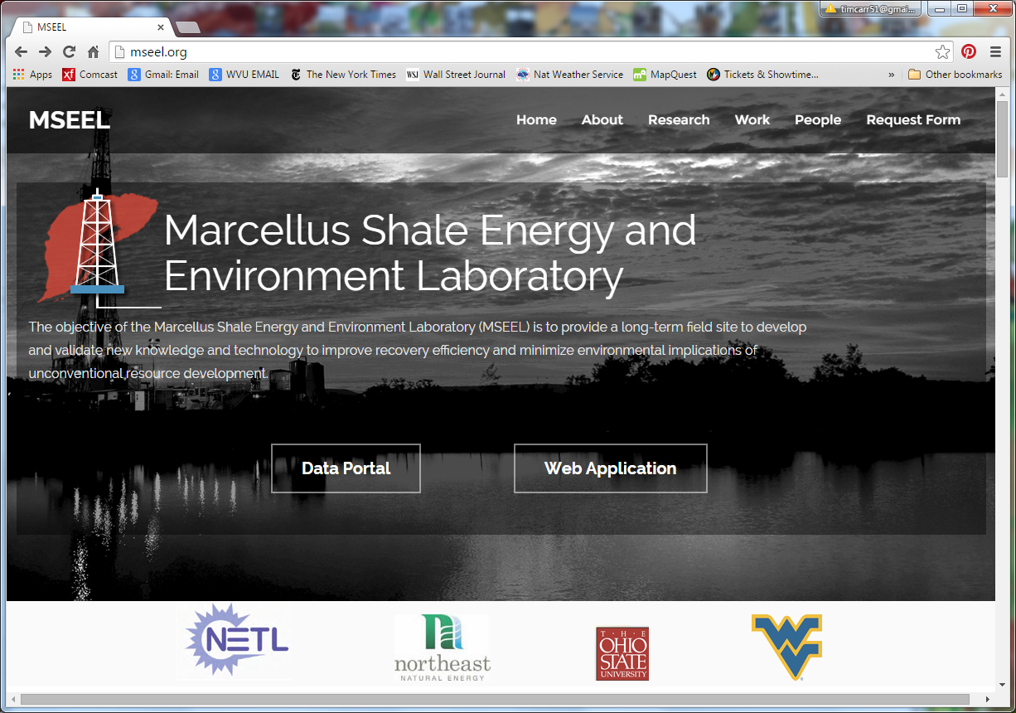
WVGIS Tech Center
13

Slide 14
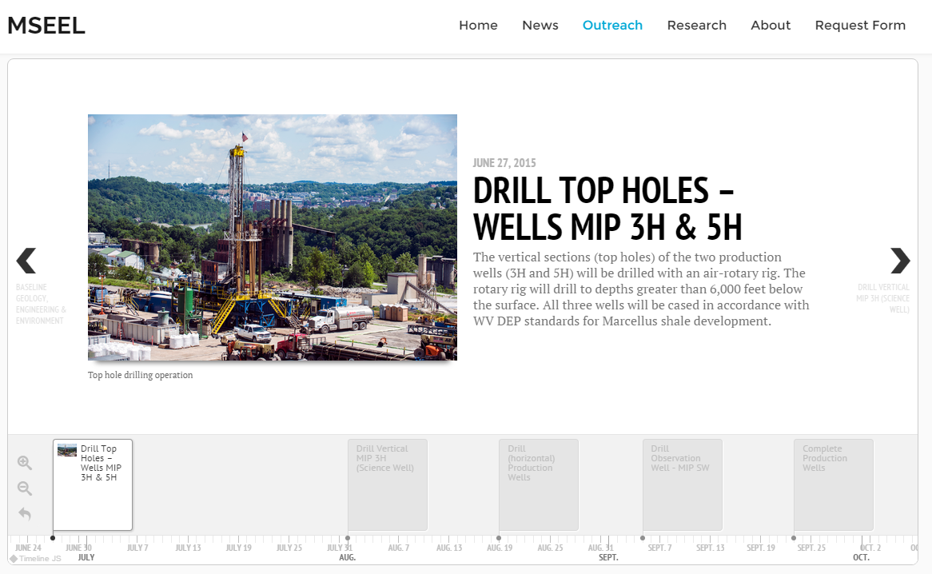
MSEEL.ORG
WVGIS Tech Center
14

Slide 15
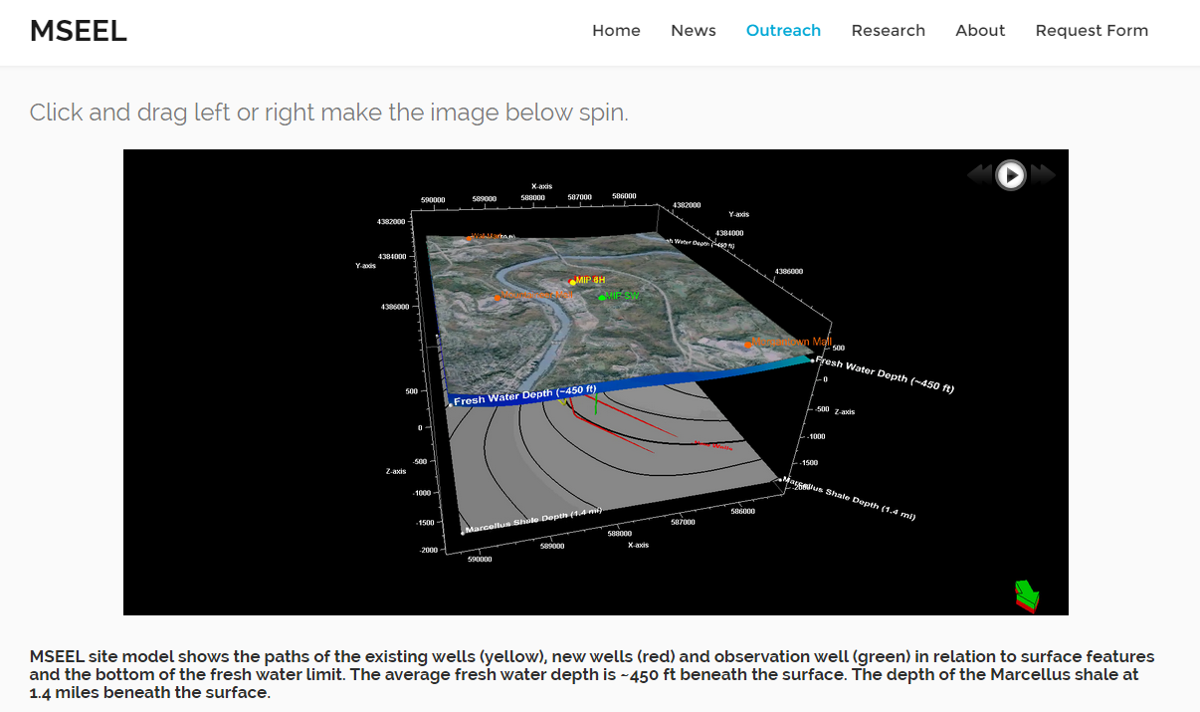
MSEEL.ORG
John Baird
15

Slide 16
MSEEL Data Portal
Data portal will serve as central place to exchange and search for data
CKAN - Open source data portal software (www.ckan.org) will be used
  EDX and Data.gov among several agencies use the same platform
  Data Portal Features
  Publish and find datasets
        Store and manage data
        Private Workspaces and Federate
        Store raw data and metadata
        Add data directly through web interface
        Harvesting – Using same data portal will allow to search data in different federal databases
        Search and Discovery
        Search and Display Geospatial Data
16

Slide 17
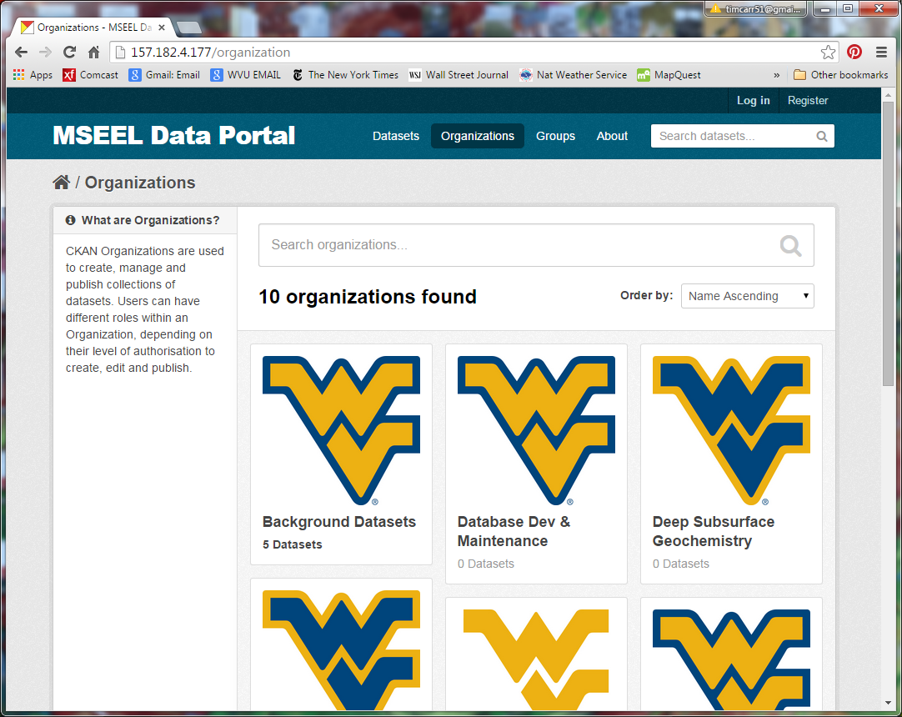
17

Slide 18
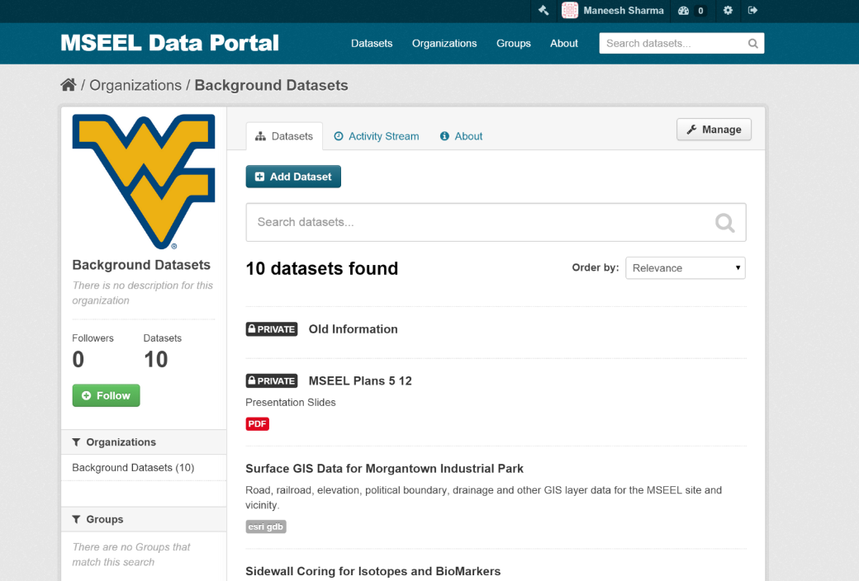
PUBLIC VS. PRIVATE
18

Slide 19
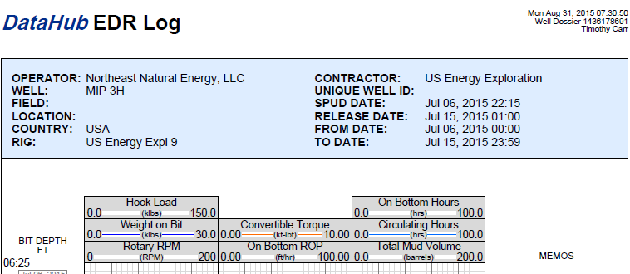
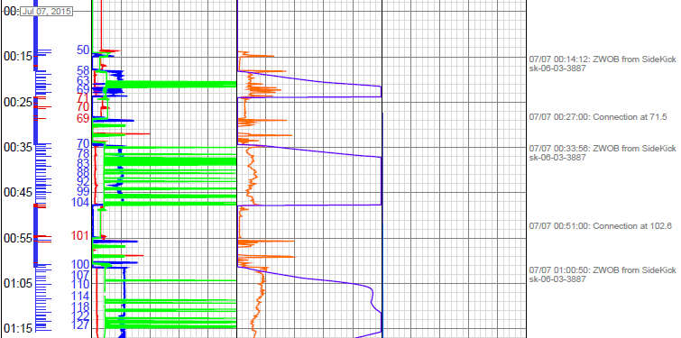
MSEEL Data Portal
19

Slide 20
MSEEL Task 1.3
Subtask 1.3.1 – Community and Public Perception Baseline
  Survey Ongoing
Subtask 1.3.2 – Regional Economic Impact Baseline
  Initial Production Data Assembled
20

Slide 21
Gas Production
19

Slide 22
Gas Production
20

Slide 23
Liquids Production
23

Slide 24
Liquids Production
24

Slide 25
MSEEL Task 1.4
Subtask 1.4.1 –Surface Sampling Plan
  Water Sampling Data Available On Data Portal
  No Apparent Contamination
Subtask 1.4.2 – Air Quality Baseline Measurements
  Air Sampling Data Available On Data Portal
Subtask 1.4.3 – Noise and Light Baseline Monitoring
  Data Collection Underway
25

Slide 26
MSEEL Task 1.4
Nitrogen emissions and deposition fluxes - Pitt
  NO2, HNO3, NH3, and O3
Area Air Measurements
  PM2.5, PM0.1, VOCs
  Noise
Water
  Surface Water Monitoring
Baseline and Background
  Meteorological
  Traffic Counts
26

Slide 27
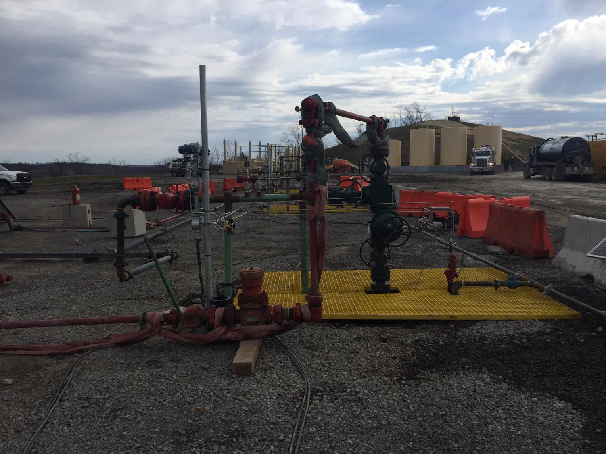
Water Sampling

Slide 28
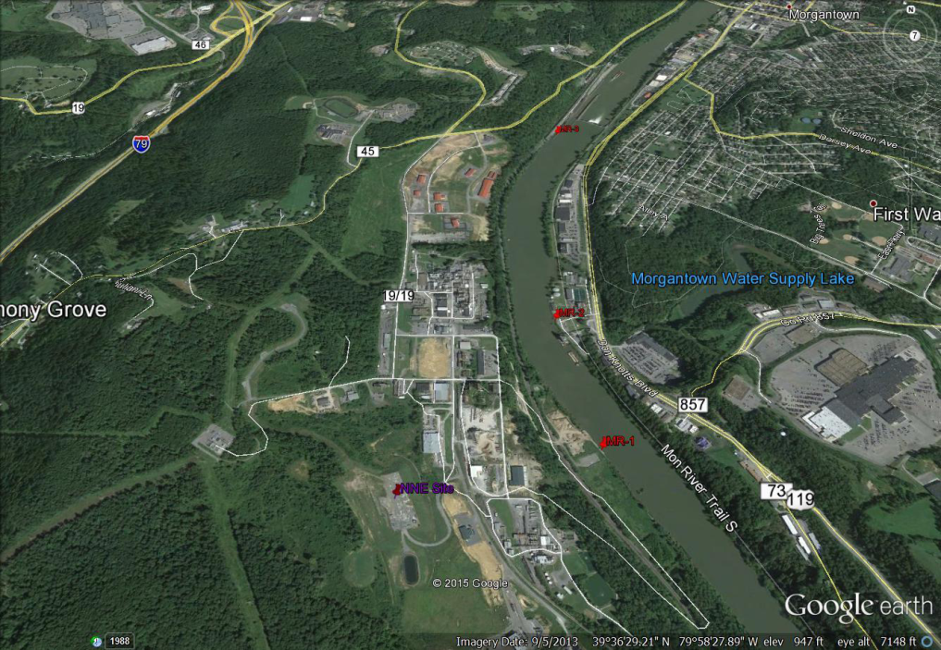
Baseline Surface Water Monitoring Stations
Paul Ziemkiewicz
28

Slide 29
Aqueous Analytical Parameters
29

Slide 30
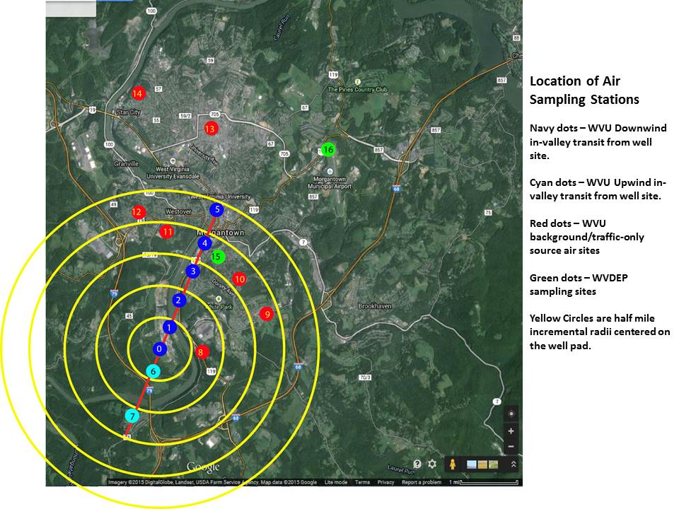
30

Slide 31
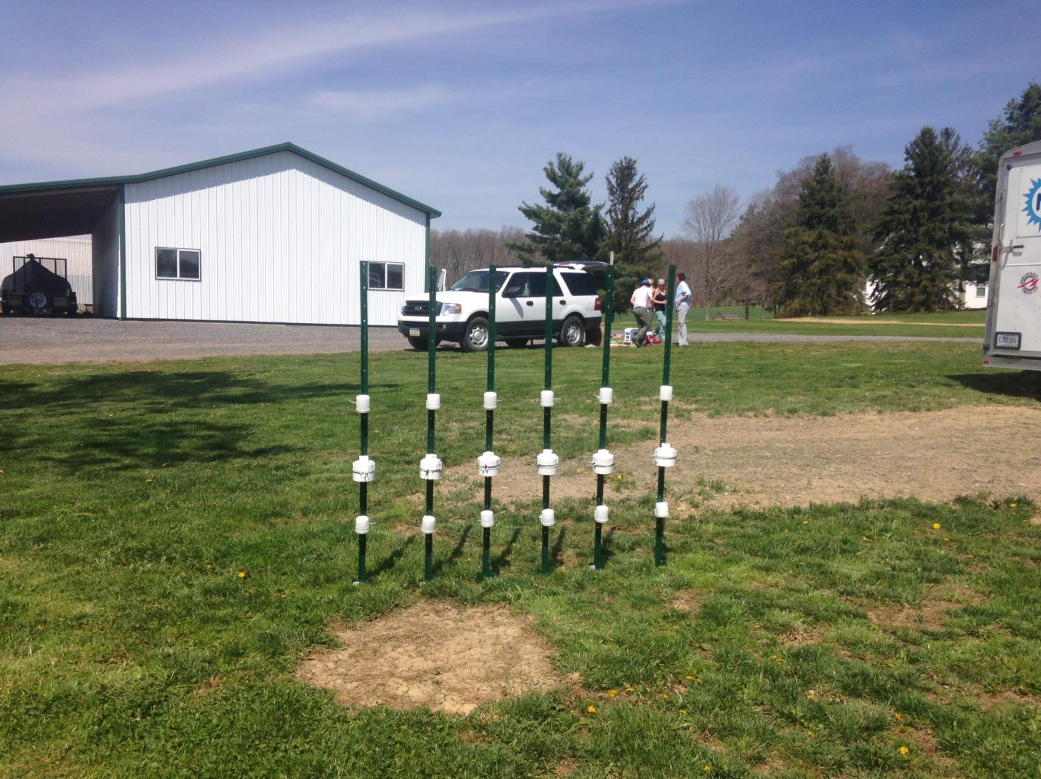
Air and Noise Sampling
31

Slide 32
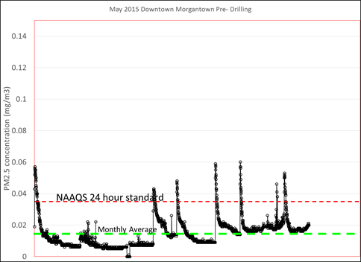
Baseline Air Monitoring
Michael McCawley
32

Slide 33
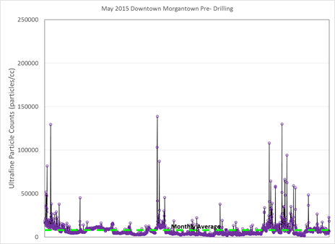
Baseline Air Monitoring
Michael McCawley
33
Notes:
Ultrafine particle number concentration measured using a TSI P-track particle counter for April (a.) and May (b.) 2015. Average monthly concentration was approximately 8,000 particles per cc for April and 10,000 particles/cc for May. There is no NAAQS standard for ultrafine particles but the literature suggests that at approximately 8,000 particle/cc exacerbation of pediatric asthma has been seen in some populations as well as exacerbation of cardiovascular disease. Levels such as those seen in April and May could therefore contribute to an enhanced background of disease, unattributable to PM2.5 releases from traffic. If unaccounted for, ultrafine concentration fluctuations could lead to an assumption that increases in drilling operations and an assumed increase in releases from the drilling are responsible for the fluctuations in those diseases.

Slide 34
MSEEL Task 1.5
Subtask 1.5.1 – Collect existing subsurface data
  Data in MSEEL Portal
Subtask 1.5.2 – Locate vertical well and design sampling plan
Subtask 1.5.3 – Site Remediation SW Well Pad
Subtask 1.5.4 – Vertical Section Sampling of 3H
  Core (120’) and Sidewalls (50)
Subtask 1.5.5 – Geophysical Logging 3H
  Complete Suite
Subtask 1.5.6 – Drill a vertical scientific observation well
  Obtain sidewall cores
34

Slide 35
Jessica Brewer
32

Slide 36
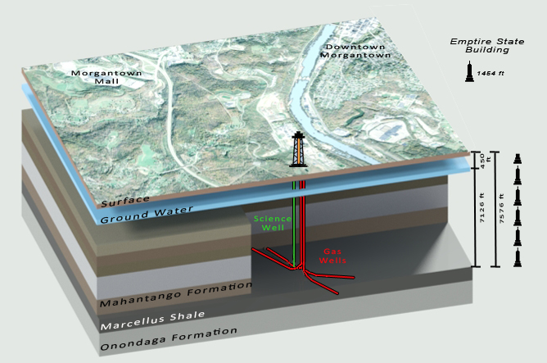
Local Setting
Jessica Brewer
33

Slide 37
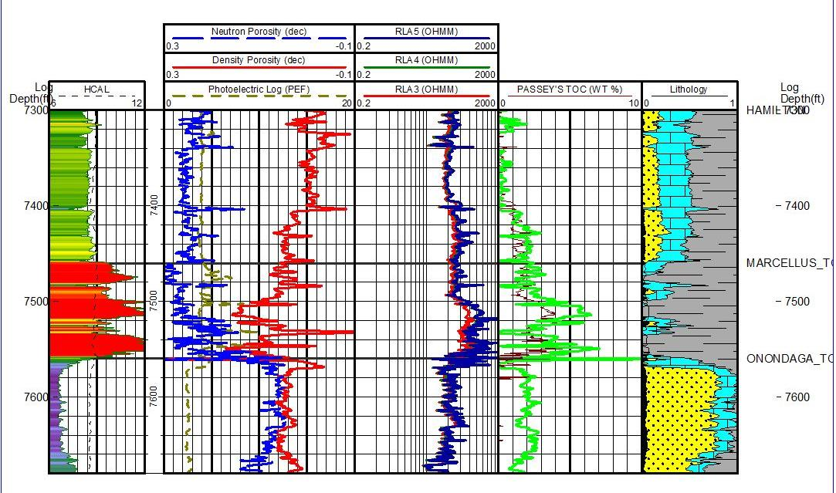
NNE MIP 4H Rhomaa-umaa Model
Tom Paronish
34

Slide 38
NNE MIP 4H Statmin Model
Guochang Wang
35

Slide 39
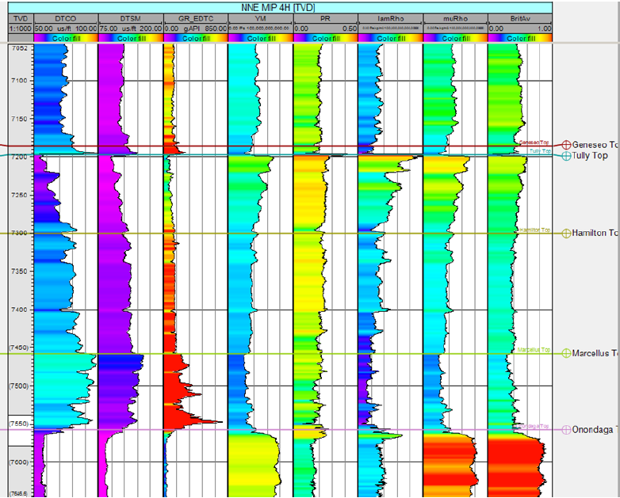
NNE MIP 4H GeoMechanical Model
Tom Wilson
36

Slide 40
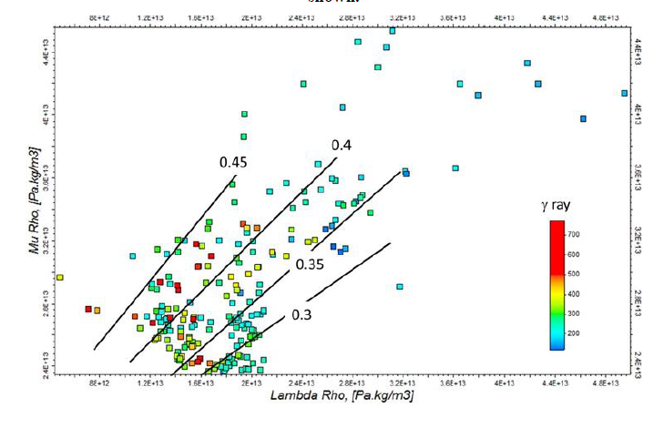
NNE MIP 4H GeoMechanical Model
Tom Wilson
37
Notes:
Lambda Rho versus Mu Rho plot for the Marcellus showing approximate variations of brittleness. Lambda Rho , Mu Rho values are colored by Gamma ray.
The ,  plot was also subdivided based on Poisson’s ratio and Young’s modulus for the entire Marcellus section (Figure 7).
The high- zones (assumed higher TOC) tend to have Poisson’s ratios between 0.15 and 0.2 and Young’s moduli between about 2.4x1010 and 3.4x1010 Pa.
The brittleness average (Figure 8) did not break out high  zones. Higher  ray intervals tend to have brittleness averages between 0.35 and 0.45. Brittle intervals tend to have lower Poisson’s ratio and fall in the range of Young’s moduli noted above.

Slide 41
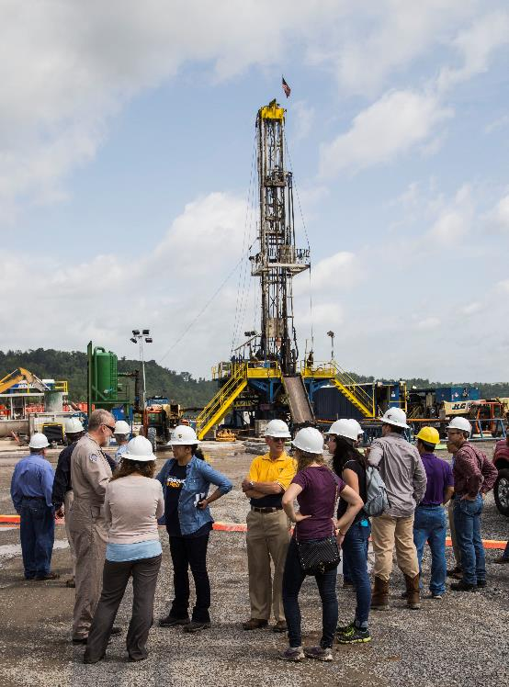
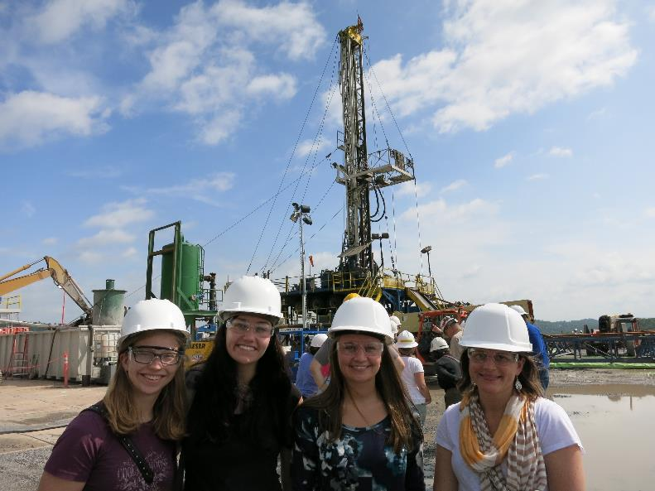
Drilled Vertical Top-holes
38

Slide 42
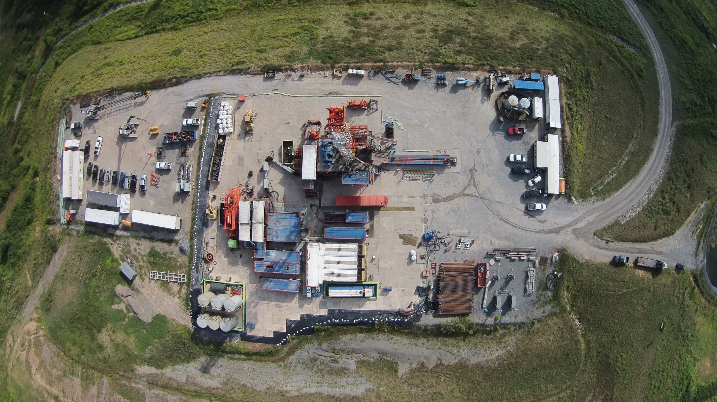
Drilled Pilot Hole
38

Slide 43
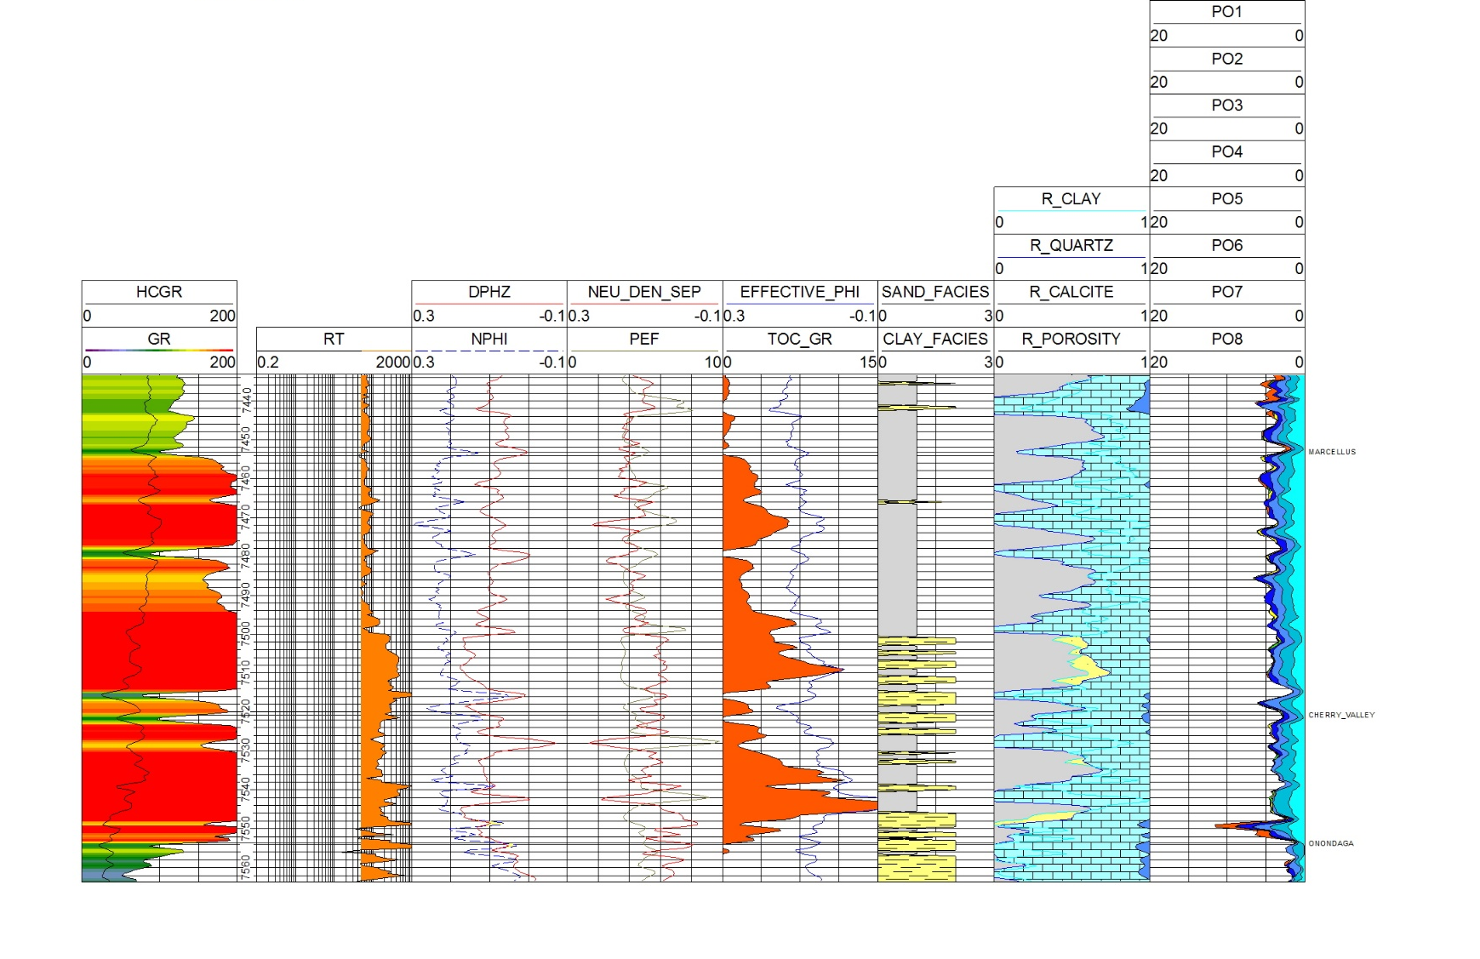
NNE MIP 3H Initial Log Analysis
Shuvajit Bhattacharya
Tom Paronish
36

Slide 44
Drill SW and Laterals
43

Slide 45
Well Site Operations
8/27 Start of Drilling operations on the MIP 3H vertical pilot - Nudge
8/29 Start Coring Operations in MIP 3H vertical pilot
9/2 finish with logging
9/2 rig tour
9/3 Sidewall cores in MIP 3H vertical pilot
9/3-9/5 Plug back and cement vertical pilot
9/6 -9/14 Skid over and drill and complete MIP 5H as horizontal production well
9/10 Rig Tour (Request if you would like a rig tour - Limited slots)
9/14 Skid back and drill and complete MIP 3H as horizontal production well. Run Fiber in 3H.
9/5-9/14 drill science observation well with small rig. Planning only sidewalls and basic logs before setting up for micro-seismic.
8

Slide 46
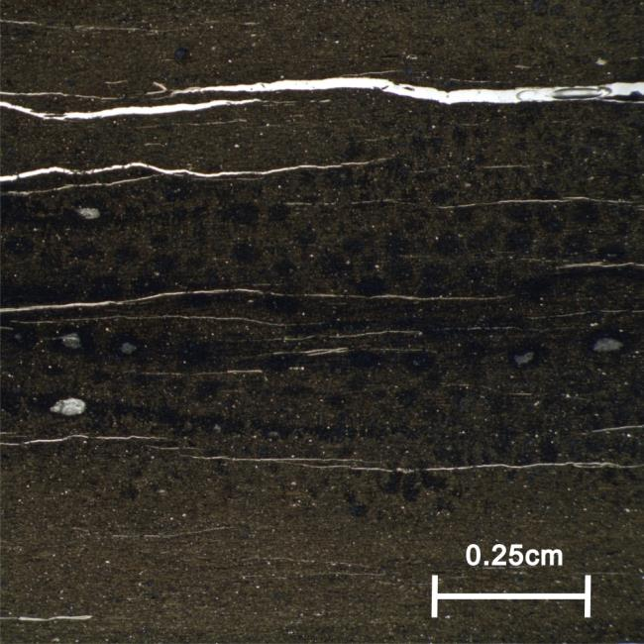
Core Analysis- Key Research Questions
What is the heterogeneity in petrophysical properties at different scales ?
    Presence, geological migration, and modern flow of fluids, water, gases and microorganisms
    Long-term production behaviour of reservoir
    What is the spatial and temporal variations in mineral and elemental composition?
    Natural/induced fracture networks
    Implications for rock-fluid interactions
Photo Courtesy: Sharma, WVU
46

Slide 47
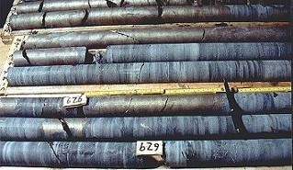
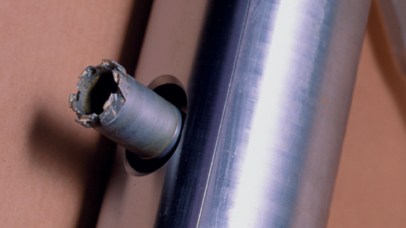
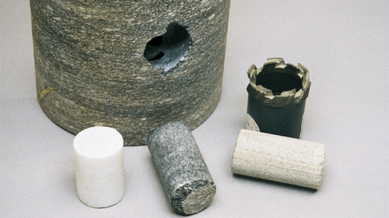
Cores Vertical Well
Sidewall Cores
50 - 2.5” X 1.5” cores
50 - 2” X 1” cores
Whole Core
120’ – 4” Core
Above, Through and Below Marcellus
47

Slide 48
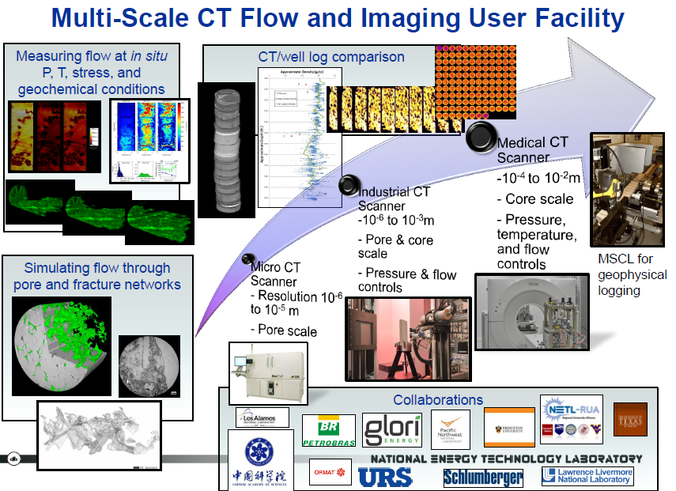

Whole Core
48

Slide 49
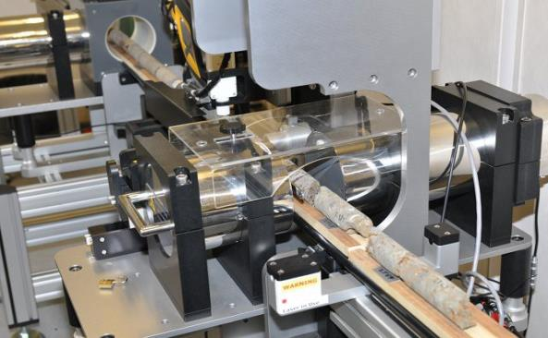
Multi-Sensor Core Logger
The NETL logger is able to rapidly obtain high-resolution data including
  p-wave velocity
  gamma-density
  natural gamma, resistivity
  magnetic susceptibility
  X-ray fluorescence spectrophotometry
on whole-round or split core samples
  Geotek Multi-sensor Core Logging unit
49

Slide 50
Whole Core Sampling Plan
Whole Core Recovery – 120 feet Cut into 3 foot lengths
Transport to NETL – NETL
CT and Core Scan – Dustin Crandall
Sample Ends TOC/XRD/GRI P&P – Soeder/Wornnell
Ship from NETL to Core Analysis Company
Core Gamma
Extrusion, Cleaning and Marking Full Diameter Core
Split 1/3-2/3 – Core Analysis Company
Photography – Core Analysis Company
Plug every foot – Liquid Nitrogen (120 samples) – Core Analysis Company
Ship Core Plugs to PPAL Khashy Aminian (3 additional core plugs Soeder)
Ship Core Core to NETL – Dustin Crandall
Additional Core Scan – Dustin Crandall
Additional TOC/XRD – Tim Carr
Core Description – Tim Carr
Samples for FIB-SEM – David Cole
Samples for additional Geochemical Analysis – Shikha Sharma
Core Plugs from PPAL to Geomechanical Analysis – Hema Siriwande
12

Slide 51
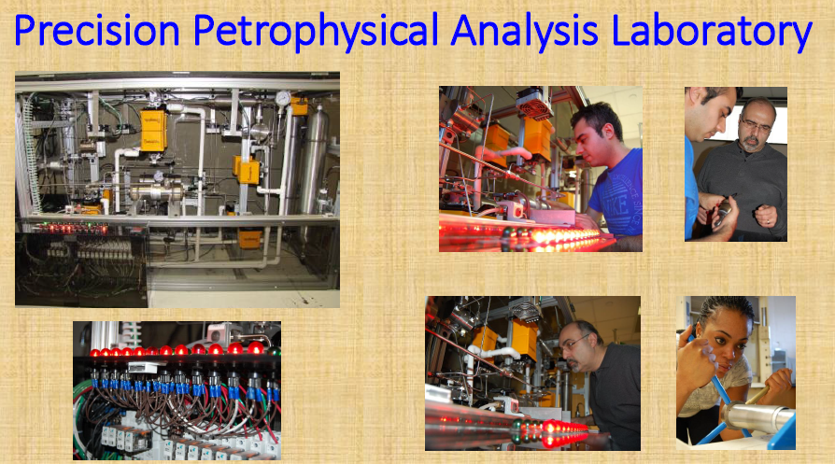
51

Slide 52


WHOLE CORE
Sample Requirement:
50g of sample from the inner part of the vertical core at 1-3 feet sampling interval to be determined based on multisensor core logger (MSCL) and Source Rock Analyzer (SRA) data from NETL
5-10 sub-cores (1.5*4 inch diameter) from vertical core; sampling interval TBD based on MSCL and SRA data
Parameters to be measured:
TOC, δ¹³C, δ¹⁸O, δ¹⁵N, δ³⁴S, Geochemistry, Biomarkers (n-alkanes, pristane, phytanes, hopanes, steranes etc.)
Research Questions:
What are temporal variations in redox, source/type of organic matter, clastic influx?
What are possible variations in fluid-rock interactions?
52

Slide 53
Cuttings Sampling Plan
Two Samples of 3H for WVU Water Research Institute
  One from Curve – One from Lateral
  Call Jennifer Hause to arrange
Cuttings Samples along curve and lateral for 3H and 5H
  Sample at regular intervals
13

Slide 54
SIDE WALL SAMPLING
OBJECTIVES
Determine extent of life in shale
Examine how microbial diversity and function relates to geology, mineralogy, geochemistry, & hydrocarbon production
This assumes 100% recovery. Any extra core (additional sidewall core run???) would allow the group to analyze duplicates, which is minimum required to generate data for high-profile publications.
9

Slide 55
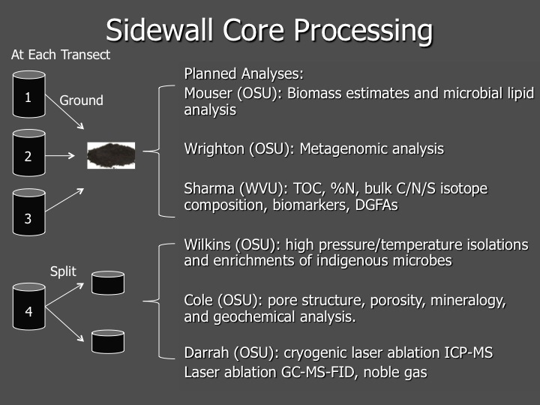
SIDE WALL CORE DISTRIBUTION & ANALYSIS
Mouser, Sharma &Wrighton, 3 of 4 cores
Mouser (PLFA, DGFAs to Rawlings) 33%
Sharma (C, N, TOC, Biomarkers) 33%
Wrighton (DNA, single-cell genomics) 33%
Cole, Wilkins & Darrah, 1 of 4 cores
Cole (pore structure, mineralogy etc.) 33%
Wilkins (high pressure/temp enrichments) 33%
Darrah (noble gas, cryo-laser ablation) 33%
11

Slide 56
MSEEL Task 1.6
Subtask 1.6.1 – Geophysical Logging of 3H and 5H
  Complete Suite in Vertical Leg of 3H
  Coring and Sidewall Sampling in 3H Vertical Leg of 3H
  Logging of Lateral 3H
  Traditional Logs in 5H
Subtask 1.6.2 – Drilling Fluid and Cuttings Sampling
Subtask 1.6.3 – Drilling & Well Construction Data
Subtask 1.6.4 – Fiber Optic Monitoring
  Temperature and Acoustic Monitoring
Subtask 1.6.5 – Microseismic Monitoring
Subtask 1.6.6 – Fluid and Gas Sampling
Subtask 1.6.7 – Environmental Monitoring
42

Slide 57
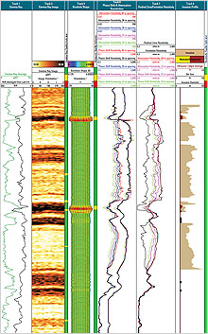
Logging Vertical Well
Full-bore Micro Imager ^{sw}
MDT stress ^{sw}
Dielectric Permittivity ^{sw}
Magnetic Resonance ^{sw}
Reservoir Saturation Tool ^{sw}
Quanta-Geo Imaging
Litho Scanner

Slide 58
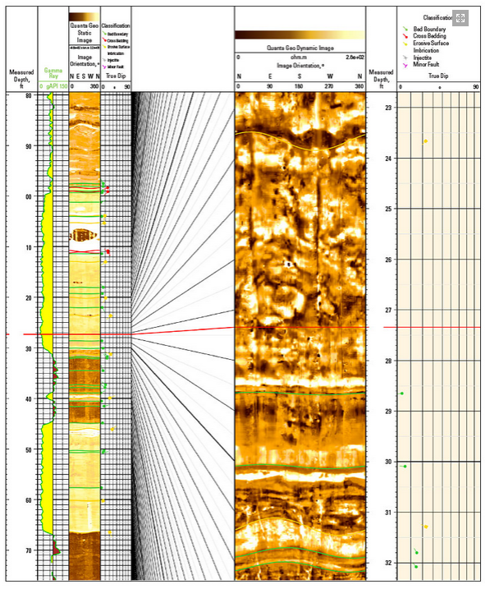
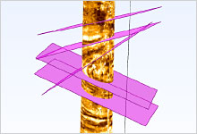
MSEEL
Logging Lateral
Schlumberger
58
Notes:
Drilling-induced fractures are clearly visible as linear or curvilinear subvertical features at approximately N45E and S45W in the expanded-scale dynamic image from Quanta Geo photorealistic reservoir geology service in Track 5. The well’s intersection of this channel sand close to its axis makes many of the scour features appear flattened, which would render them unrecognizable on a conventional OBM-adapted image. The dipping portion of a basal scour interpreted at 31.3 ft suggests that the axis of deposition is N20E–S20W. The scour is filled by a 1-ft-thick lower-energy deposit. Scour features identified higher in the section indicate that paleotransport shifted to a NW–SE axis.

Slide 59
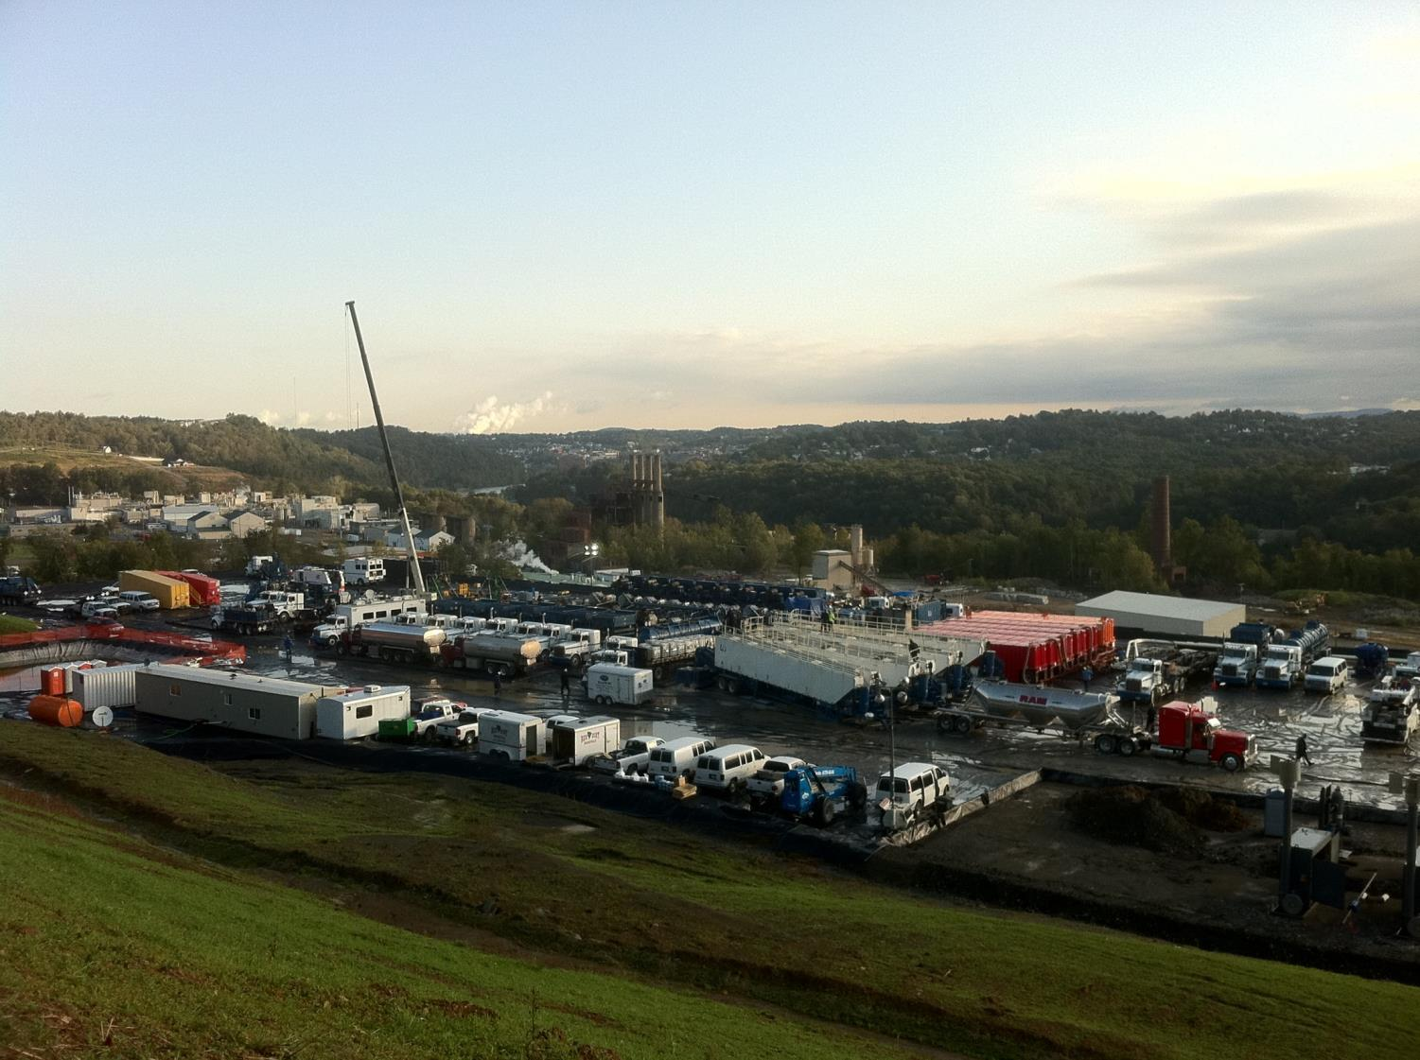
Completions

Slide 60
Complete and Monitor Laterals
44

Slide 61
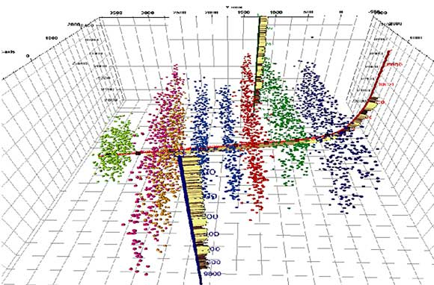
Micro Seismic
61

Slide 62
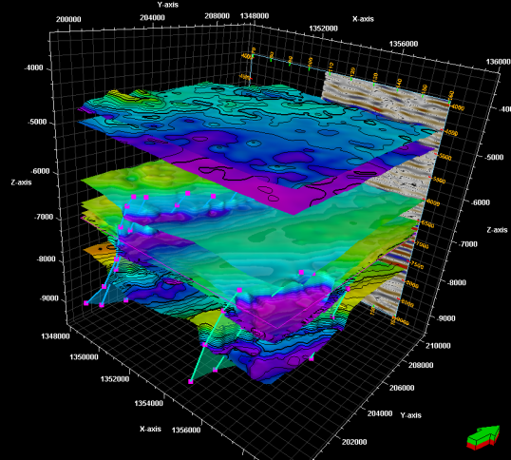
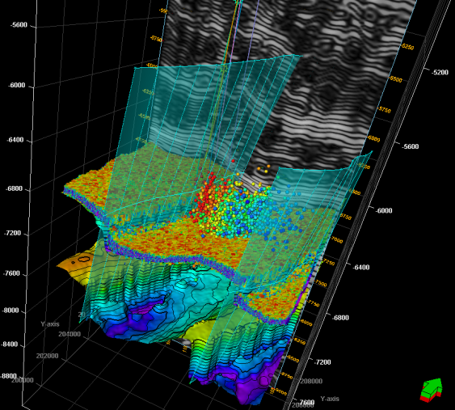
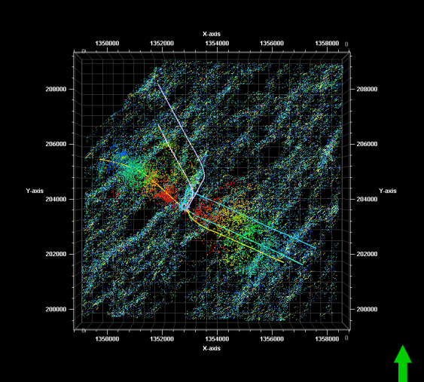
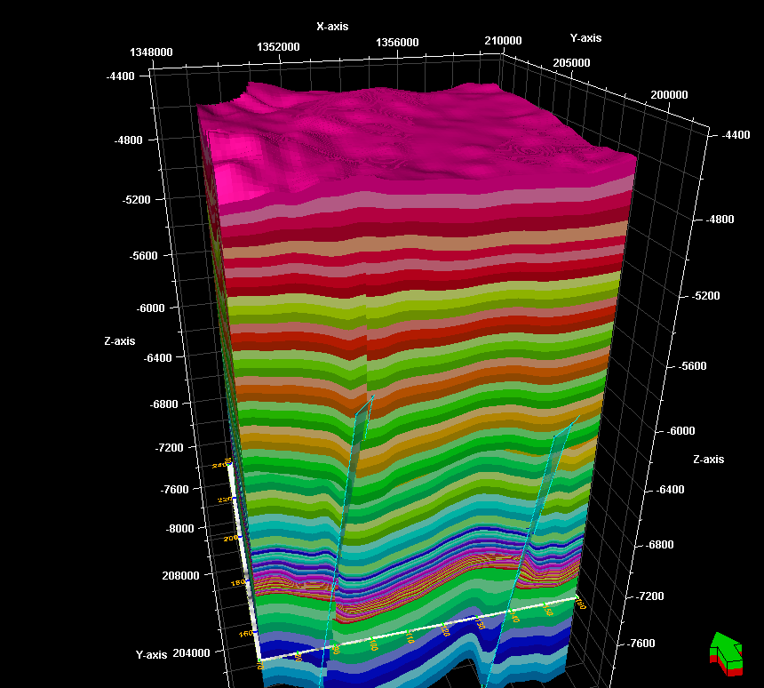
Some microseismic perspectives for the Morgantown MSEEL site
Starting model
Tom Wilson, WVU Geophysics
62

Slide 63

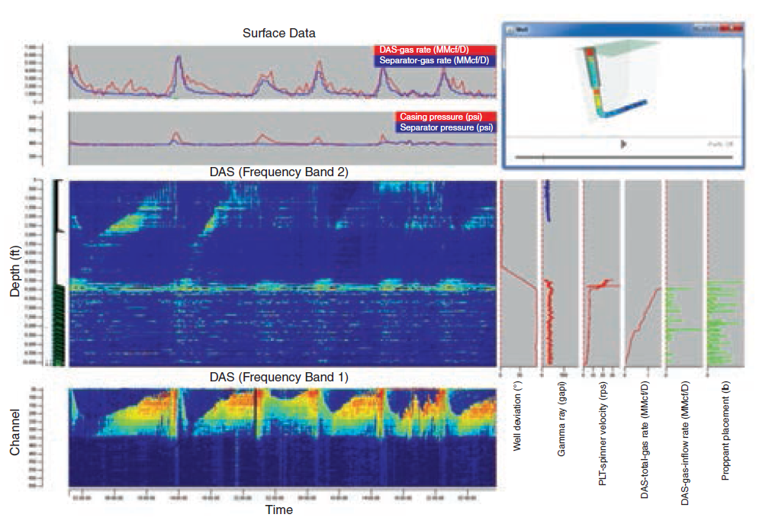
Fiber Optic Fracture and Production Monitoring
63
Notes:
Different applications place different requirements on the lasers used in fiber-optic systems. Some lasers need to have broadband wavelengths, while others require narrow wavelengths to best relay important downhole data back to the interrogator unit. Photo courtesy of Halliburton.
A display shows processed and evaluated distributed acoustic sensing (DAS) data for a horizontal gas well operated by Shell. The information shows zonal and cumulative production rates compared with surface production rates, a 3D well view, and various depth points with conventionally acquired downhole information that includes well deviation, hydraulic fracturing proppant volumes, and production logging tool data, and gamma ray data. Image courtesy of OptaSense.

Slide 64
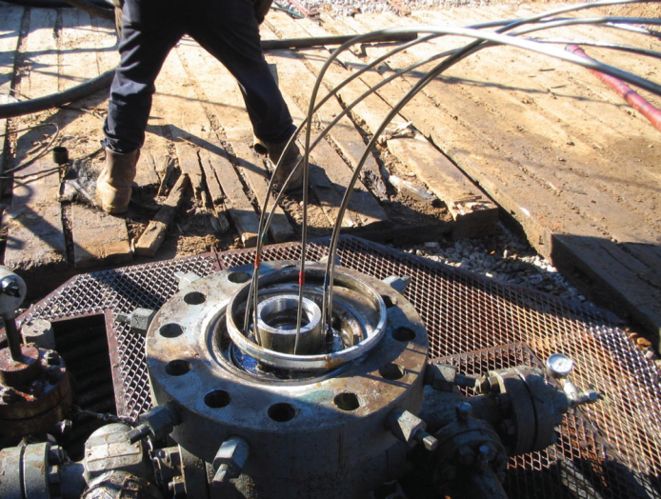
Fiber-Optics
64

Slide 65
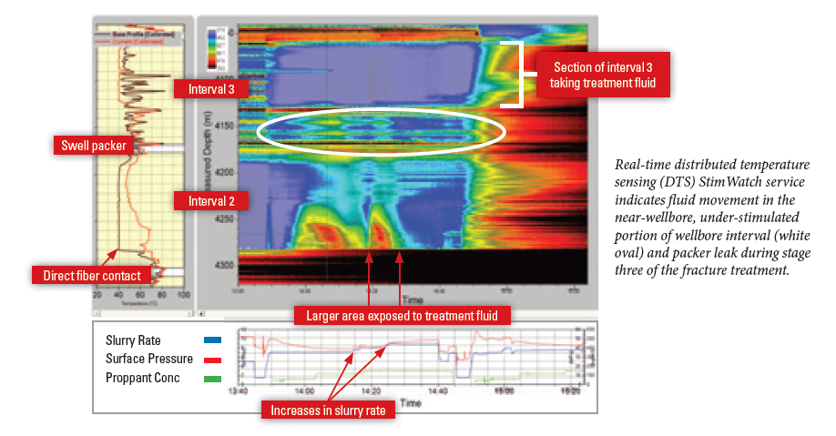
Fiber-Optics
Distributed Temperature Sensing

Slide 66
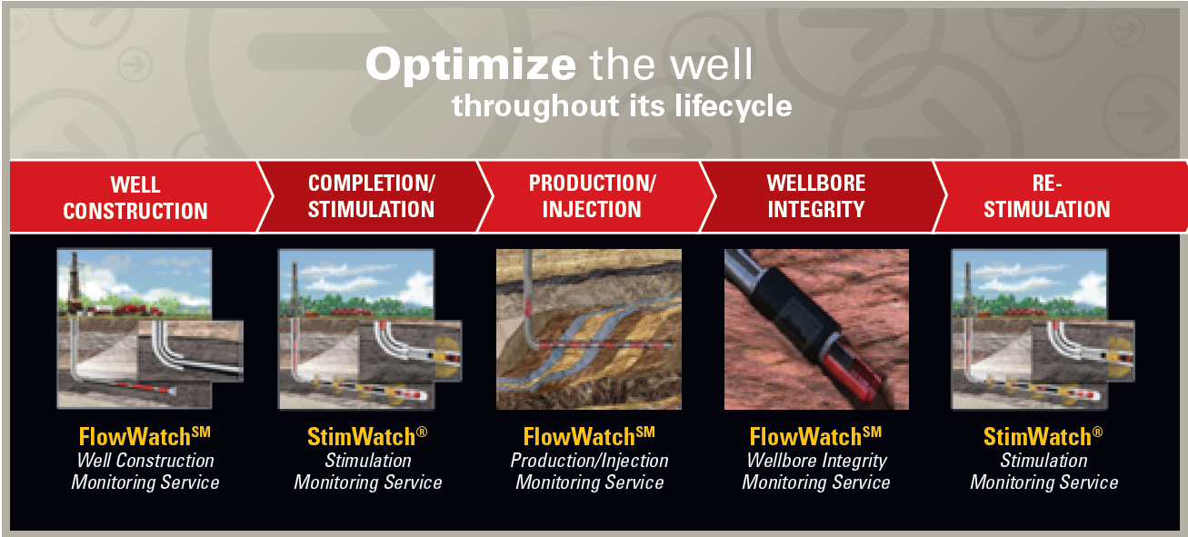
MSEEL
Microseismic and Fiber Optics
Pinnacle
66

Slide 67
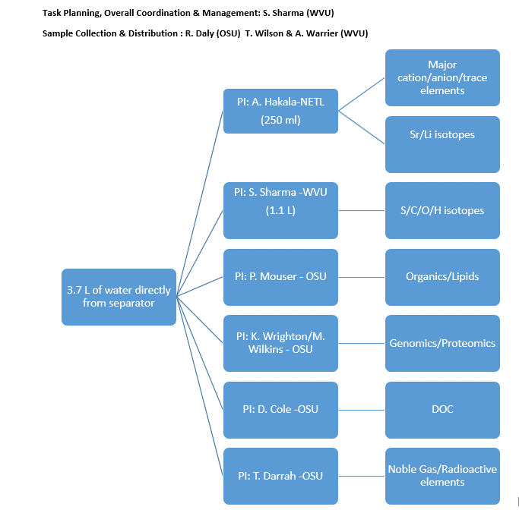
FLUID SAMPLING PLAN - Separator
14

Slide 68
Drilling Services
Patterson 254
Rotary Steerable (Archer)
Synthetic Based Mud (Megadril/Warp)
PDC MDSi613
Solids control (Reuse)
45

Slide 69
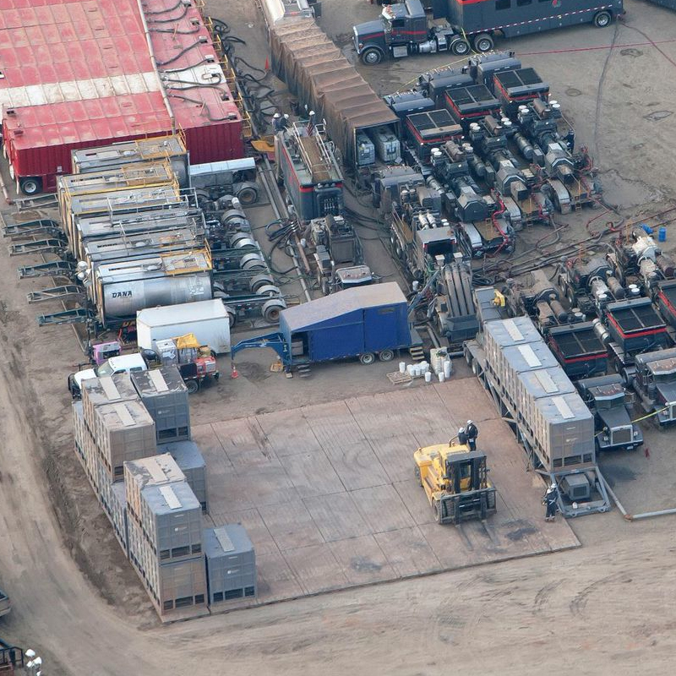
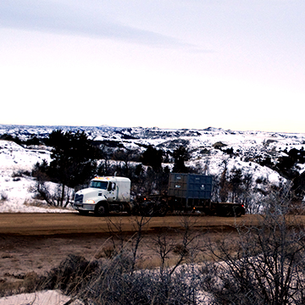
Northeast Natural Energy
SandBox Logistics & DustPro
Reduced road traffic
Reduced personnel on frac site
Eliminate silica dust particles
http://www.sandboxlogistics.com/gallery.php
69

Slide 70

Northeast Natural Energy
SandBox Logistics & DustPro
http://www.dustpro.com/system/
70

Slide 71


Building Partnerships for Research, Education, and Outreach
Industry
MSEEL
Community
NGOs
Government
Academia
Tim Carr
Phone: 304.293.9660
Email: tim.carr@mail.wvu.edu

