Slide 1
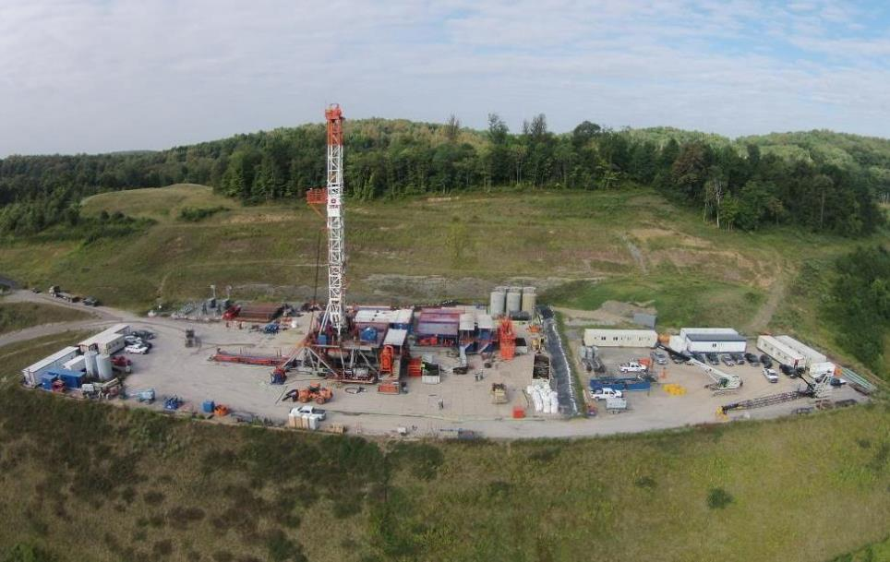





Marcellus Shale Energy and Environment Laboratory
MSEEL
Tim Carr
Phone: 304.293.9660
Email: tim.carr@mail.wvu.edu

Slide 2

Marcellus Shale Energy and Environment Laboratory
MSEEL
The objective of the Marcellus Shale Energy and Environment Laboratory (MSEEL) is to provide a long-term collaborative field site to develop and validate new knowledge and technology to improve recovery efficiency and minimize environmental implications of unconventional resource development

Slide 3
MSEEL Site
Notes:
In the summer months (no heating load) ranges from 2000 mcf to 6000 mcf per day. On a peak winter day the usage is between 35,000 mcf and 45,000 mcf per day.
If you need more precise numbers ‑ let me know.
Hope you are doing well and glad to see Northeast drilling in Morgantown. Not making out so well in Charleston with your legislator from Morgantown
Bob

Slide 4
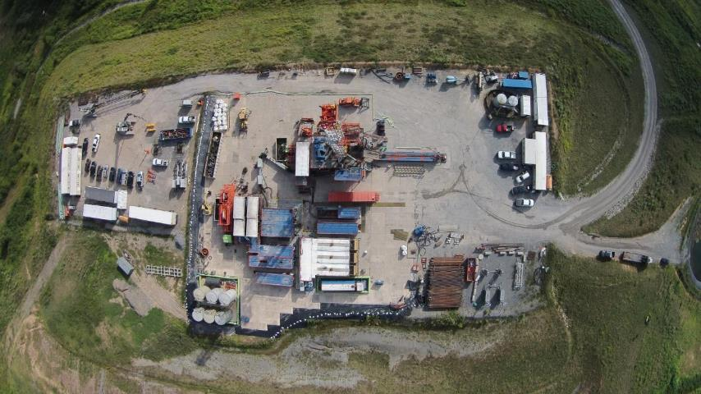
Drilled Wells

Slide 5
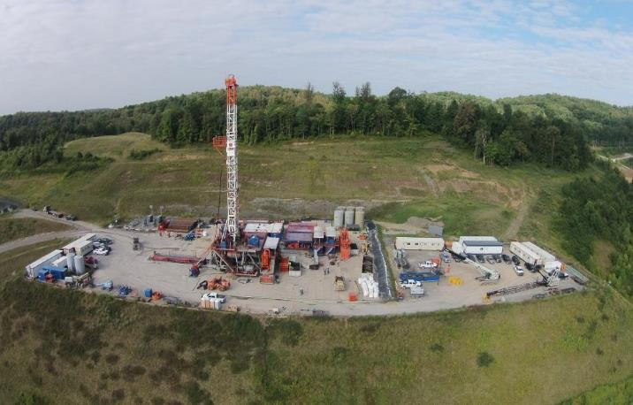
Northeast Natural Energy
MIPU 3H and 5H

Slide 7
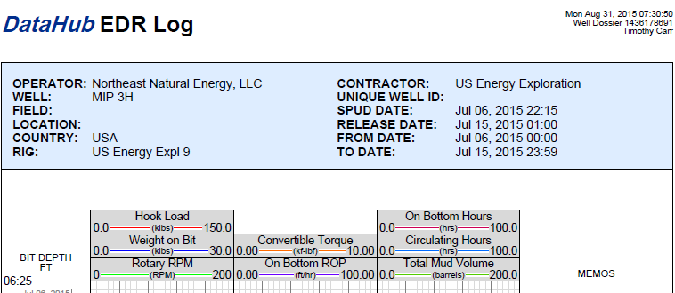
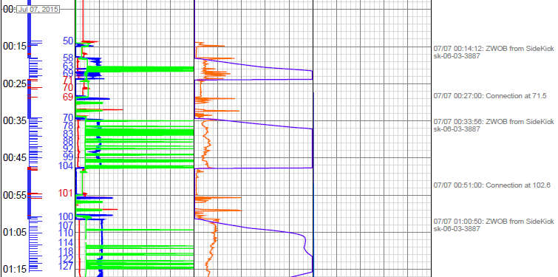
MSEEL Data Portal

Slide 8
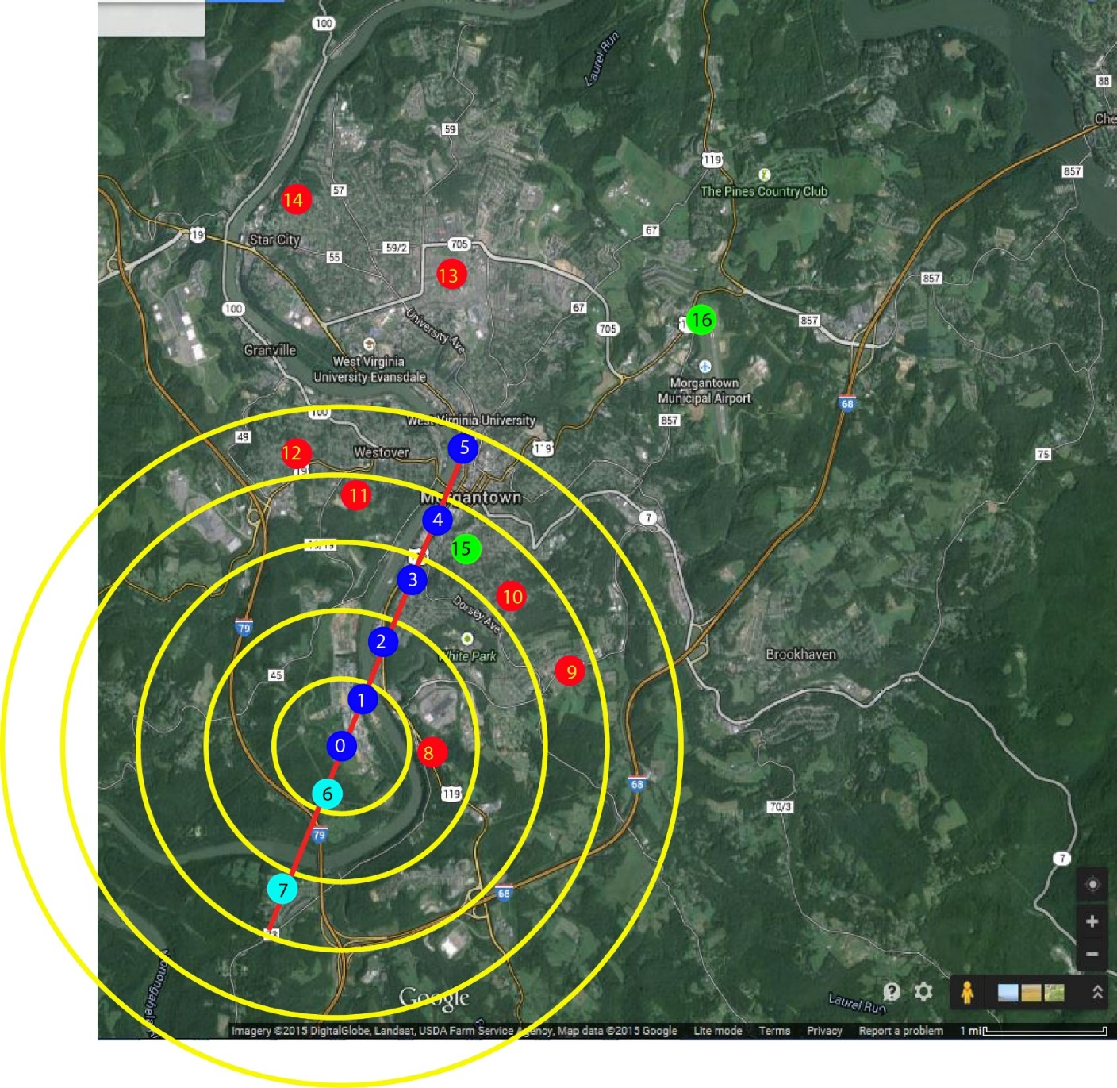
Environmental Monitoring

Slide 9
Environmental Monitoring

Slide 11
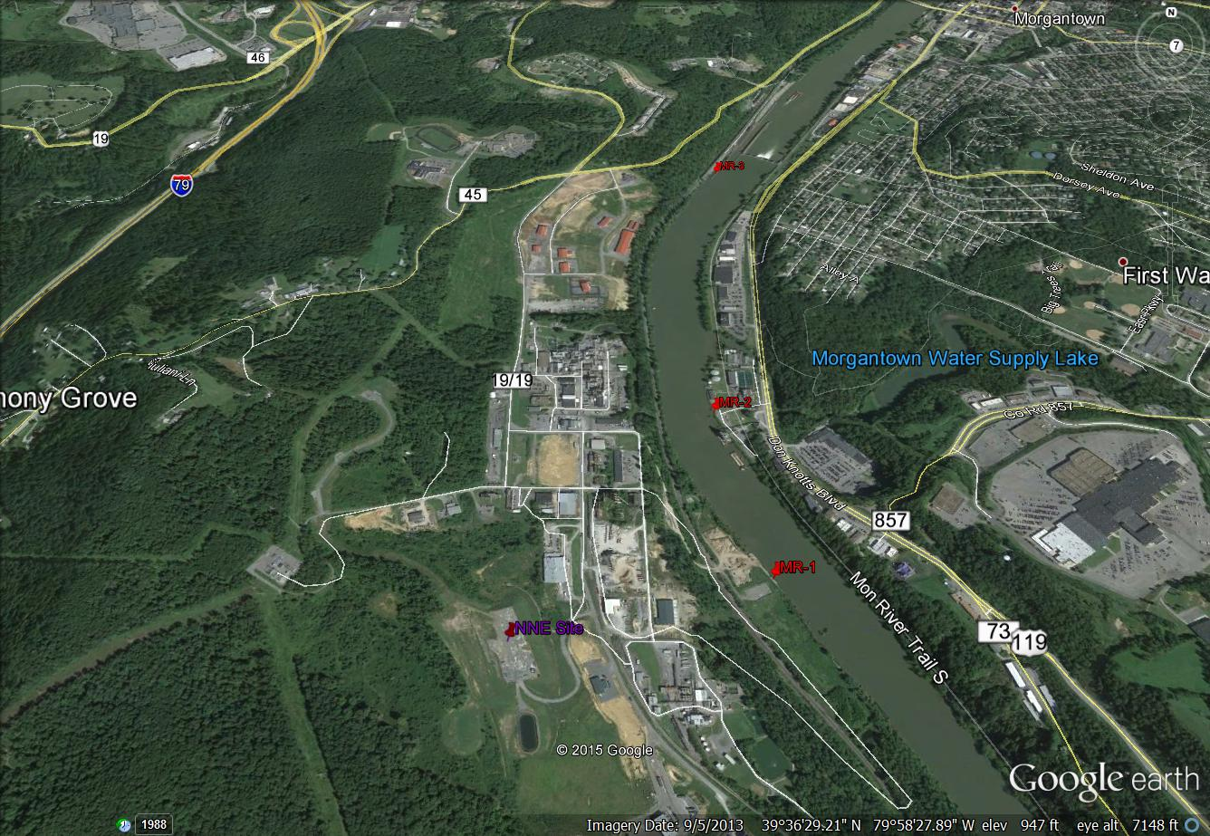
Environmental Monitoring

Slide 12
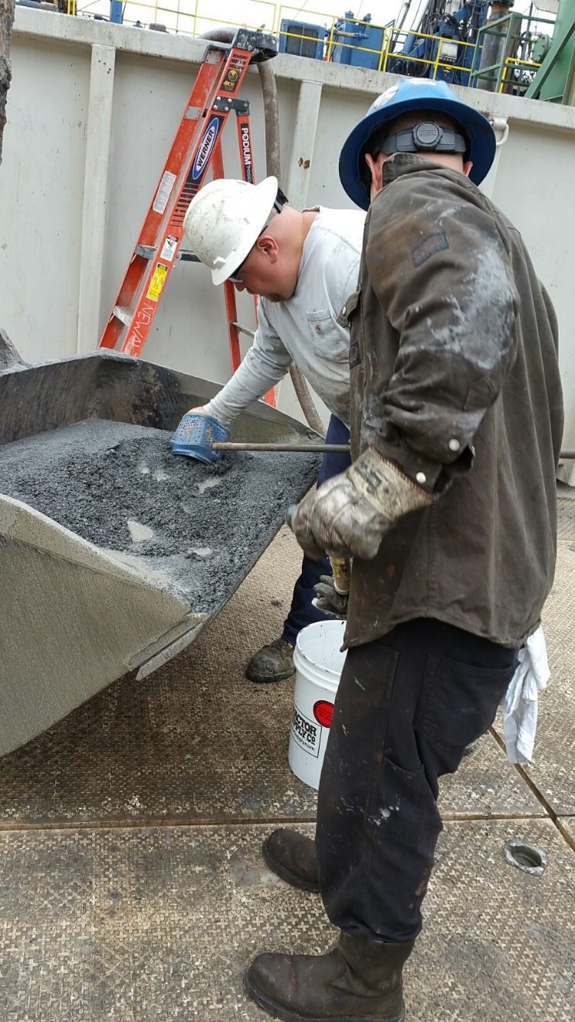
Cuttings Monitoring

Slide 13
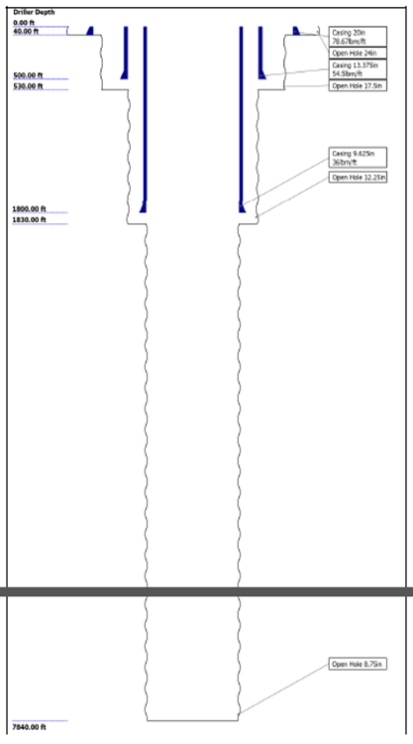
Vertical Well Work Highlights
Drilled 3H Pilot well and 5H well
Drilled SW (Science monitor Well)
Vertical well logs (FMI, Sonic and Litho)
Retrieved 111’ of whole core from 3H
Retrieved 197 sidewall cores from 3H and Science Well

Slide 14
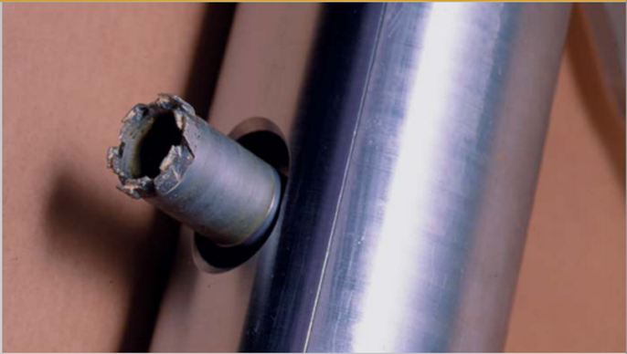
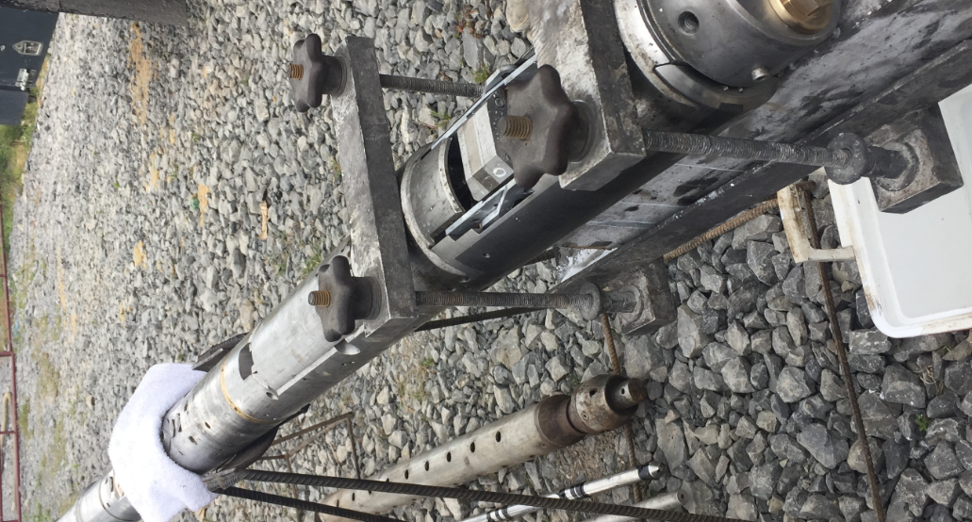
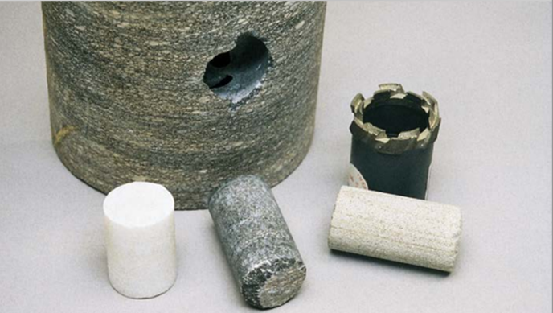
Sidewall Cores
Collected 197 sidewall cores from the SW and 3H well

Slide 15
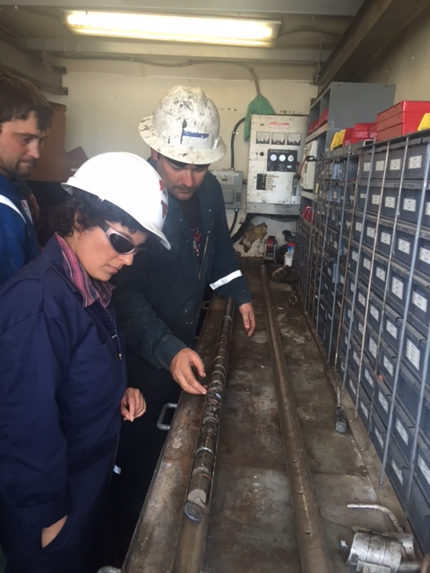
Sidewall Cores

Slide 16
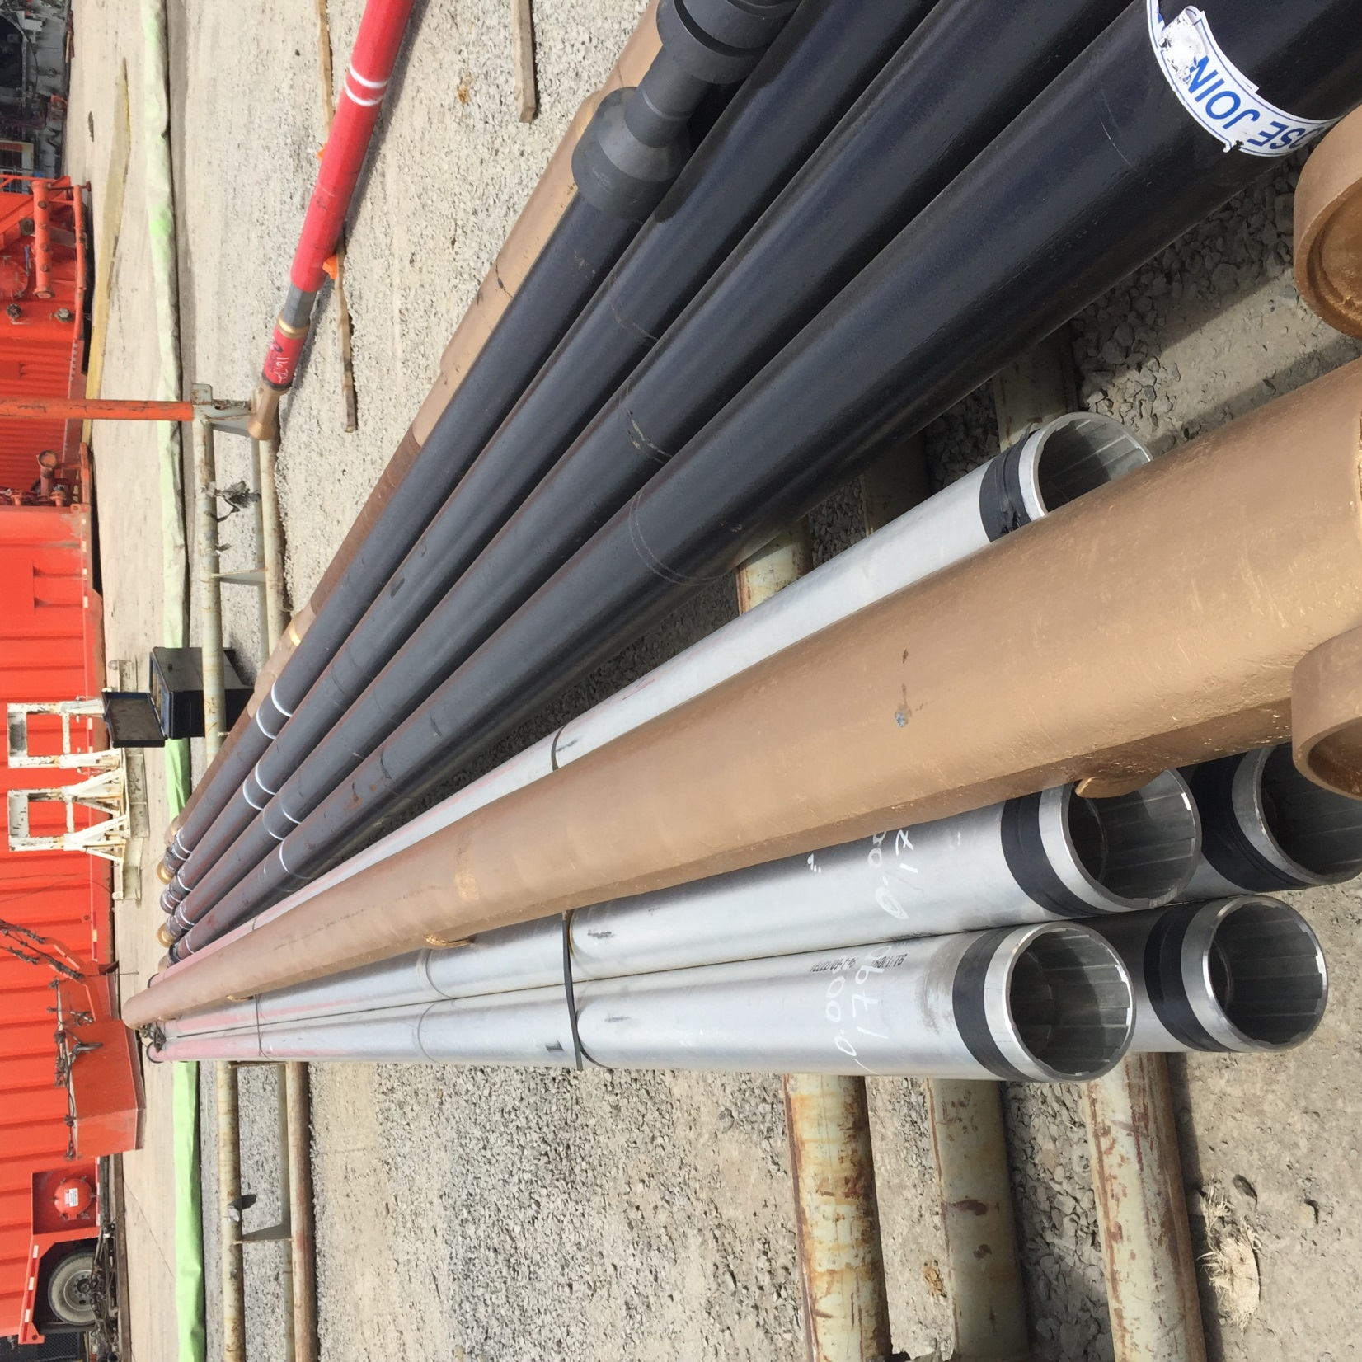
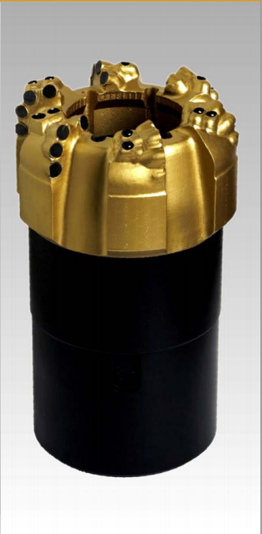
Coring Tools – Whole Core
Retrieved 111’ of a targeted 120’ whole core

Slide 17

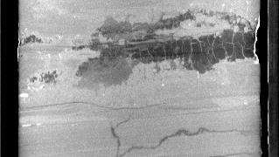
Whole Core

Slide 18
Sonic Scanner 3H Vertical

Slide 19
Geosteering MIP-3H

Slide 20
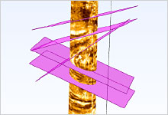
High Definition open hole logs in lateral with synthetic mud
MSEEL - Logging Lateral
Schlumberger
Notes:
Drilling-induced fractures are clearly visible as linear or curvilinear subvertical features at approximately N45E and S45W in the expanded-scale dynamic image from Quanta Geo photorealistic reservoir geology service in Track 5. The well’s intersection of this channel sand close to its axis makes many of the scour features appear flattened, which would render them unrecognizable on a conventional OBM-adapted image. The dipping portion of a basal scour interpreted at 31.3 ft suggests that the axis of deposition is N20E–S20W. The scour is filled by a 1-ft-thick lower-energy deposit. Scour features identified higher in the section indicate that paleotransport shifted to a NW–SE axis.

Slide 21
Anisotropic Closure Pressure

Slide 22
Anisotropic Closure Pressure
Thin Data Prediction

Slide 23
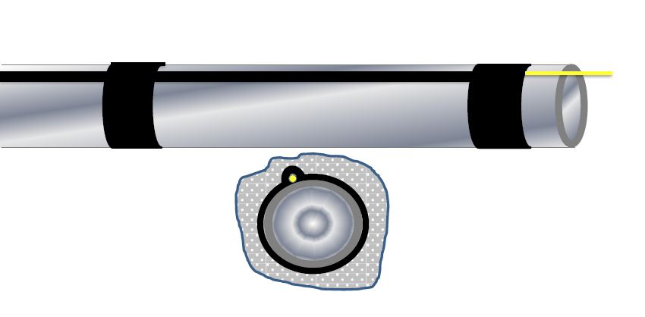
Fiber Optic Installation
Fiber Optic Cable
Blast Shield
Casing
Cement

Slide 24
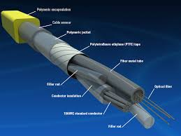
Fiber Optic Monitoring
Installation of fiber-optic cable in 3H well tied to the outside of the production casing
Data will be collected to analyze fracture distribution as well as better understanding where production is coming from

Slide 25
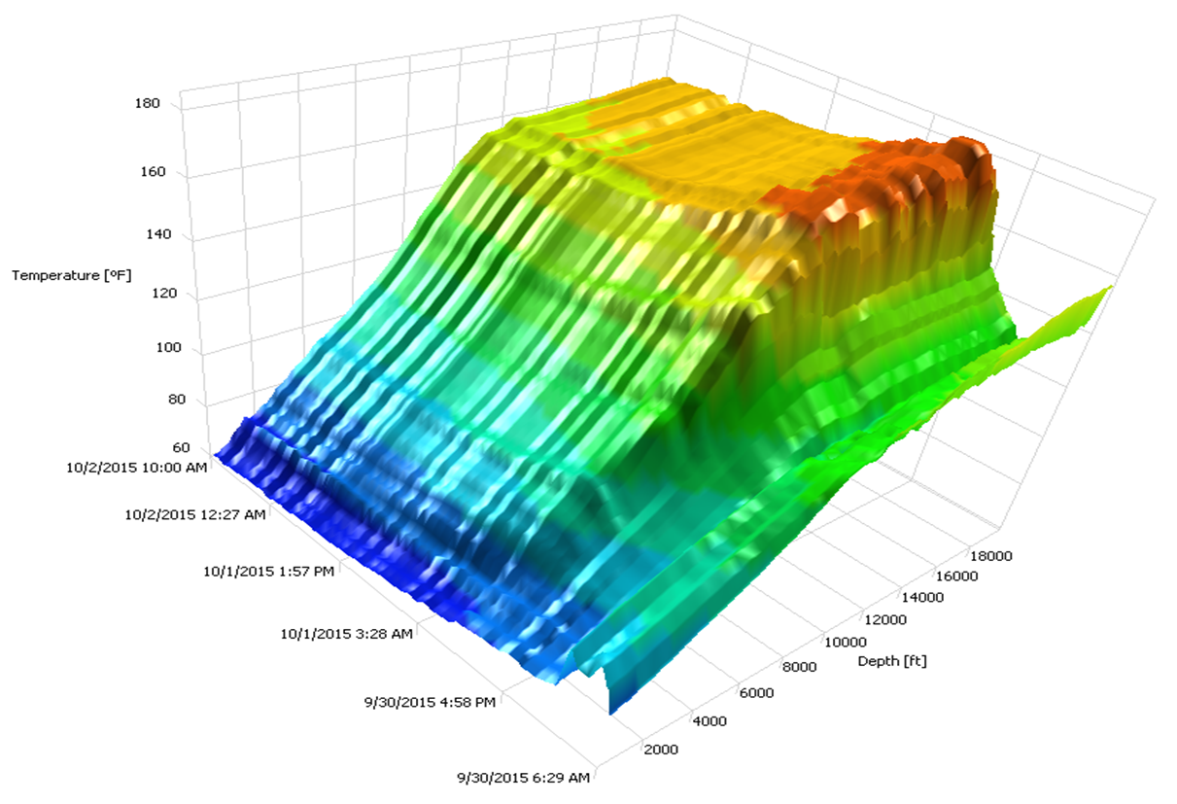
Watching Cement Dry with Fiber Optic Cable

Slide 26
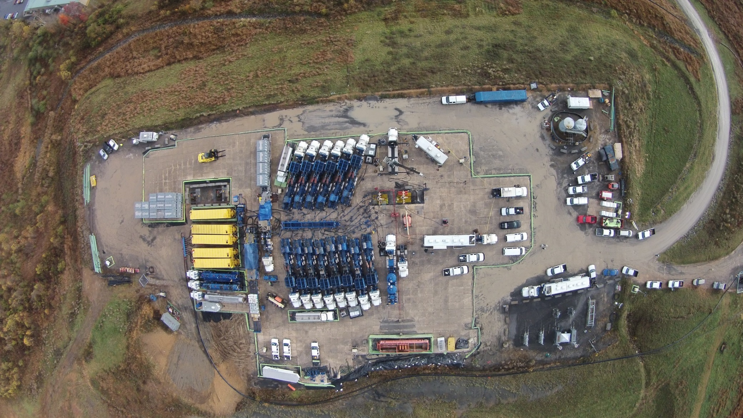
Fracture Stimulation

Slide 27
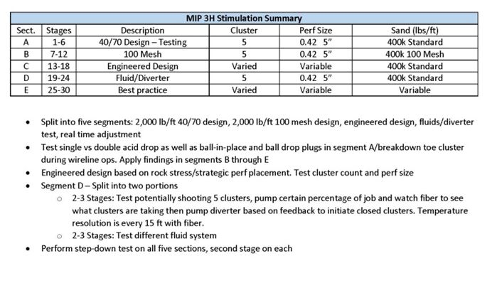
MIP 3H Completion Design

Slide 28
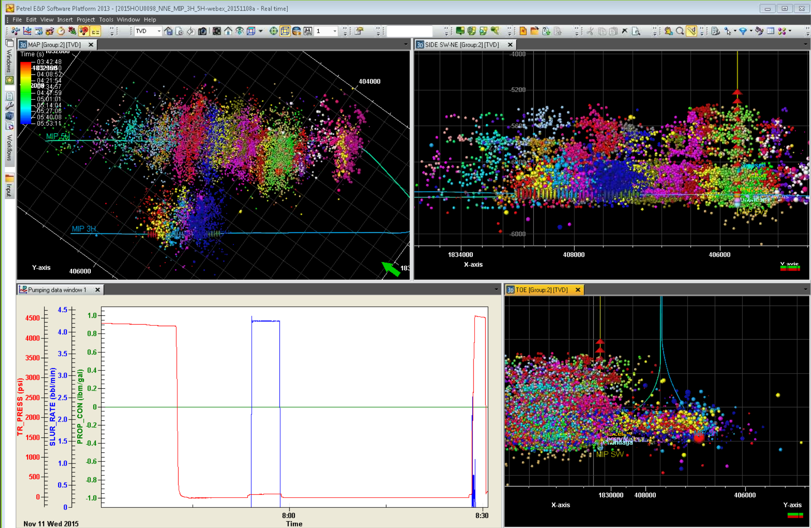

Slide 29
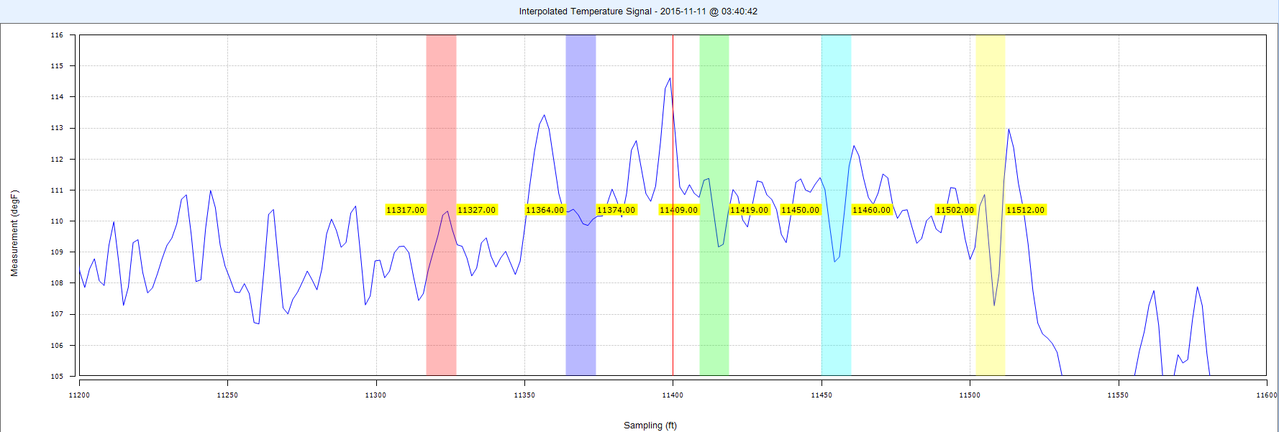
Stage 11 DTS Pre-Job

Slide 30
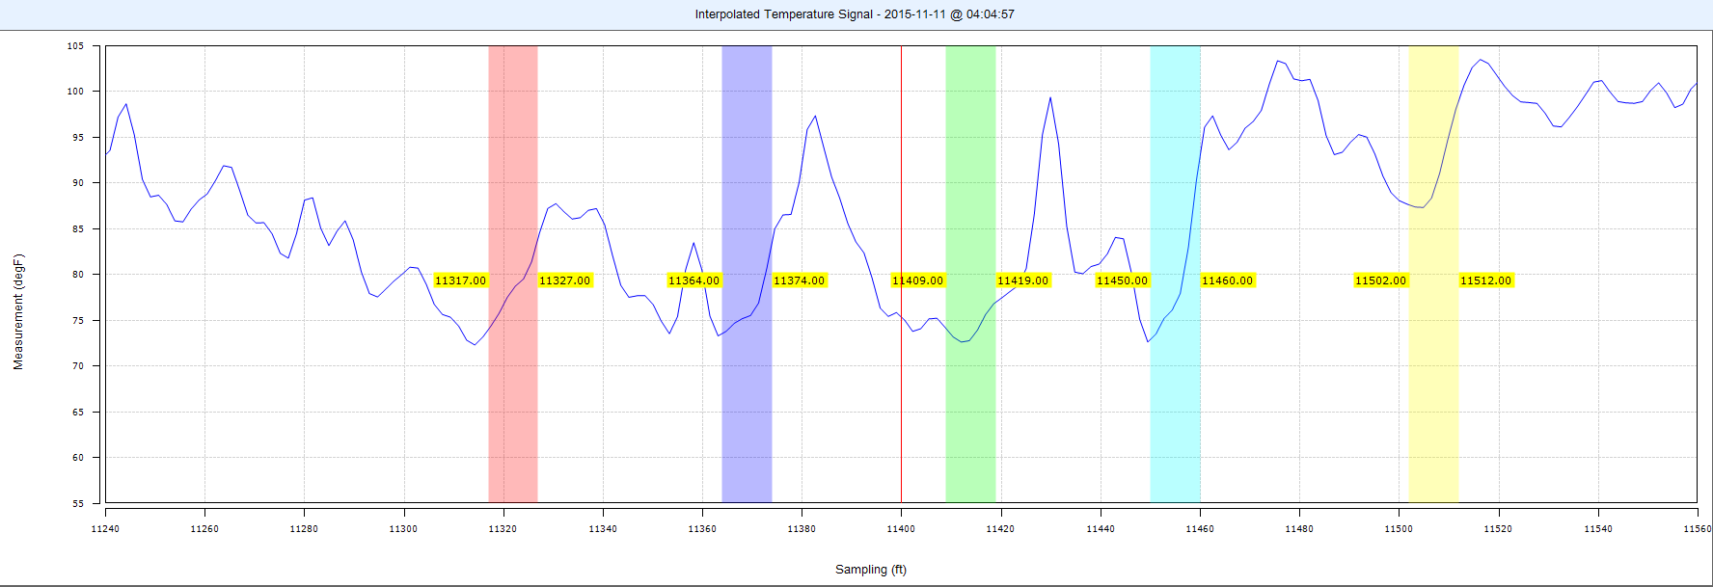
Stage 11 DTS at Designed Treating Rate
Cluster 1 cooling much slower than 2-5

Slide 31
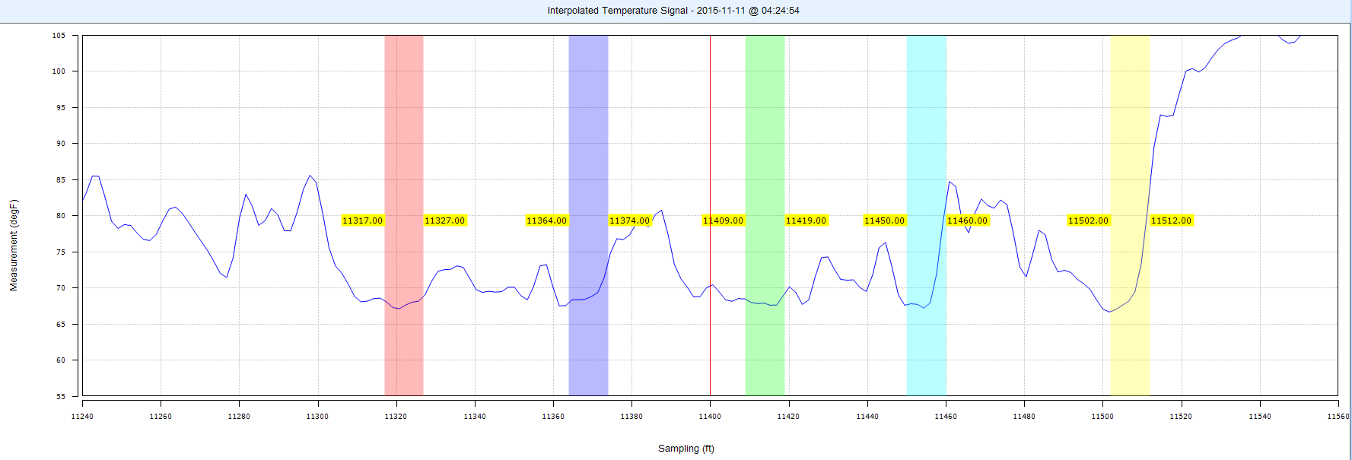
Stage 11 DTS at 1.5 ppg 100 Mesh at Perfs
5 and 4 show cooling between clusters
1 shows good temperature distribution

Slide 32
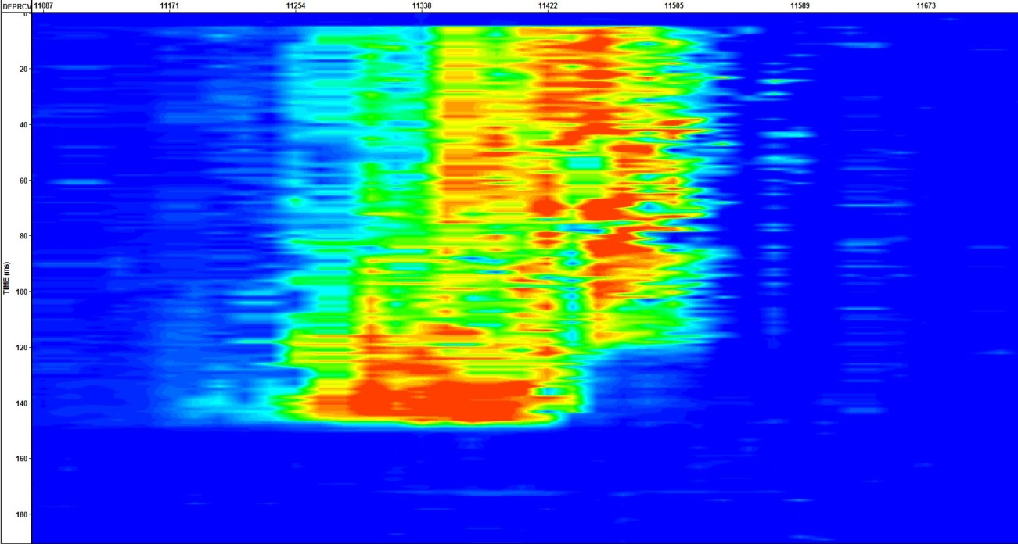
Stage 11 hDVS Final
Stopped Pumping
Cluster not active
Clusters Increases In Energy
Plug Sealed Increase Pumping Rate
Low energy on 1 and 2
Start Pumping
Cluster #
#3
#5
#4
# 2
# 1

Slide 33
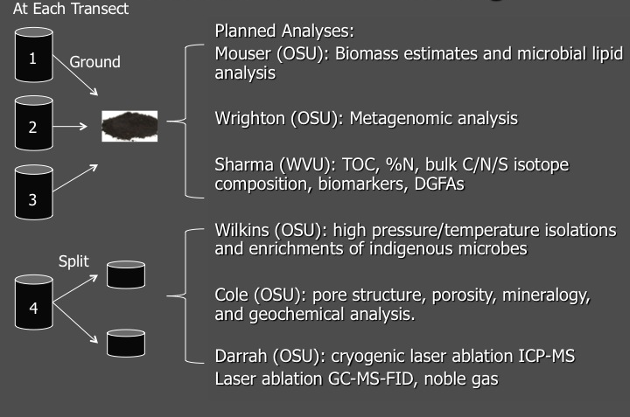
Sidewall Cores
6 Large Diameter Samples – 98 Small Diameter Unassigned

Slide 34
VERTICAL CORE PETROPHYSICAL ANALYSIS
K. Aminian
WVU
Trimmed Core Plug
Porosity and Permeability Analysis
T. Carr & L. Song
WVU
(10 g)
BET Analysis for
P&P
H. Siriwandene
WVU
(Plugs from Aminian)
A. Weislogel & J. Donovan
WVU
(5 g)
D. Soeder & T. Carr
NETL & WVU
(10g)
Source Rock Analysis (SRA)
TOC
Mechanical
Properties
XRD Analysis
PPAL Lab
* ID Sample based on core depth
* Trim Ends
* Trimmed Samples distributed to different PI’s
2.5 "
1 core plug
(every 3 foot)
1.5 "
30 Samples

Slide 35
VERTICAL CORE BIOGEOCHEMICAL ANALYSIS
S. Sharma
WVU
(70 g)
Kerogen Characterization
C/N/S Isotopes
Biomarkers
A. Hakala
NETL
(10 g)
Sr/Li Isotopes
Geochemistry
D. Cole
OSU
(Chips from sides)
A. Weislogel & J. Donovan
WVU
(5 g)
D. Soeder & T. Carr
NETL & WVU
(10g)
Source Rock Analysis (SRA)
TOC
FIB/SEM
Hg porosimetry
XRD Analysis
S. Sharma Lab
* ID Sample based on core depth
* Sides chipped off
* Sample ground & homogenized
* Sample split using a splitter
* Sample aliquots distributed to different PI’s
2.5 "
1 core plug
(every 3 foot)
1.5 "
30 Samples

Slide 36
VERTICAL CORE EXTERNAL ANALYSIS
B. Carey
LANL
12 Trimmed Core Plugs
Fracture Network Analysis
H. Daigle
UT Austin
4 Core Butts
NMR Measurements During Fracturing
J. Pluckette
OSU
(Core Plug Trimmings)
Y. Wang
Sandia
6 Trimmed Core Plugs
K. Jenssen
USC
6 Core Butts
Fracture/Fluid Interaction
Fluid Rock Interactions
High P&T Gas Adsorption
External Requests
* ID Sample based on core depth
* Trim Ends
* Trimmed Samples & Core Butts distributed to different PI’s
D. Zhu
TAMU
10 Trimmed Core Plugs
Fracture Conductivity
D. Soeder
TAMU
6 Trimmed Core Plugs
CO2 Storage
2.5 "
1 core plug
(every 3 foot)
1.5 "
30 Samples
22 Samples and 2 Vertical Unassigned

Slide 37
Fluid Sampling
5 Gallon FRESH WATER
7.5 Gallon FRAC FLUIDS
5 Gallon PRODUCED FLUIDS
A. Hakala-NETL
Alexandra.Hakala@netl.doe.gov
Major cation/anion/trace elements
Sr/Li isotopes
S. Sharma -WVU
shikha.sharma@mail.wvu.edu
S/C/O/H isotopes
D. Cole -OSU
cole.618@osu.edu
T. Darrah -OSU
darrah.24@osu.edu
K. Wrighton- OSU
wrighton.1@osu.edu
P. Mouser - OSU
mouser.19@osu.edu
Organics/biomass
TC/TN
DOC isotopes
Major cation/anion/trace elements
Noble Gas/Radioactive elements
Genomics/Proteomics

Slide 38
Fluid Sampling
Time | Frequency | Sample Type | Purpose
Before fracturing, 1-5 days | Collect at 2 time points before fracturing | Freshwater used for Fracturing | Evaluate input microbial communities, redox power, carbon, and ion inputs
Time 0 during fracturing | Collect at 2 time points during fracturing | Hydraulic Fracturing Fluids | After biocides have been applied and chemical additives mixed, evaluate microbial communities, redox power, carbon, and ion inputs
Time 0-14 days post fracturing | Collect 14 samples, every days throughout the flowback period | Flowback | Monitor changes in ecosystem, redox power, carbon and ions during mixing with shale
Time 15-90 days | Collect 6 samples, approximately every 2 weeks | Flowback/Produced Fluids | Monitor changes in ecosystem, redox power, carbon and ions during mixing with shale
Time 3 -12 months | Collect 3 samples approximately every 3 months | Produced Fluids | Monitor changes in ecosystem, redox power, carbon and ions during mixing with shale

Slide 39
Produced Gas Analysis & Distribution
Task Planning, Overall Coordination & Management: S. Sharma (WVU)
Sample Collection & Distribution : T. Wilson & A. Warrier (WVU)
GAS SAMPLE
PI: Sharma
( WVU)
C,H isotope composition of methane, ethane, CO₂
PI :DARRAH
(OSU)
Noble gas isotopes

Slide 40
MSEEL Subsurface Science
MSEEL Project Team
Geochemistry (Sharma, Weislogel, Donovan - WVU; Cole, Darrah - OSU)
Rock – Kerogen; TOC; C/N/S; XRD; FIB/SM; cryolaser ablation; Hg porosimetry
Fluids/Gases – Continuous monitoring S/C/O/H isotopes, organics, DOC, NORM, noble gases
Microbiology (Mouser, Wrighton - OSU; Sharma - WVU)
Biomass; microbial lipids, metagenomics
Petrophysics/Geomechanics (Aminian, Wang, Siriwardane – WVU)
Steady-state permeability (in situ P/T); porosity; pore-size; adsorption → dynamic petrophysics f(P); vertical/lateral heterogeneity.
Mechanical strength measurements
FIB/SEM: pore and mineralogical structure
Horizontal section: natural fracture imaging; geomechanics fibre-optics monitoring
Log to core calibration; comparison to industry standard methods; refinement of prior basin-scale models.
Real-time, actionable data for HF operations
Advanced multi-scale reservoir modeling
Geophysics (Wilson – WVU)
Borehole microseismic – SRV characterization in multi-well context
Protocols developed during MSEEL reflect strong collaboration and project commitment from WVU and Northeast Natural Energy. NETL will strive to extend this approach to other Field Observatories as those projects progress.
Progression into Field Laboratories (downhole experimental science) faces numerous challenges related to costs and liabilities. Good promise for future tests of SRV diagnostic/imaging technologies; well-bore integrity.
Complementary (enabled by NETL/MSEEL)
From NETL-ORD
Crandall (NETL): multi-scale CT imaging/micro-scale structure; MSCL
Hakala (NETL): Sr/Li isotopes; major cation/anion/trace elements
Hammack (NETL): surface micro-science array; fracturing and relaxation
Soeder (NETL): SRA/TOC
Boyle (NETL): Fracture modeling (FMI)
From Existing National Laboratory Contributors*,#
Xu (LANL): XRD, XRF, DSC/TG, SEM, TEM → characterization and LBM modeling; SANS → hydrocarbon phase and flow behavior
Carey (LANL): tri-axial core-flood w/tracers & AE → in situ fracture formation and permeability; X-ray tomography → apertures and conductivity.
Wang (SNL): thermodynamics of CH₄-CO₂-H₂O under nanopore confinement; Hi T/P sorption measurement methods.
Moridis (LBNL): thermodynamic; X-Ray CT → production strategies
From Collaborating Federal Agencies
Orem (USGS): contaminants in drill cuttings – wastewater evaluations
From Shale Gas Cooperative Agreement Contributors*^{,+}
Zhu (TAMU): fracture conductivity
Daigle (UT-A): tri-axial compressive strength; ultrasonic velocity; NMR during fracture; SEM and FIB
Jessen (USC): shale-rock interactions
Puckett (Ok. St.): petrophysical protocols: shale-fluid interaction
Add’l supplement from SubTER participants?
TBD via FY16 “Lab Call” to enable additional science as desired by SubTER management
# Selected during FY14 NL Call’; + Selected via prior NETL/RPSEA FOAs * Science incorporated via NETl/MSEEL sample request protocol – access to primary project samples

Slide 41
Marcellus Shale Energy and Environment Laboratory
MSEEL
Sample Request Decisions
  Surface Material (Water and Gas)
  Sidewall Cores
  Whole Core
Data Request Decisions
  Case Western – Roger French
Talks and Publications
  Review Process Decisions

Slide 42
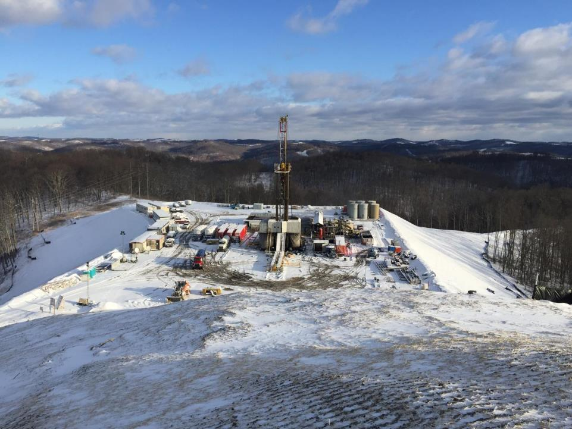

Building Partnerships for Research, Education, and Outreach
Industry
MSEEL
Community
NGOs
Government
Academia
Tim Carr
Phone: 304.293.9660
Email: tim.carr@mail.wvu.edu

